Slide 1

Is timing everything? The effects of measurement timing on the performance of nonlinear longitudinal models
Sebastian Sciarra

Slide 2
Model of workplace deviance

Slide 3
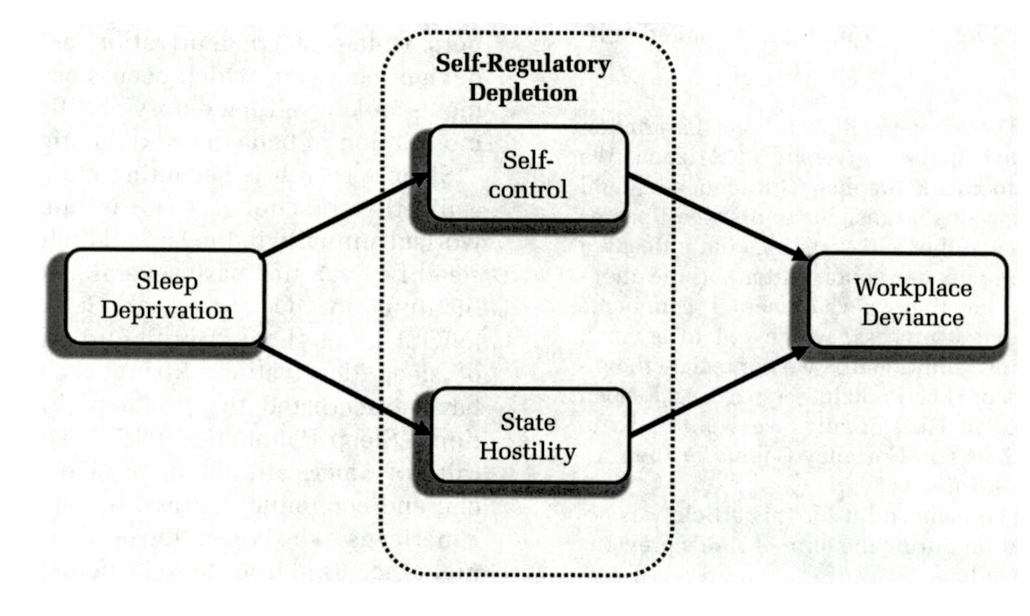
Model of workplace deviance
-
-
+
+
time

Slide 4
Model of workplace deviance
-
-
+
+
time

Slide 5
Model of workplace deviance
-
-
+
+
time

Slide 6
Model of workplace deviance
-
-
+
+
time
time

Slide 7
Time is integral to understanding psychological processes
Model of workplace deviance
-
-
+
+
time
time

Slide 8
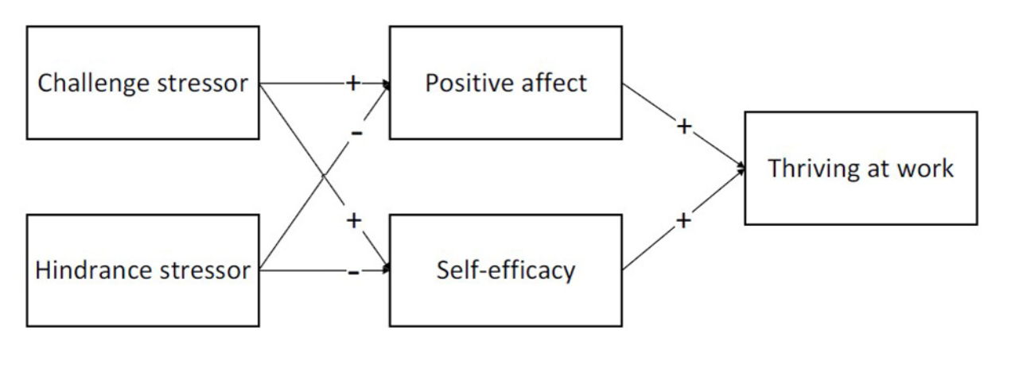
Time is integral to understanding psychological processes
Model of thriving at work
time

Slide 9
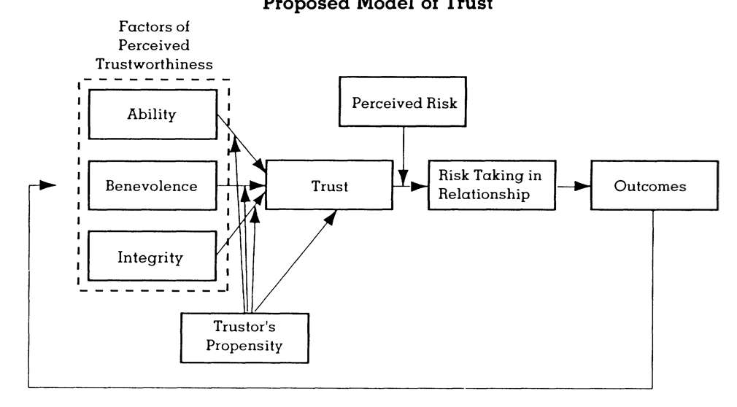
Time is integral to understanding psychological processes
Model of organizational trust
time

Slide 10
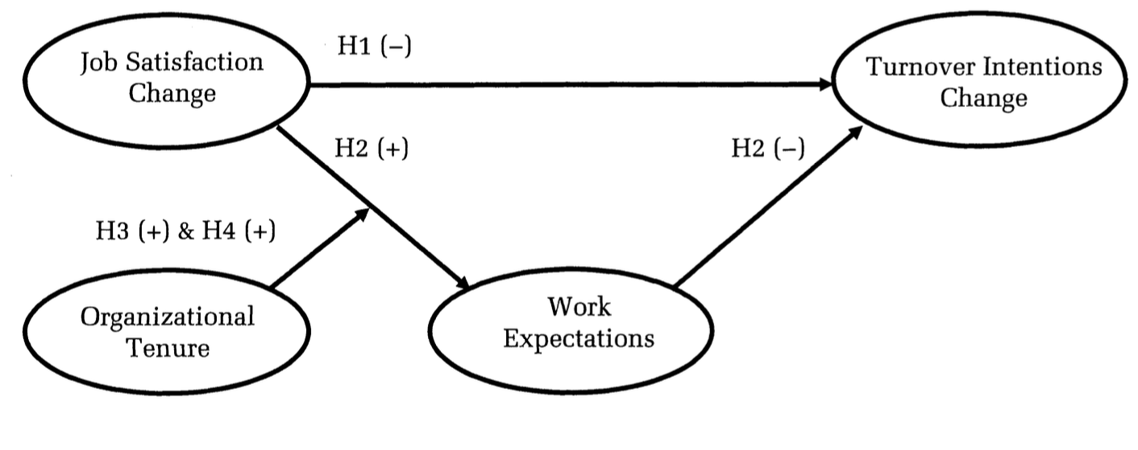
Time is integral to understanding psychological processes
Model of turnover intentions
time

Slide 11
Change over time is likely to be nonlinear
Notes:
Given that longitudinal research must be conducted to understand temporal dynamics, it is important to understand what patterns of change to expect over time. In doing so, we see that change over time is nonlinear. For example, rate of rate forgetting curve.

Slide 12
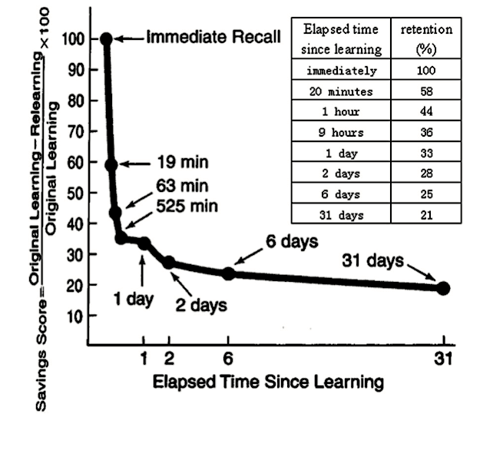
Change over time is likely to be nonlinear
Forgetting curve
Notes:
Given that longitudinal research must be conducted to understand temporal dynamics, it is important to understand what patterns of change to expect over time. In doing so, we see that change over time is nonlinear. For example, rate of rate forgetting curve.

Slide 13
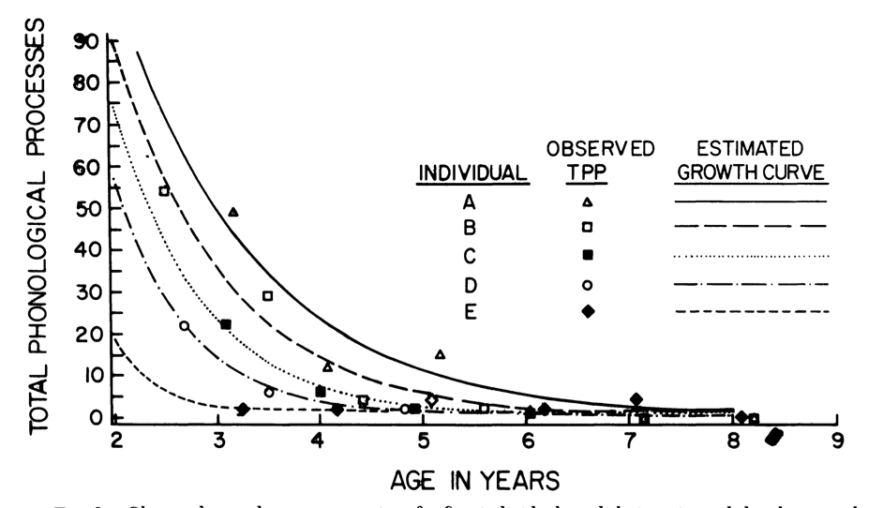
Change over time is likely to be nonlinear
Number of speech errors throughout child development
Notes:
Incidence of speech errors throughout child development

Slide 14
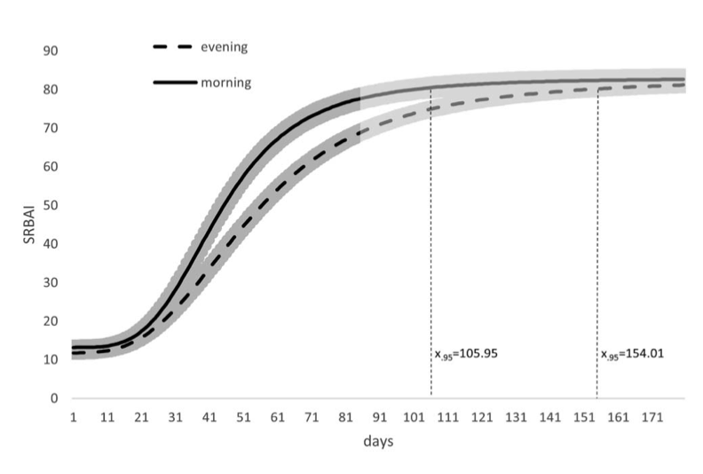
Change over time is likely to be nonlinear
Development of habits
Notes:
Given that a common practitioner question is whether spacing measurements near periods of change yields better estimates and how to space measurement when the nature of change is uncertain, I devised an experiment to answer this question.

Slide 15
Experiment 1
Question 1: Does placing measurements near periods of change increase model performance?
Question 2: How to space measurements when the nature of change is unknown?
Notes:
In addition to answering this question, I also designed Experiment 1 to determine whether placing measurements near periods of change increased model performance.
At this point, one question might concern how I went about answering these questions. Therefore, I am going to discuss my methods in the slides that follow.

Slide 16
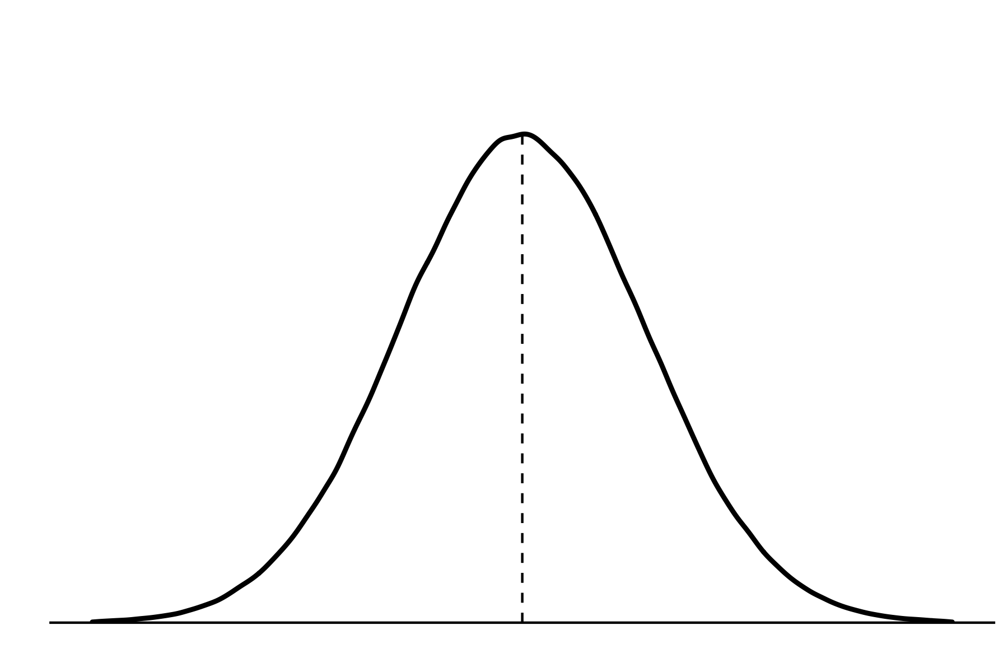
The Monte Carlo method
= model
= sample
1. Population definition
µ (known)
Notes:
In the Monte Carlo method, we define a population mean and then generate samples according to this population.

Slide 17
The Monte Carlo method
= model
= sample
1. Population definition
µ (known)
2. Sample generation
s₁
s₂
s₃
s₄
s_{n}
Notes:
In the Monte Carlo method, we define a population mean and then generate samples according to this population.

Slide 18
The Monte Carlo method
= model
= sample
1. Population definition
µ (known)
2. Sample generation
m₁
m₂
m₃
m₄
m_{n}
3. Modelling
s₁
s₂
s₃
s₄
s_{n}
s₁
s₂
s₃
s₄
s_{n}
Notes:
In the Monte Carlo method, we define a population mean and then generate samples according to this population.

Slide 19
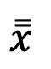
The Monte Carlo method
= model
= sample
1. Population definition
µ (known)
$$\overset{̿}{x}$$
2. Sample generation
4. Model performance
m₁
m₂
m₃
m₄
m_{n}
3. Modelling
s₁
s₂
s₃
s₄
s_{n}
s₁
s₂
s₃
s₄
s_{n}
Notes:
In the Monte Carlo method, we define a population mean and then generate samples according to this population.

Slide 20
The Monte Carlo method
= model
= sample
µ (known)
µ (estimated)
1. Population definition
Parameter bias
$$\overset{̿}{x}$$
2. Sample generation
4. Model performance
m₁
m₂
m₃
m₄
m_{n}
3. Modelling
s₁
s₂
s₃
s₄
s_{n}
s₁
s₂
s₃
s₄
s_{n}
Notes:
In the Monte Carlo method, we define a population mean and then generate samples according to this population.

Slide 21
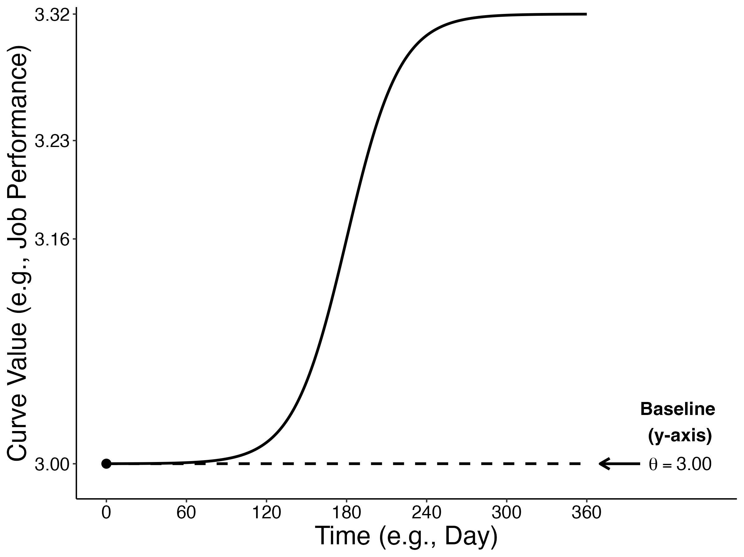
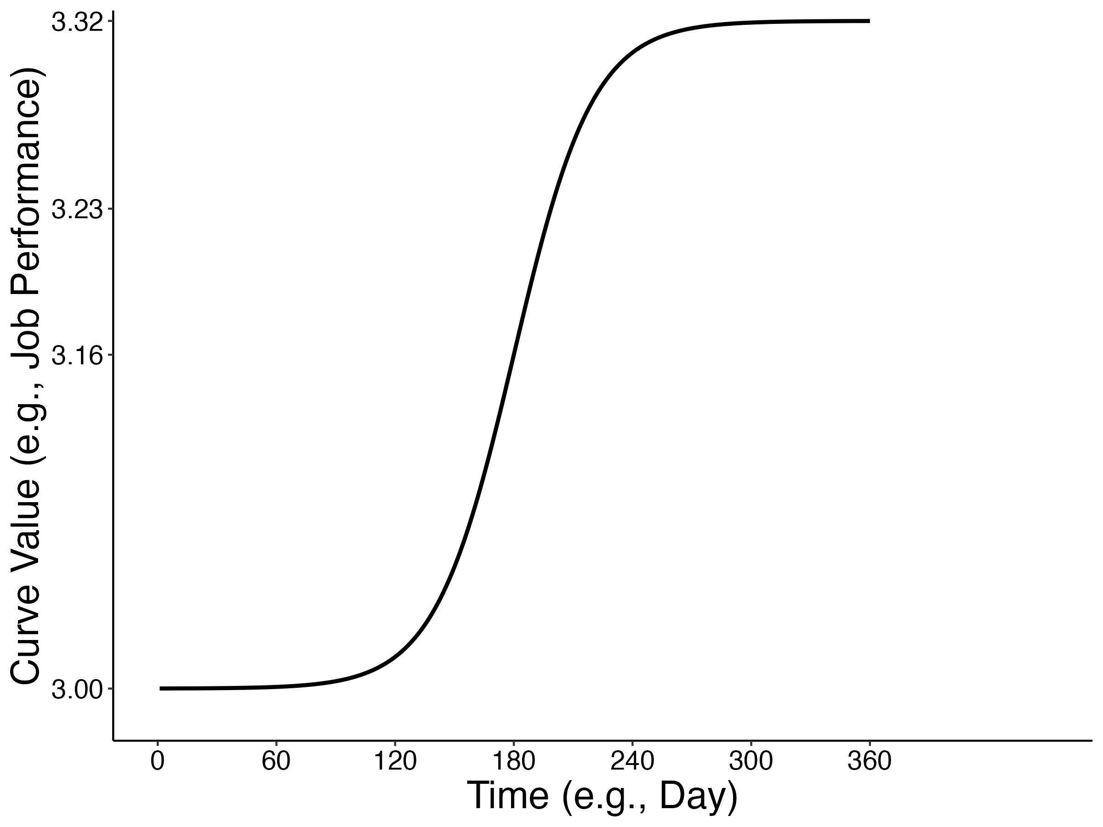
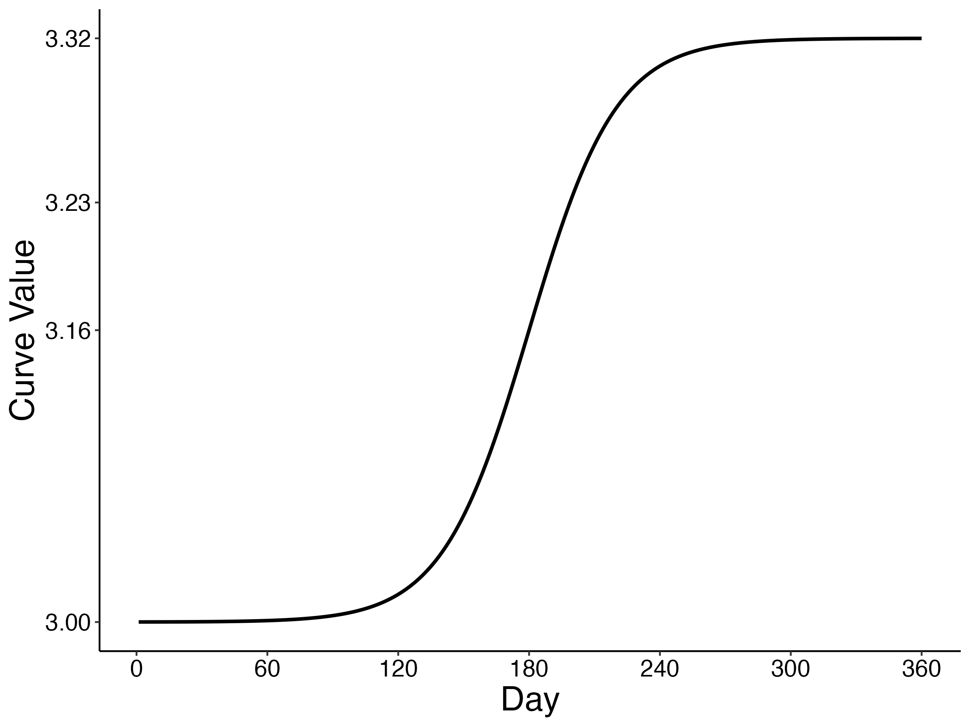
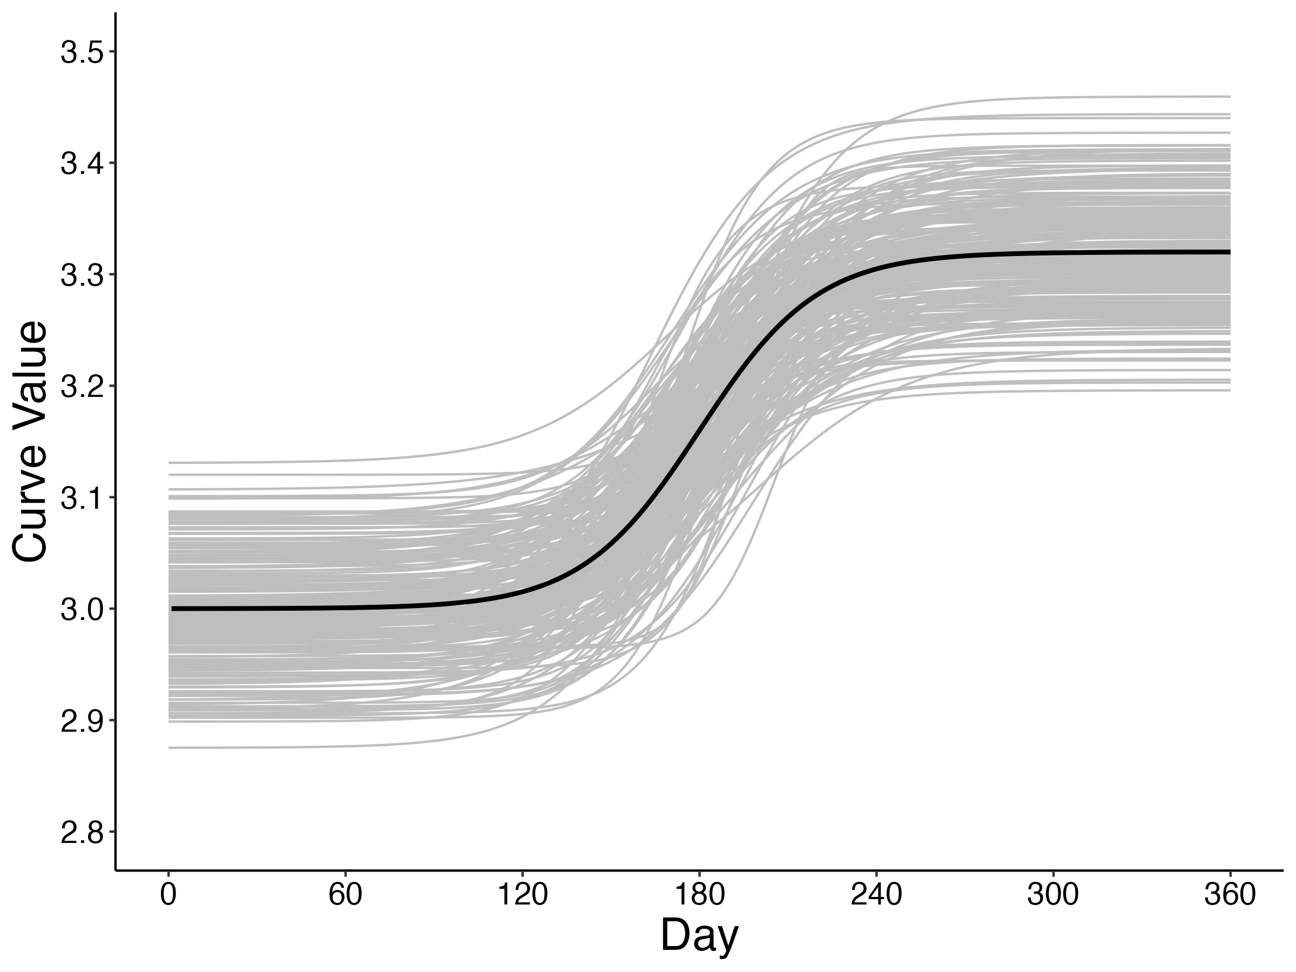
The Monte Carlo method: Population definition
Lawrence et al. (2001)
Notes:
Given that people will exhibit variability in their patterns of change, I defined the population to account for this variability. This was accomplished by setting variabilities for each parameter. These are also known as random-effects values, which are provided on this slide. The values presented earlier represent the mean curve and are also called fixed effects.

Slide 22

The Monte Carlo method: Population definition
1. Baseline ($θ$) = 3.00
Notes:
Given that people will exhibit variability in their patterns of change, I defined the population to account for this variability. This was accomplished by setting variabilities for each parameter. These are also known as random-effects values, which are provided on this slide. The values presented earlier represent the mean curve and are also called fixed effects.

Slide 23
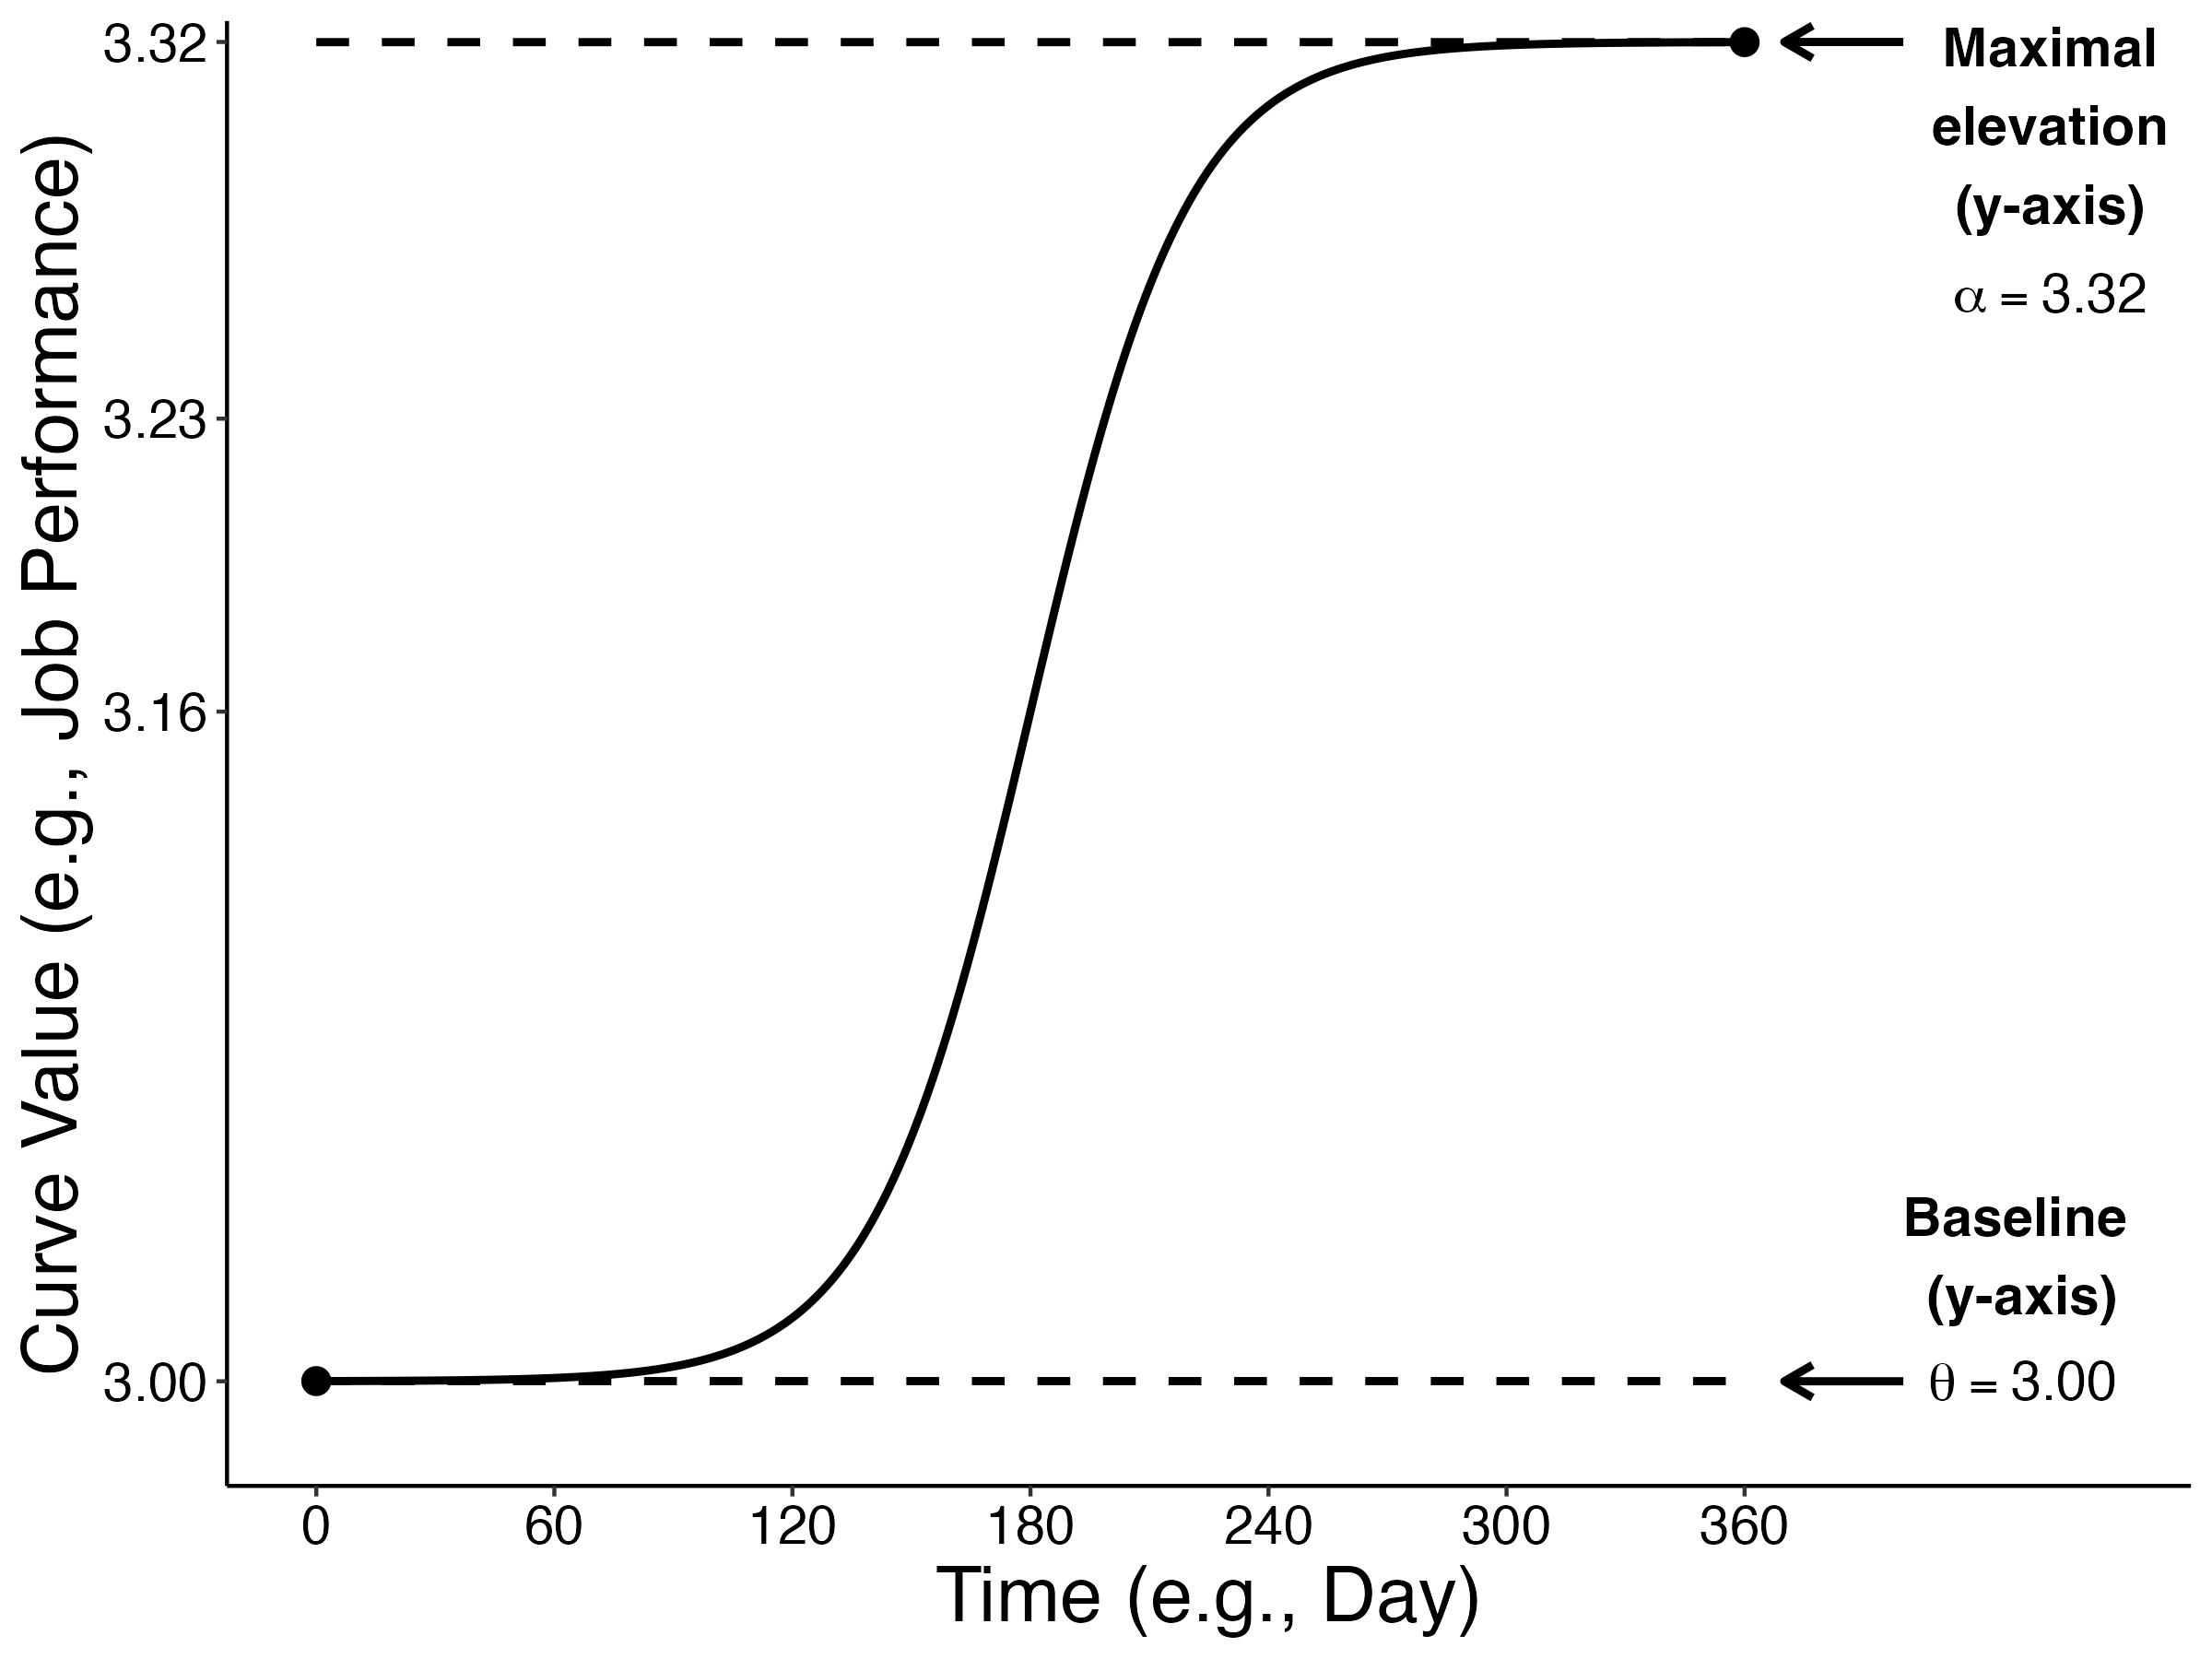
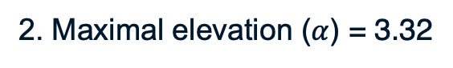
The Monte Carlo method: Population definition
1. Baseline ($θ$) = 3.00
2. Maximal elevation ($α$) = 3.32
Notes:
Given that people will exhibit variability in their patterns of change, I defined the population to account for this variability. This was accomplished by setting variabilities for each parameter. These are also known as random-effects values, which are provided on this slide. The values presented earlier represent the mean curve and are also called fixed effects.

Slide 24
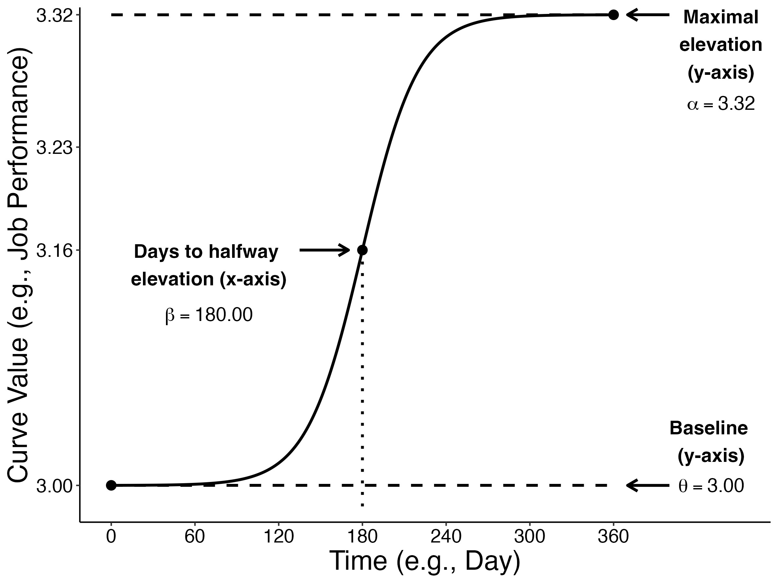
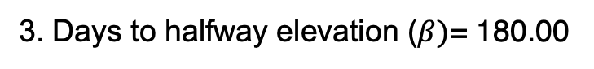
The Monte Carlo method: Population definition
1. Baseline ($θ$) = 3.00
2. Maximal elevation ($α$) = 3.32
3. Days to halfway elevation ($β)$= 180.00
Notes:
Given that people will exhibit variability in their patterns of change, I defined the population to account for this variability. This was accomplished by setting variabilities for each parameter. These are also known as random-effects values, which are provided on this slide. The values presented earlier represent the mean curve and are also called fixed effects.

Slide 25
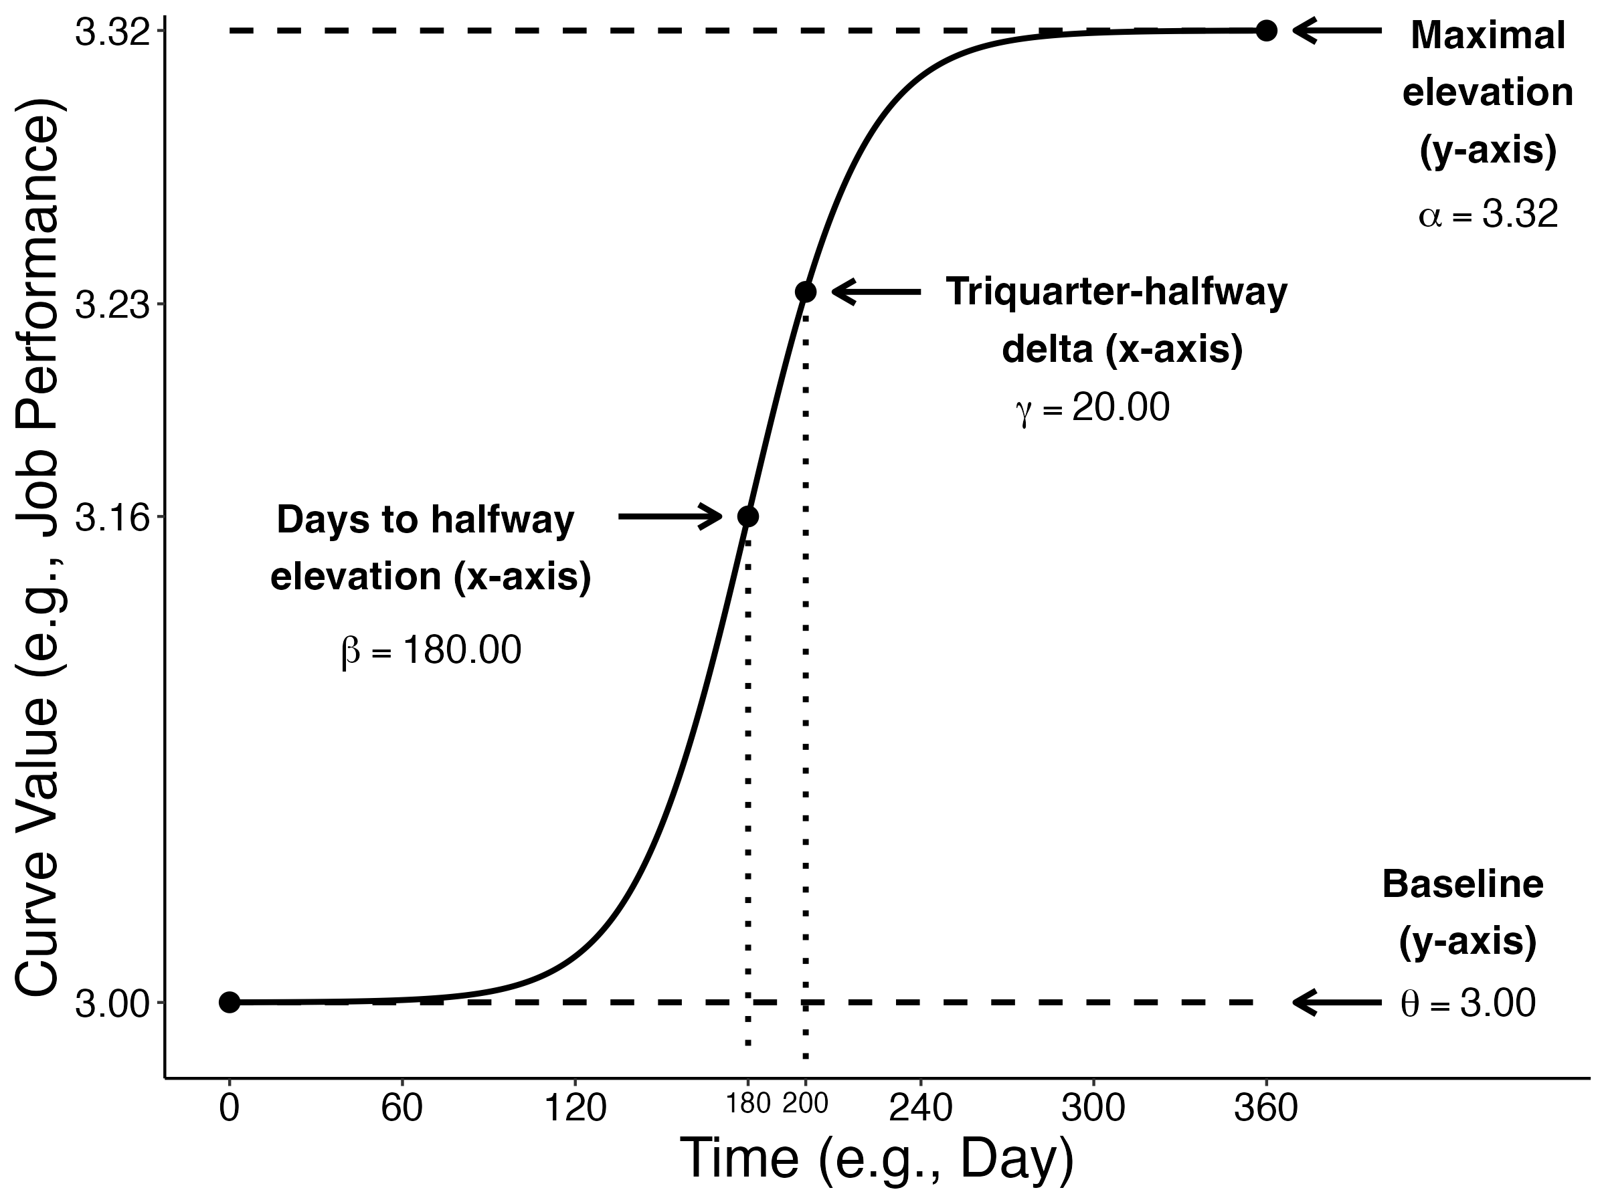
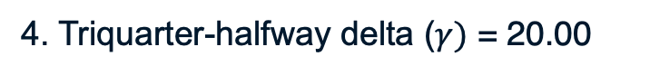
The Monte Carlo method: Population definition
1. Baseline ($θ$) = 3.00
2. Maximal elevation ($α$) = 3.32
3. Days to halfway elevation ($β)$= 180.00
4. Triquarter-halfway delta ($γ)$ = 20.00
Notes:
Given that people will exhibit variability in their patterns of change, I defined the population to account for this variability. This was accomplished by setting variabilities for each parameter. These are also known as random-effects values, which are provided on this slide. The values presented earlier represent the mean curve and are also called fixed effects.

Slide 26
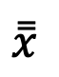
The Monte Carlo method
= model
= sample
µ (known)
µ (estimated)
1. Population definition
Parameter bias
$$\overset{̿}{x}$$
2. Sample generation
4. Model performance
m₁
m₂
m₃
m₄
m_{n}
3. Modelling
s₁
s₂
s₃
s₄
s_{n}
s₁
s₂
s₃
s₄
s_{n}
Notes:
In the Monte Carlo method, we define a population mean and then generate samples according to this population.

Slide 27
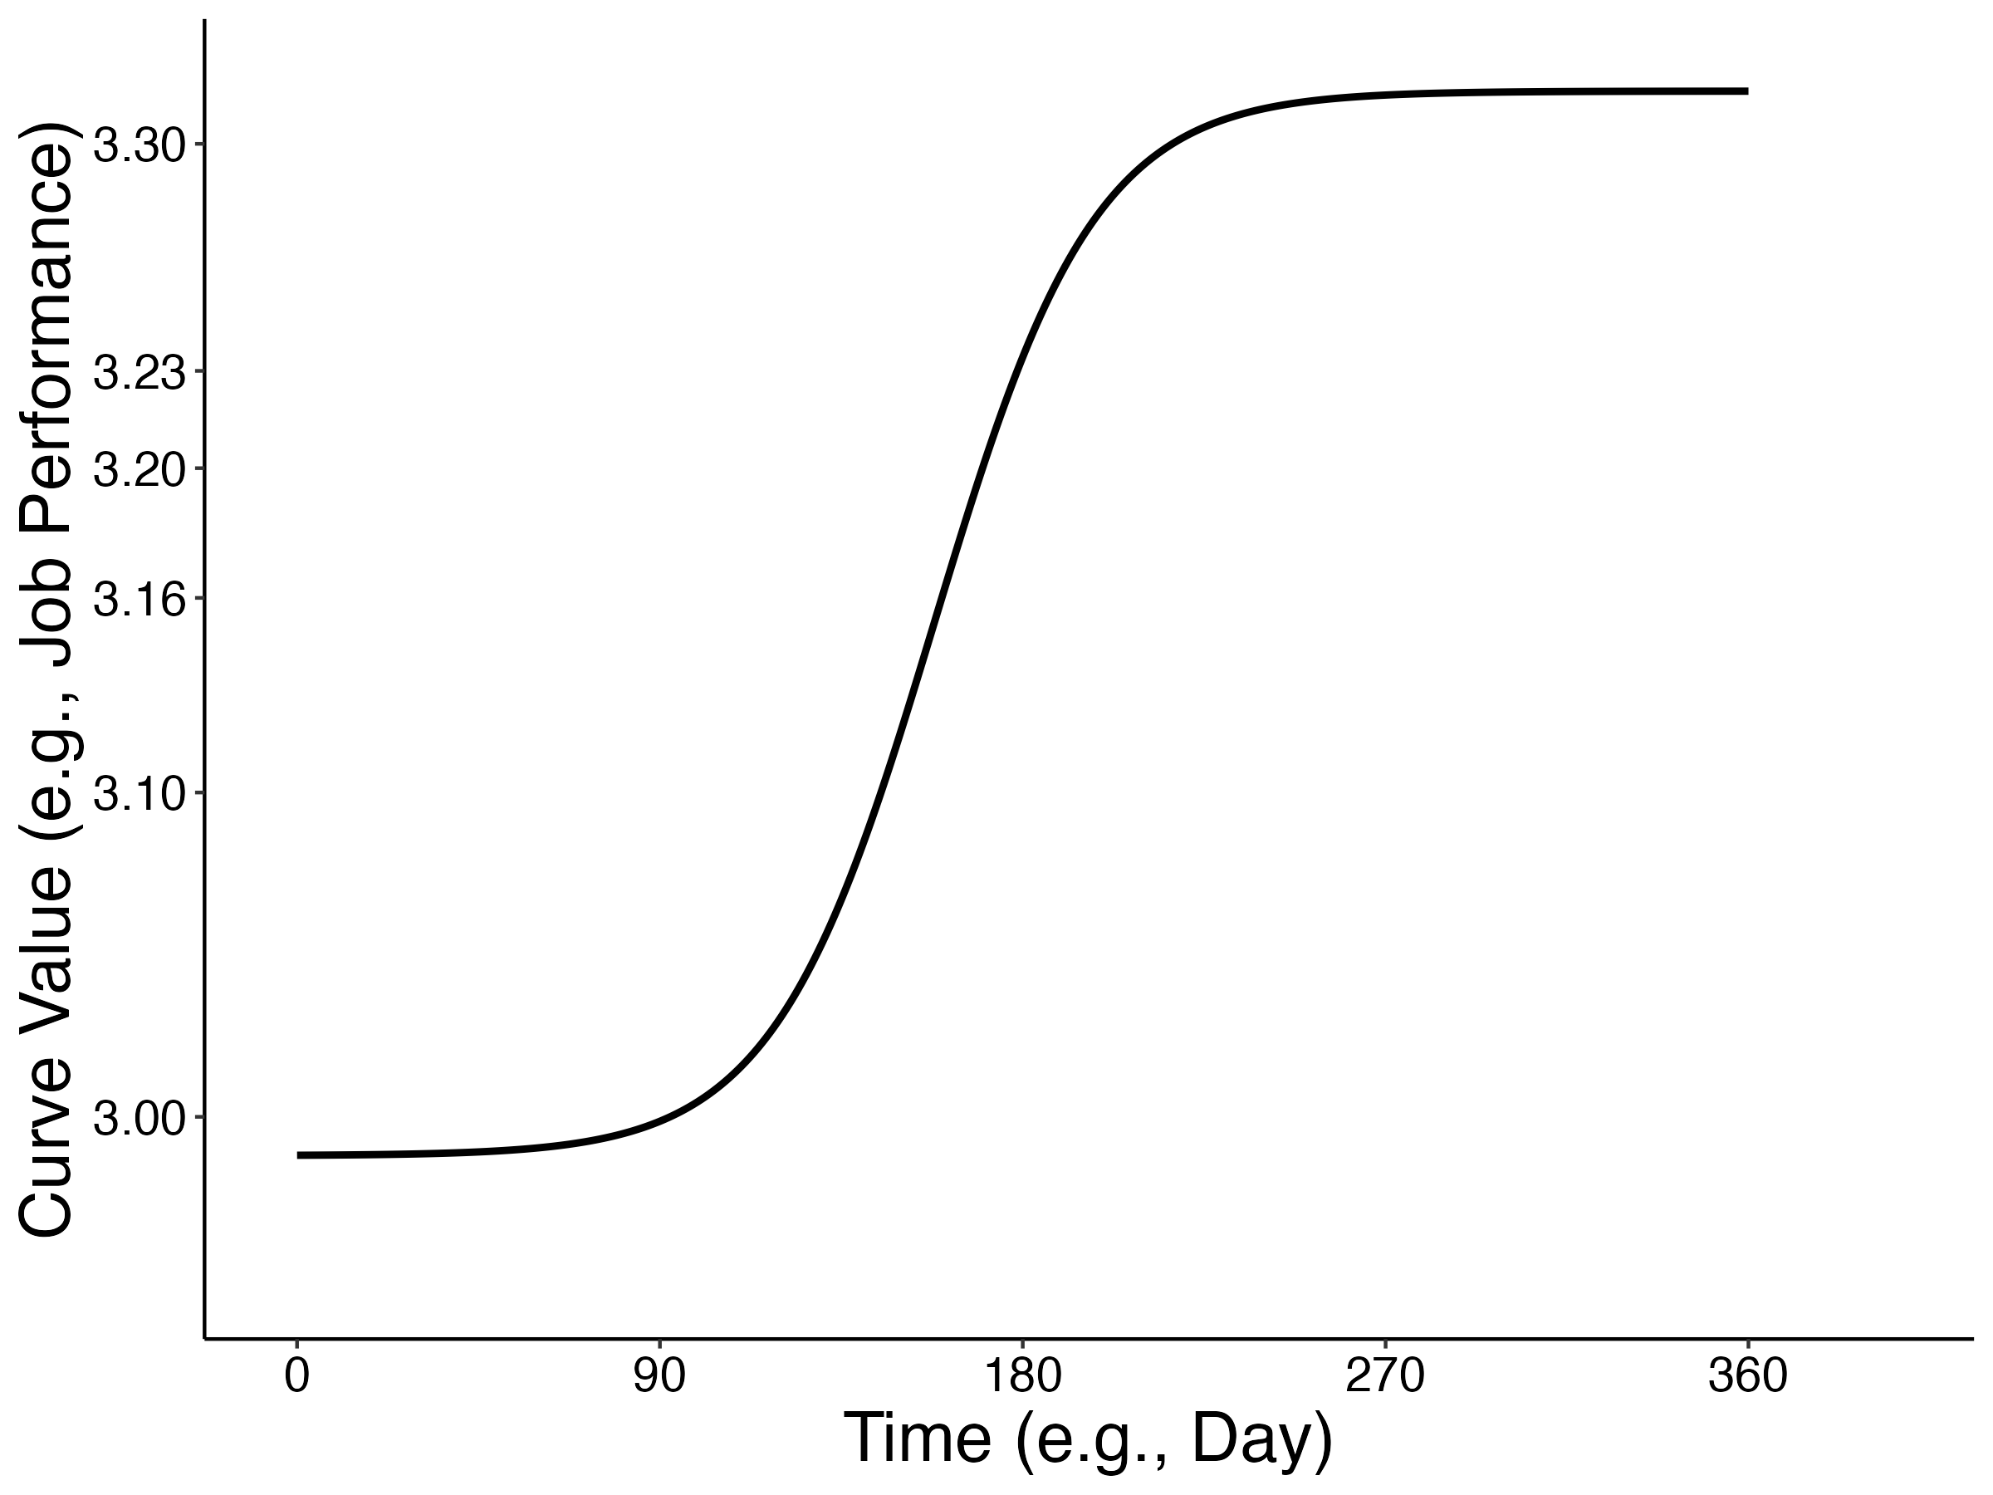
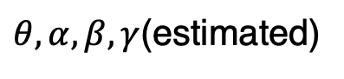
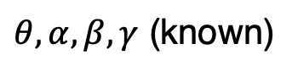
The Monte Carlo method
= model
= sample
$θ, α, β, γ$ (known)
$θ, α, β, γ$(estimated)
1. Population definition
2. Sample generation
4. Model performance
m₁
m₂
m₃
m₄
m_{n}
3. Modelling
s₁
s₂
s₃
s₄
s_{n}
s₁
s₂
s₃
s₄
s_{n}
Notes:
In the Monte Carlo method, we define a population mean and then generate samples according to this population.

Slide 28
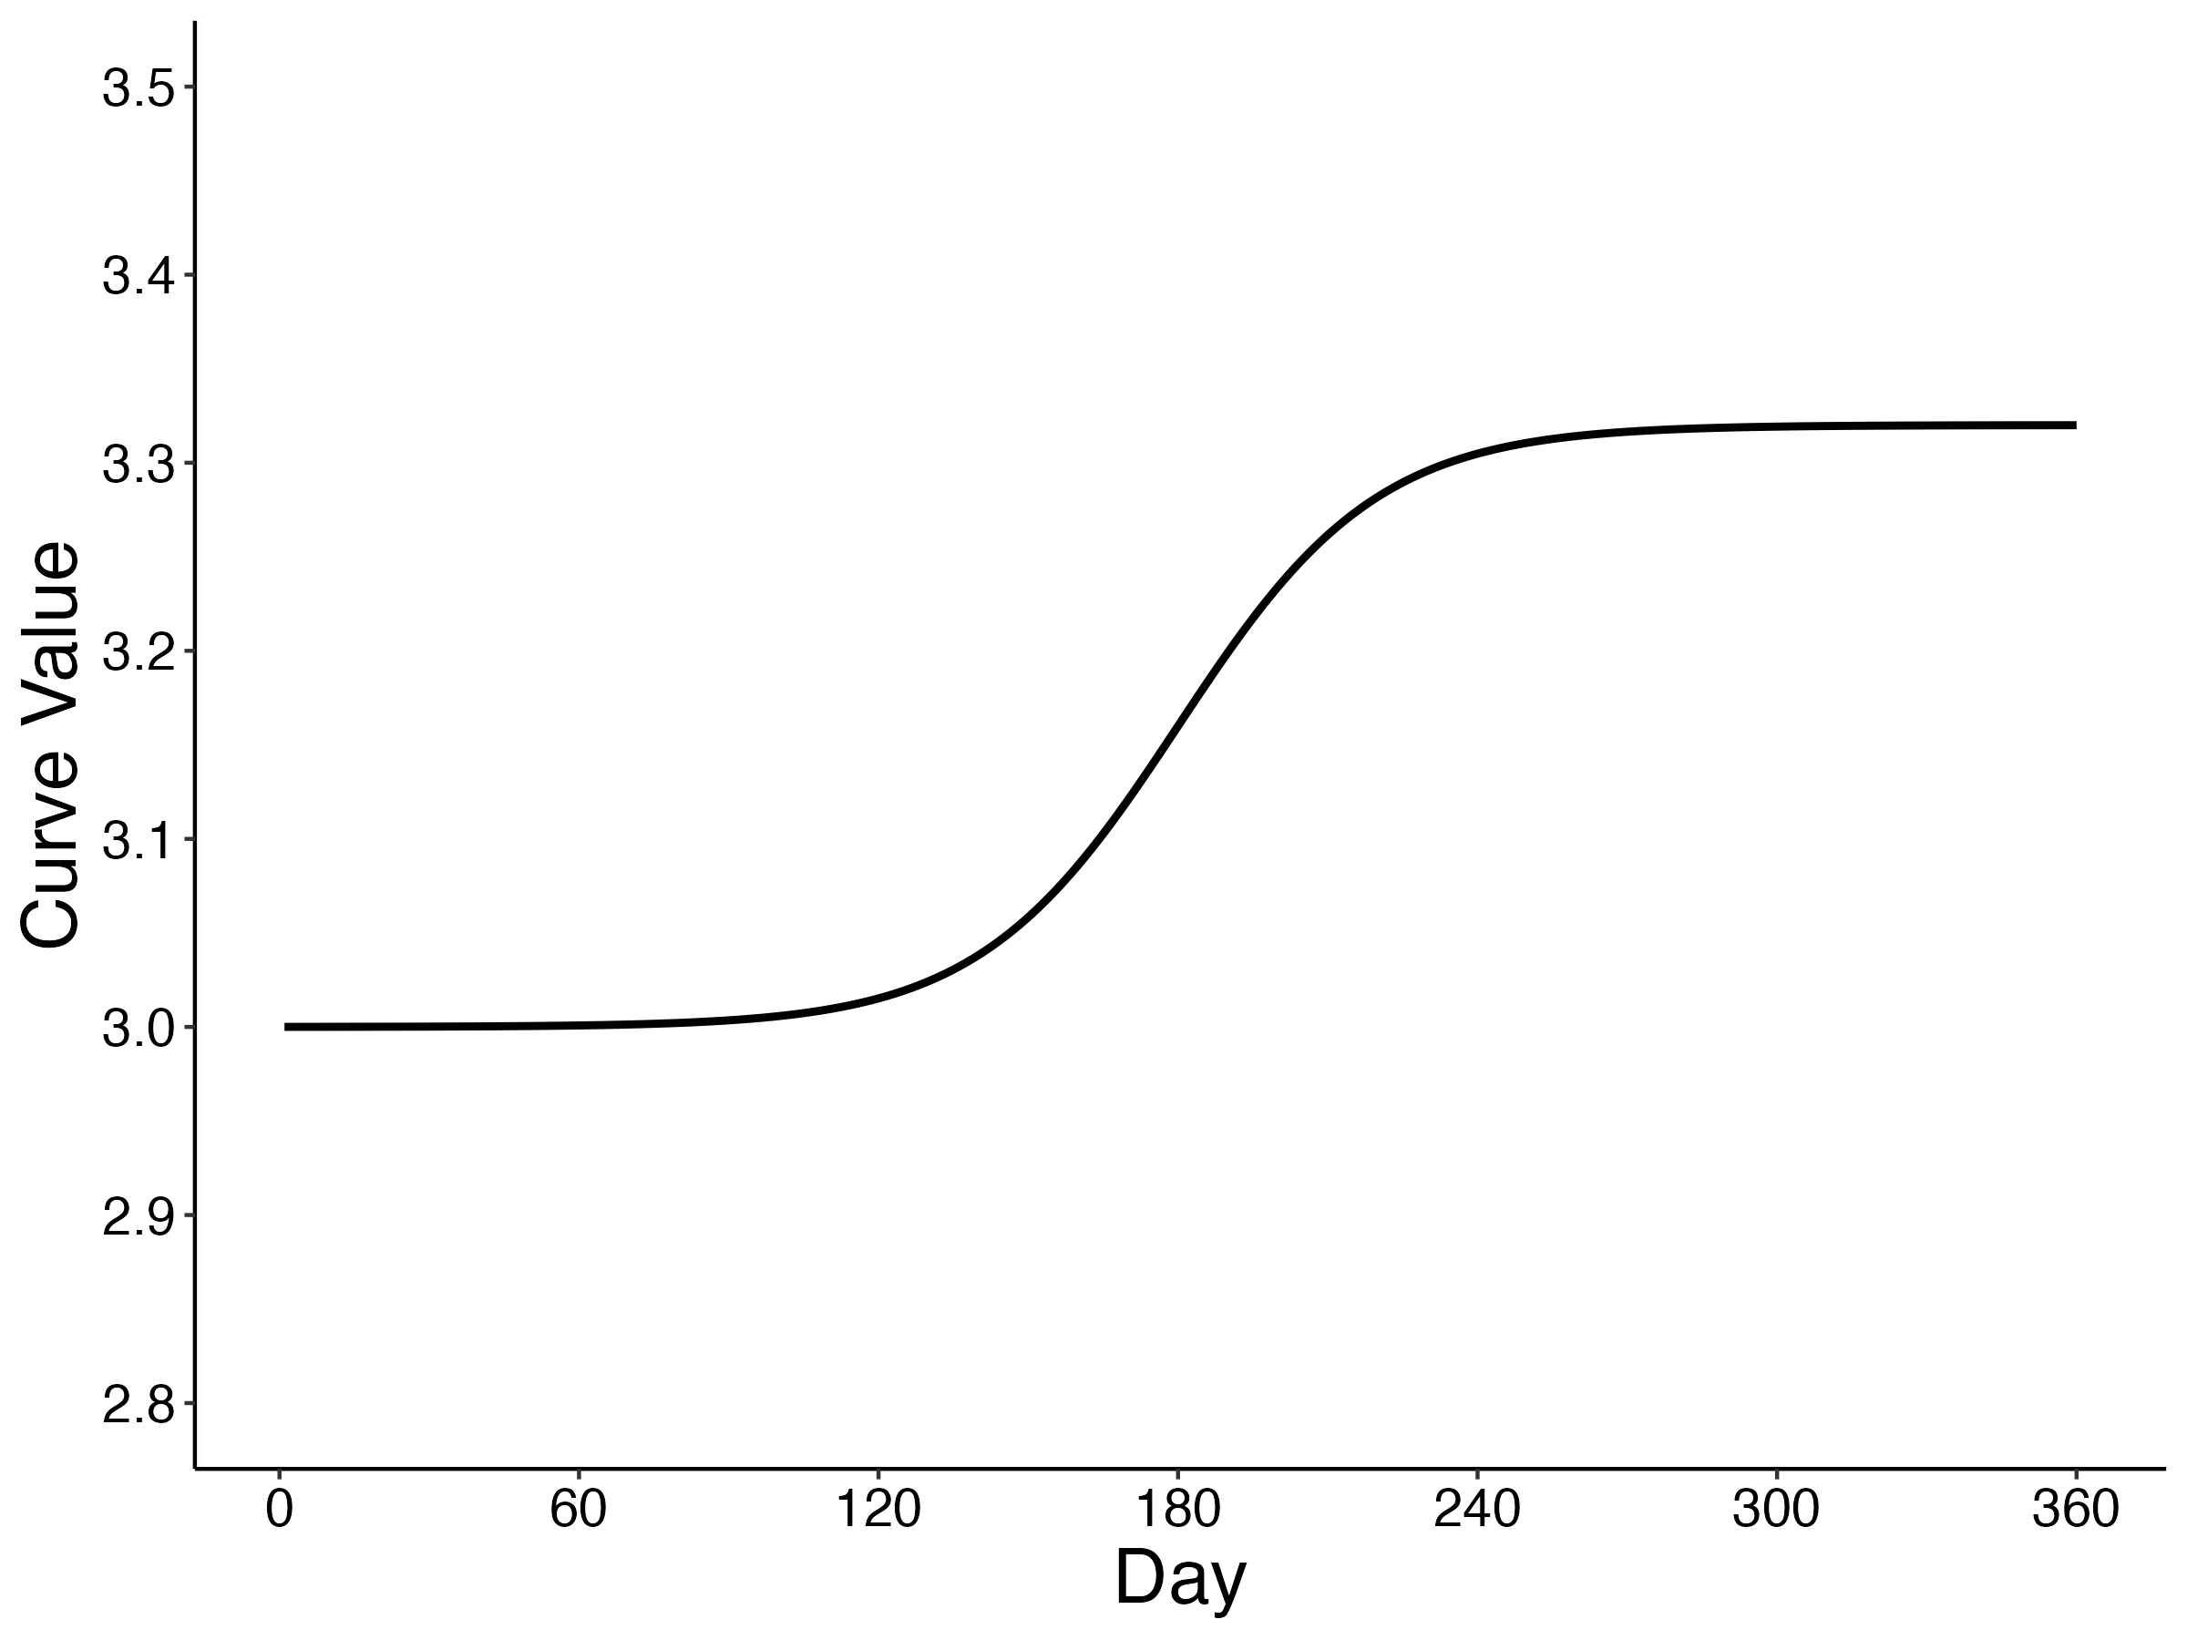
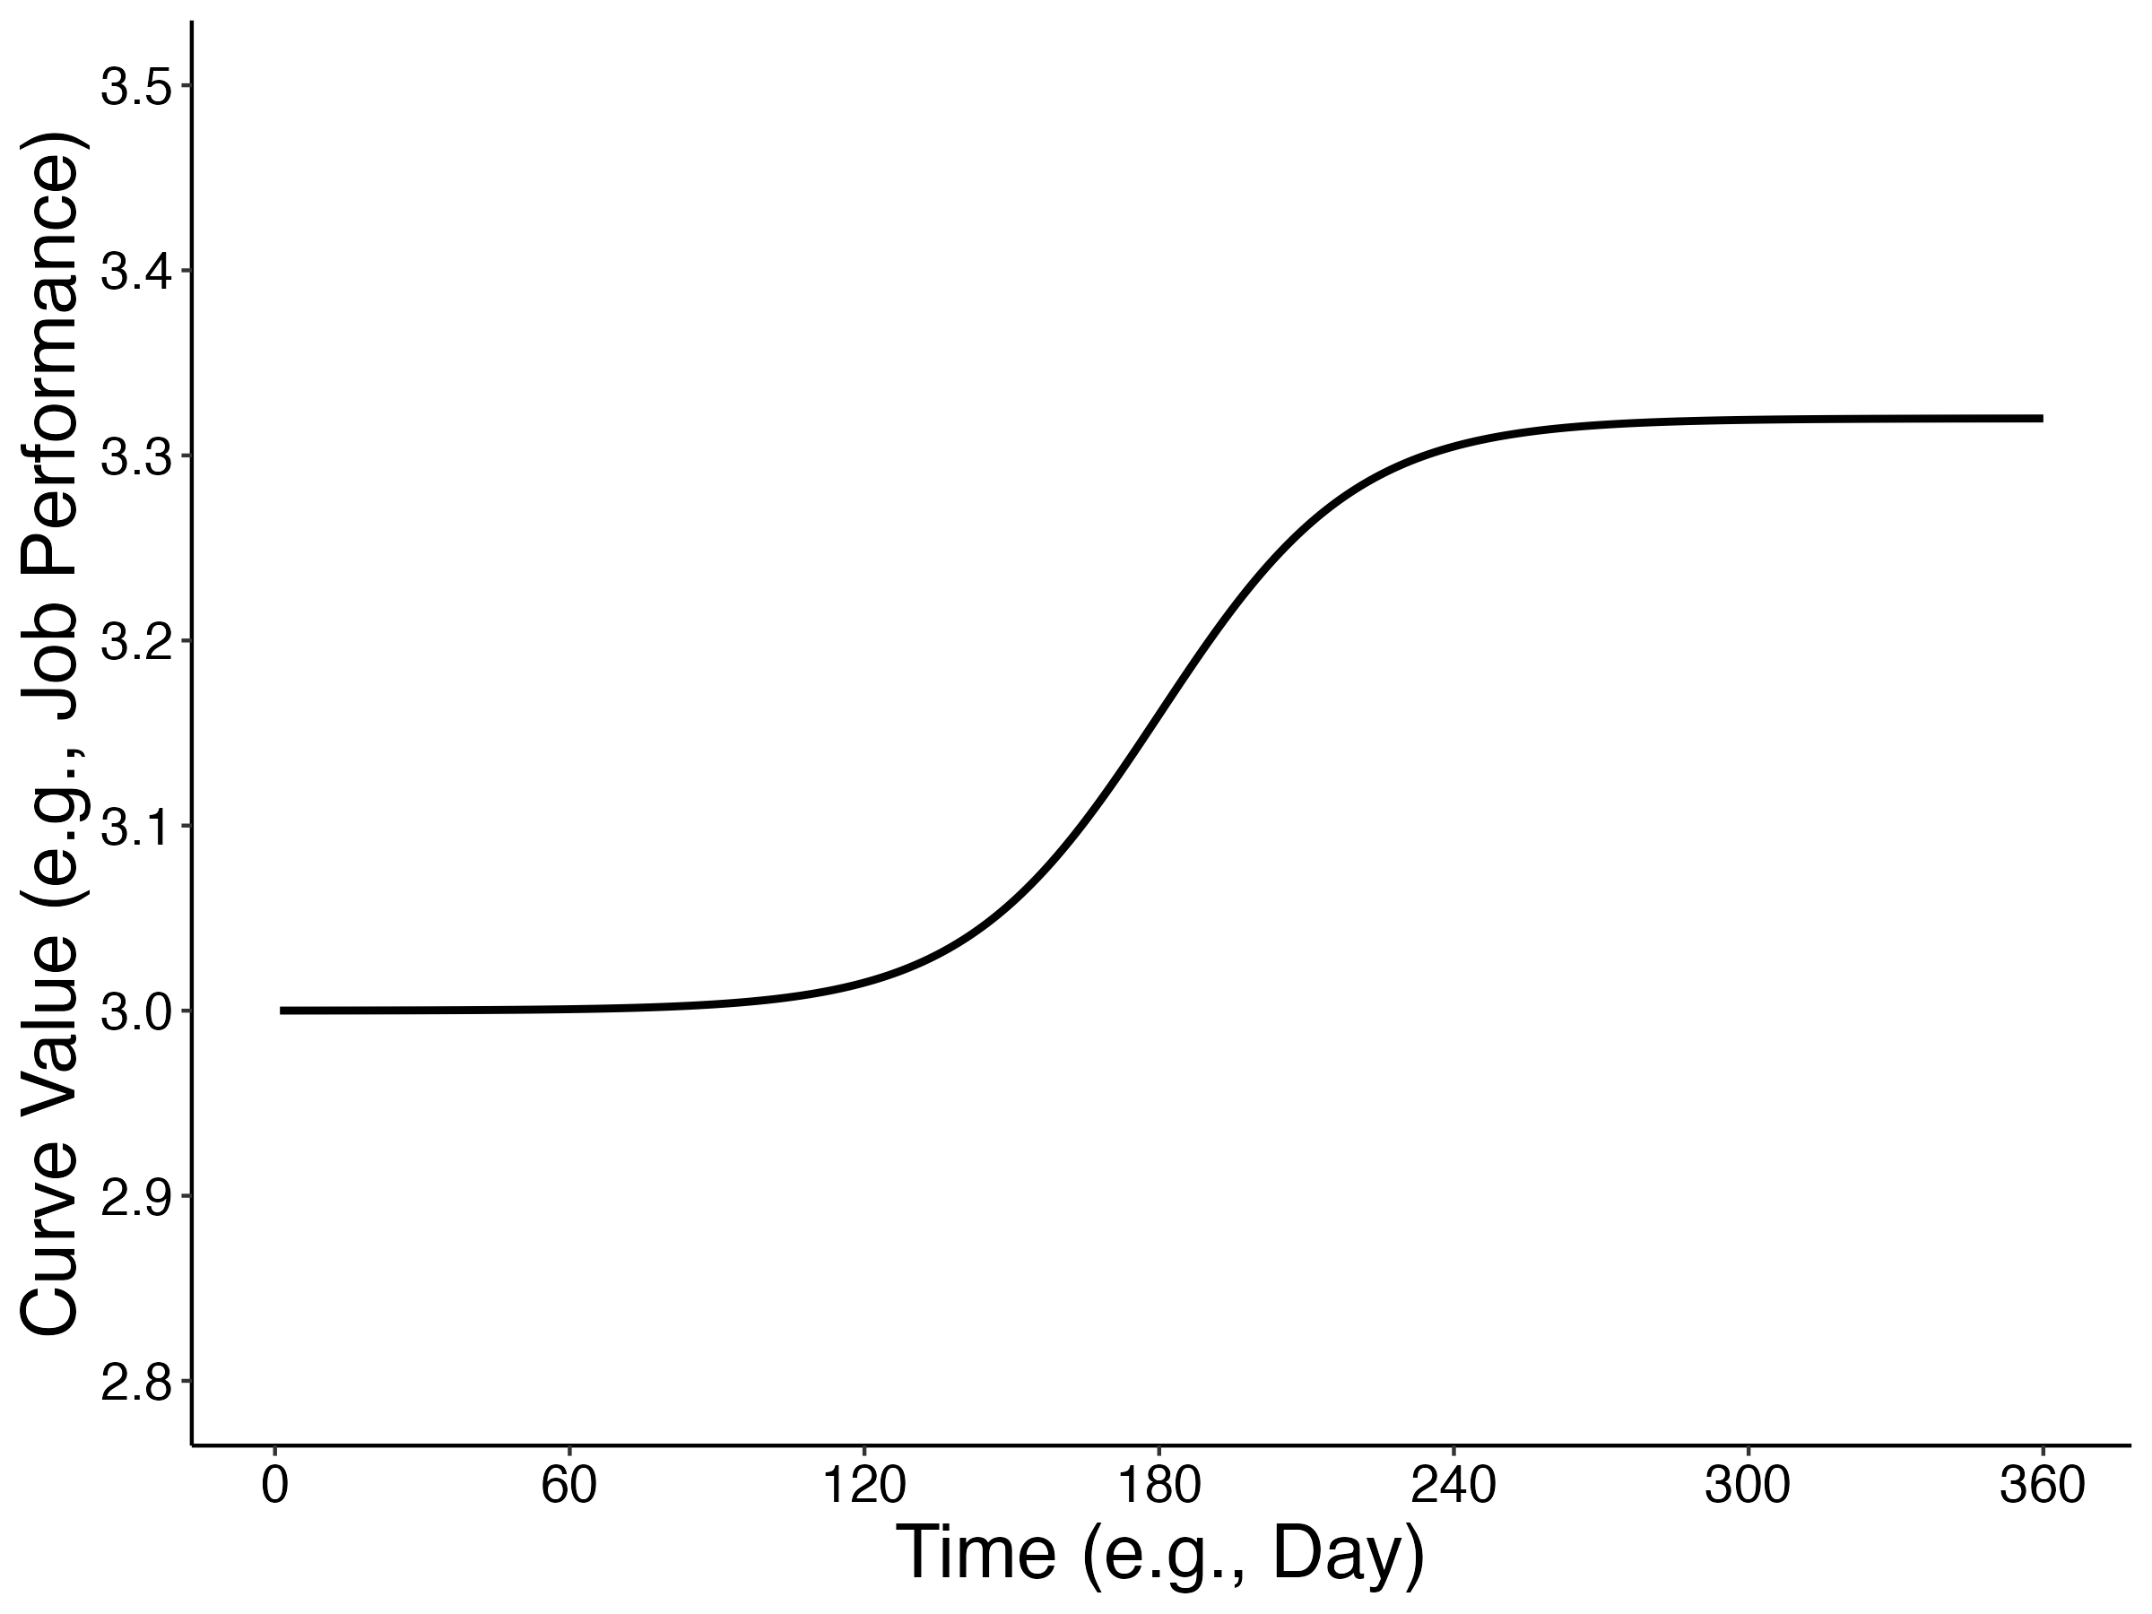
The Monte Carlo method: Population definition
Notes:
Given that people will exhibit variability in their patterns of change,

Slide 29

The Monte Carlo method: Population definition
Notes:
Given that people will exhibit variability in their patterns of change,

Slide 30

The Monte Carlo method: Population definition
Notes:
Given that people will exhibit variability in their patterns of change,

Slide 31

The Monte Carlo method: Population definition
Notes:
Given that people will exhibit variability in their patterns of change,

Slide 32

The Monte Carlo method: Population definition
Notes:
Given that people will exhibit variability in their patterns of change,

Slide 33
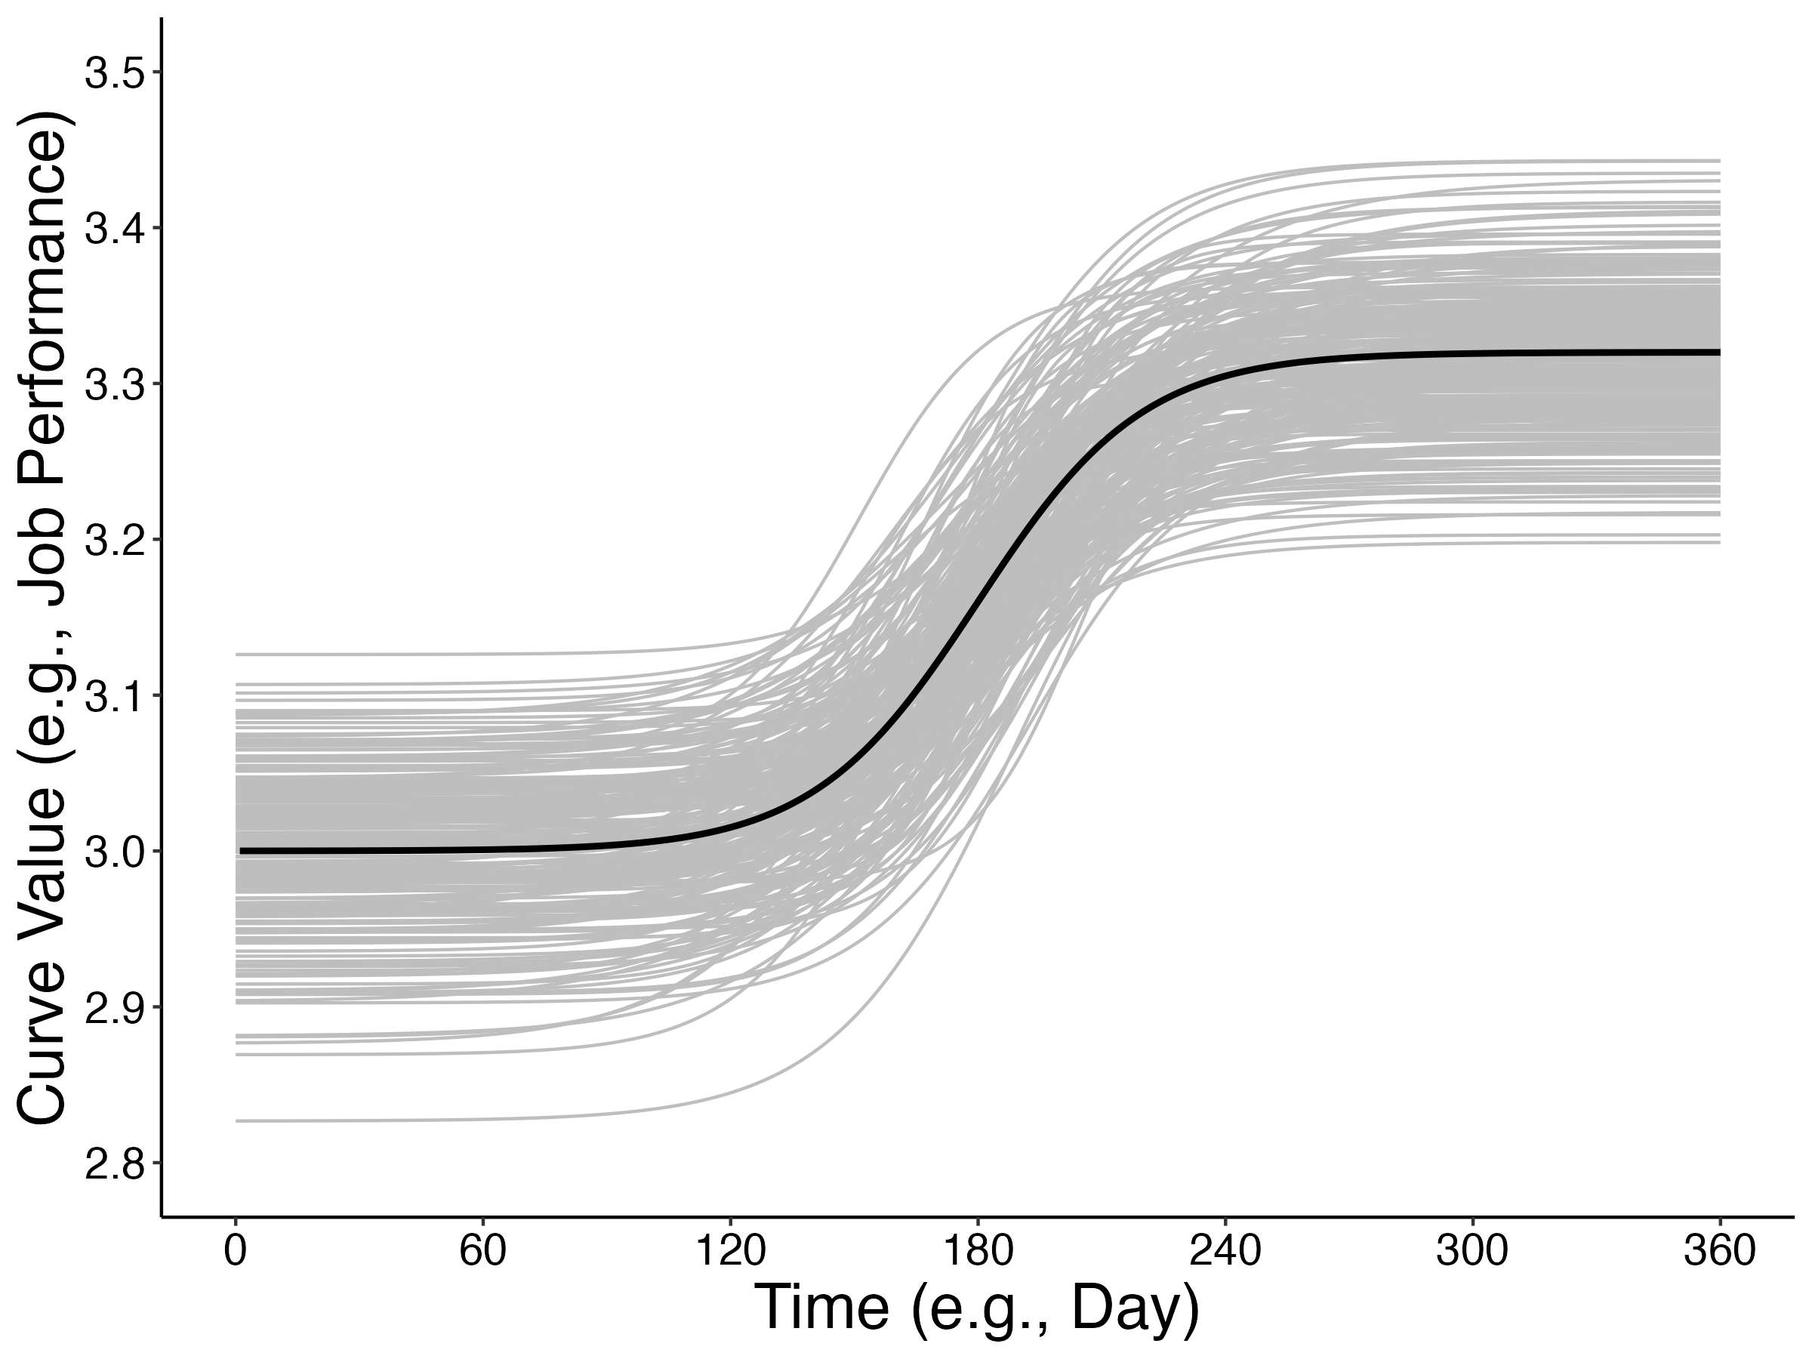
The Monte Carlo method: Population definition
Notes:
Given that people will exhibit variability in their patterns of change,

Slide 34
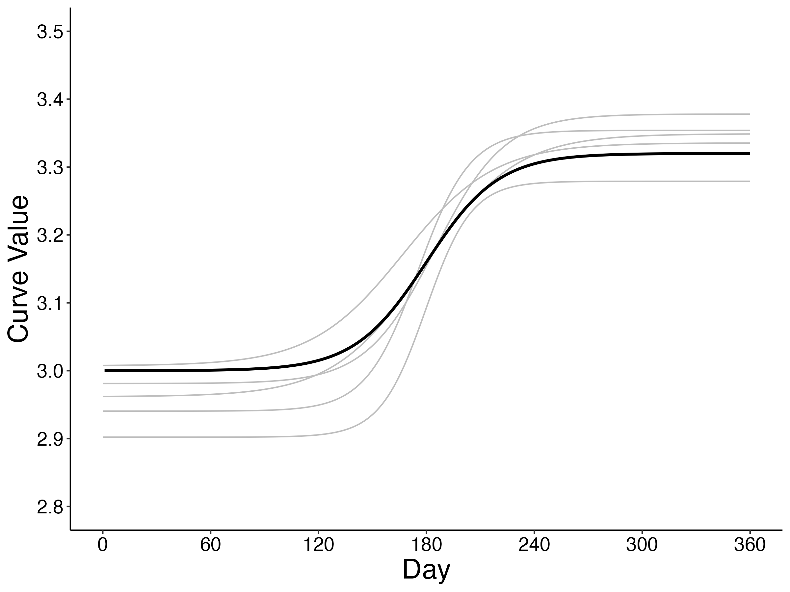

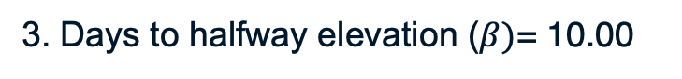
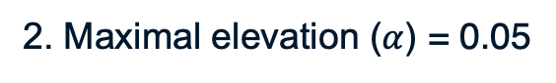
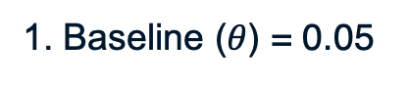
The Monte Carlo method: Population definition
Random effects* (grey curves)
1. Baseline ($θ$) = 0.05
2. Maximal elevation ($α$) = 0.05
3. Days to halfway elevation ($β)$= 10.00
4. Triquarter-halfway delta ($γ)$ = 4.00
Notes:
Given that people will exhibit variability in their patterns of change, I defiend the population to account for this variability. This was accomplished by setting variabilities for each parameter. These are also known as random-effects values, which are provided on this slide. The values presented earlier represent the mean curve and are also called fixed effects.

Slide 35
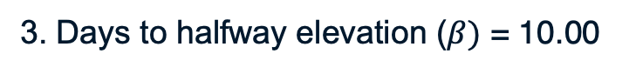
The Monte Carlo method: Population definition
Fixed effects (black curve)
1. Baseline ($θ$) = 3.00
2. Maximal elevation ($α$) = 3.32
3. Days to halfway elevation ($β)$= 180.00
4. Triquarter-halfway delta ($γ)$ = 20.00
Random effects* (grey curves)
1. Baseline ($θ$) = 0.05
2. Maximal elevation ($α$) = 0.05
3. Days to halfway elevation ($β)$ = 10.00
4. Triquarter-halfway delta ($γ)$ = 4.00
Notes:
Given that people will exhibit variability in their patterns of change, I defiend the population to account for this variability. This was accomplished by setting variabilities for each parameter. These are also known as random-effects values, which are provided on this slide. The values presented earlier represent the mean curve and are also called fixed effects.

Slide 36
The Monte Carlo method
= model
= sample
$θ, α, β, γ$ (known)
$θ, α, β, γ$(estimated)
1. Population definition
2. Sample generation
4. Model performance
m₁
m₂
m₃
m₄
m_{n}
3. Modelling
s₁
s₂
s₃
s₄
s_{n}
s₁
s₂
s₃
s₄
s_{n}
Notes:
In the Monte Carlo method, we define a population mean and then generate samples according to this population.

Slide 37
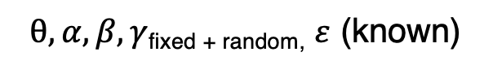
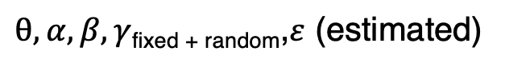
The Monte Carlo method
= model
= sample
$θ,α,β,γ$_{fixed + random,} $ε$ (known)
$θ,α,β,γ$_{fixed + random},$ε$ (estimated)
1. Population definition
2. Sample generation
4. Model performance
m₁
m₂
m₃
m₄
m_{n}
3. Modelling
s₁
s₂
s₃
s₄
s_{n}
s₁
s₂
s₃
s₄
s_{n}
Notes:
In the Monte Carlo method, we define a population mean and then generate samples according to this population.

Slide 38
Independent variable I: Nature of change
Question 2: How to space measurements when the nature of change is unknown?

Slide 39
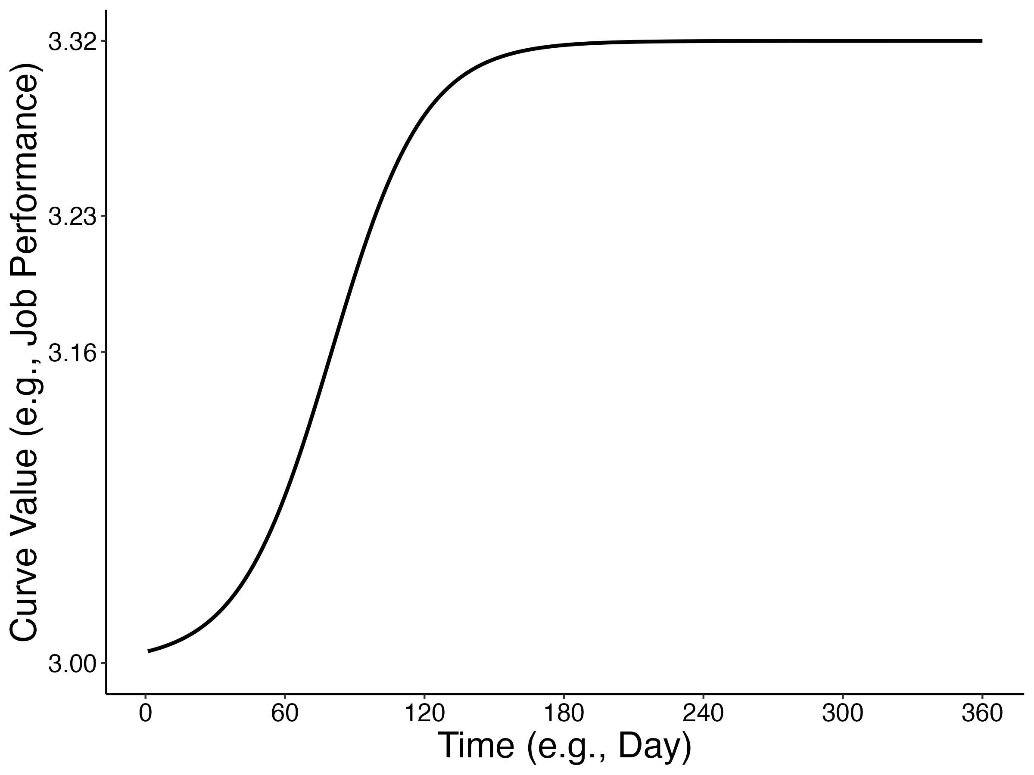
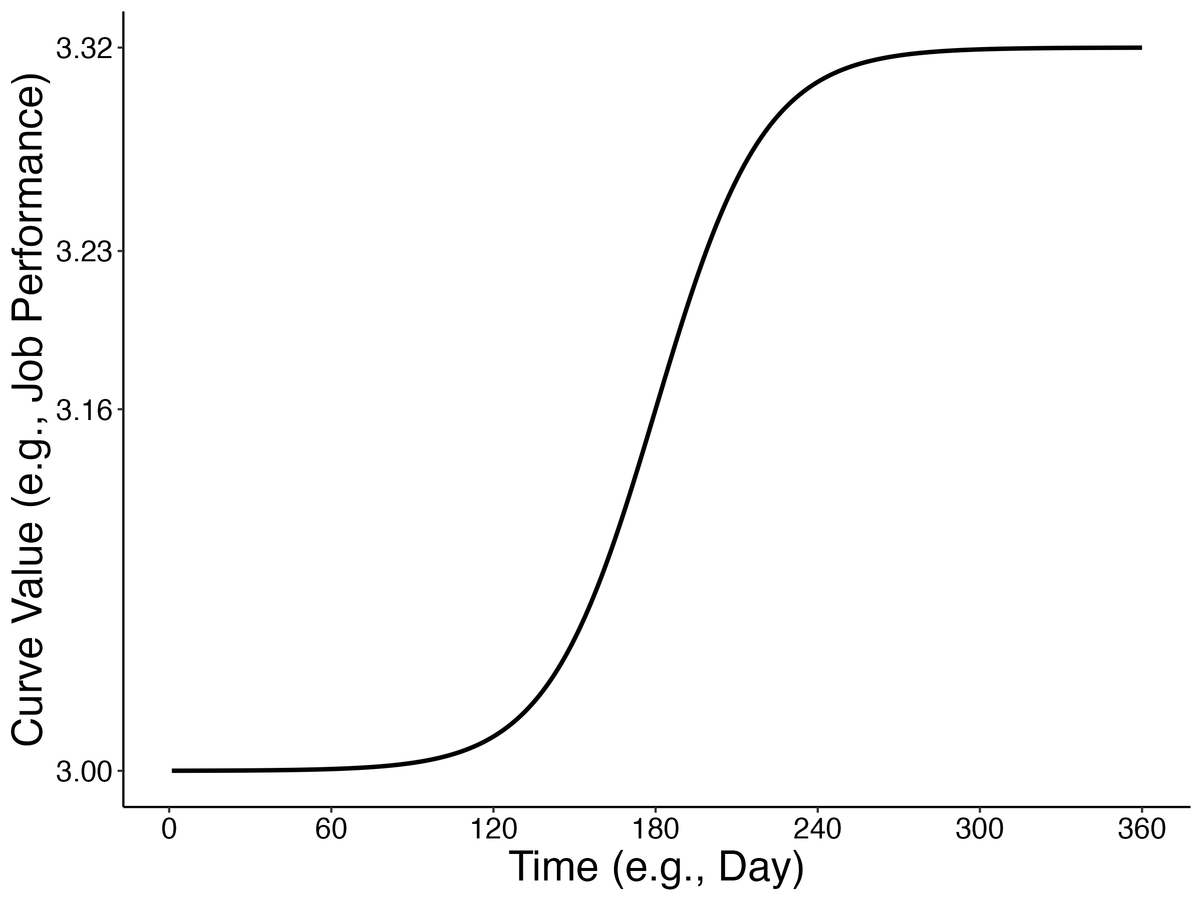
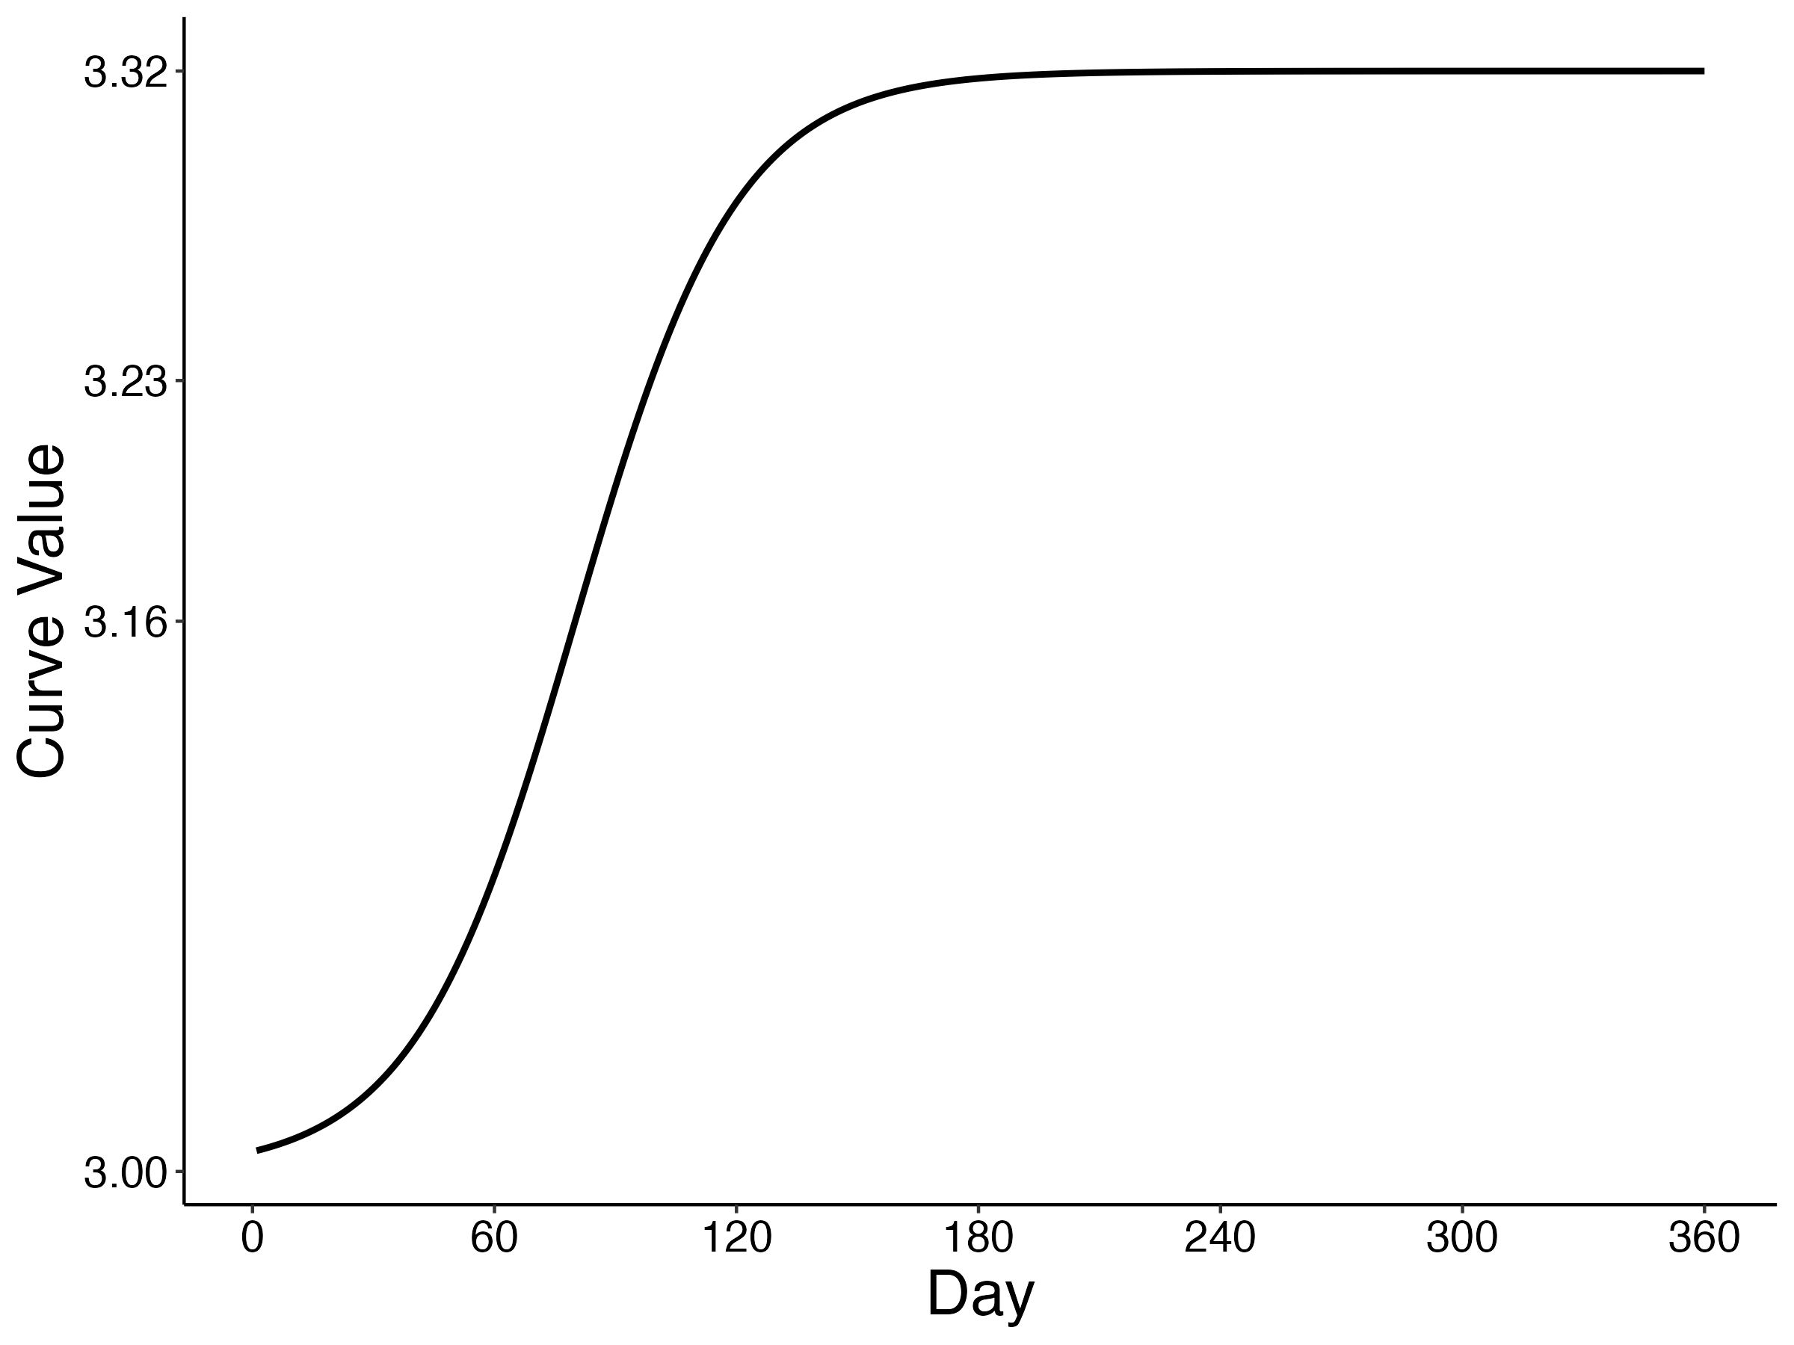
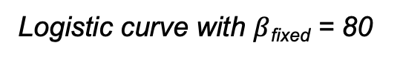
Independent variable I: Nature of change
Logistic curve with $β$_{fixed} = 80
Question 2: How to space measurements when the nature of change is unknown?

Slide 40
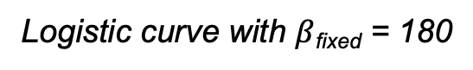
Independent variable I: Nature of change
Logistic curve with $β$_{fixed} = 180
Question 2: How to space measurements when the nature of change is unknown?

Slide 41
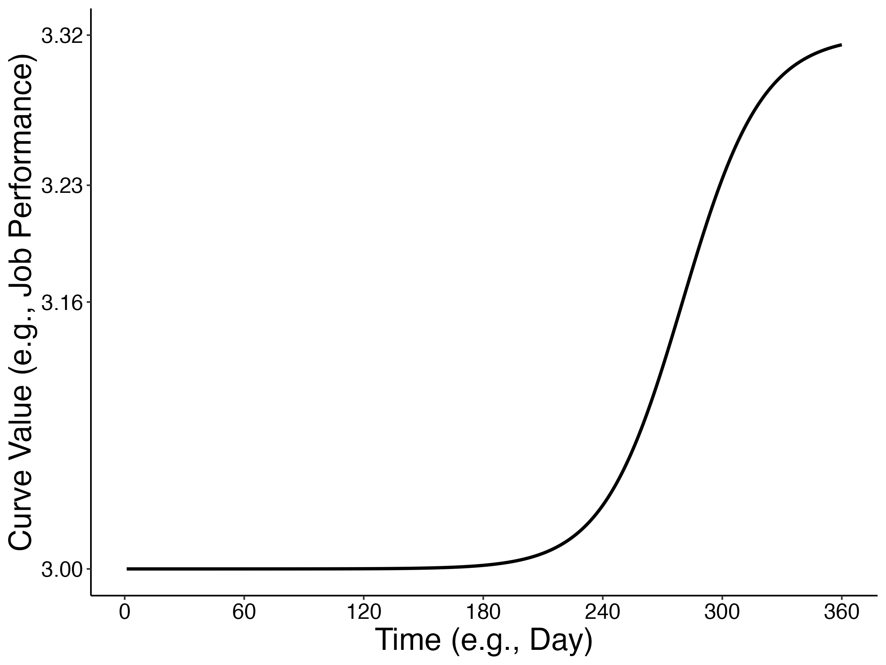
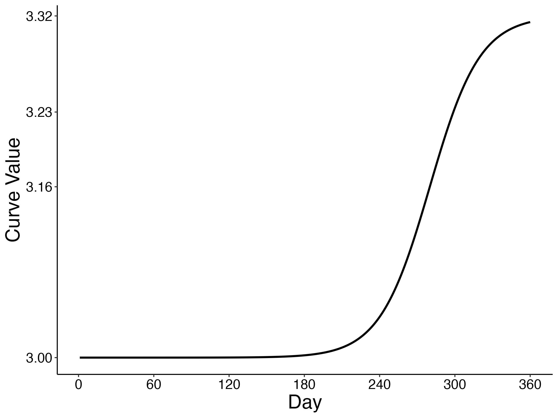
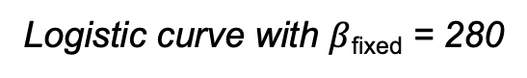
Independent variable I: Nature of change
Logistic curve with $β$_{fixed} = 280
Question 2: How to space measurements when the nature of change is unknown?

Slide 42
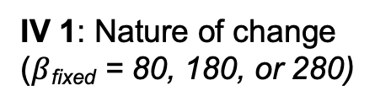
The Monte Carlo method
= model
= sample
$θ,α,β,γ$_{fixed + random,} $ε$ (known)
$θ,α,β,γ$_{fixed + random},$ε$ (estimated)
1. Population definition
IV 1: Nature of change ($β$_{fixed} = 80, 180, or 280)
2. Sample generation
4. Model performance
m₁
m₂
m₃
m₄
m_{n}
3. Modelling
s₁
s₂
s₃
s₄
s_{n}
s₁
s₂
s₃
s₄
s_{n}
Notes:
In the Monte Carlo method, we define a population mean and then generate samples according to this population.

Slide 43
Independent variable II: Number of measurements

Slide 44
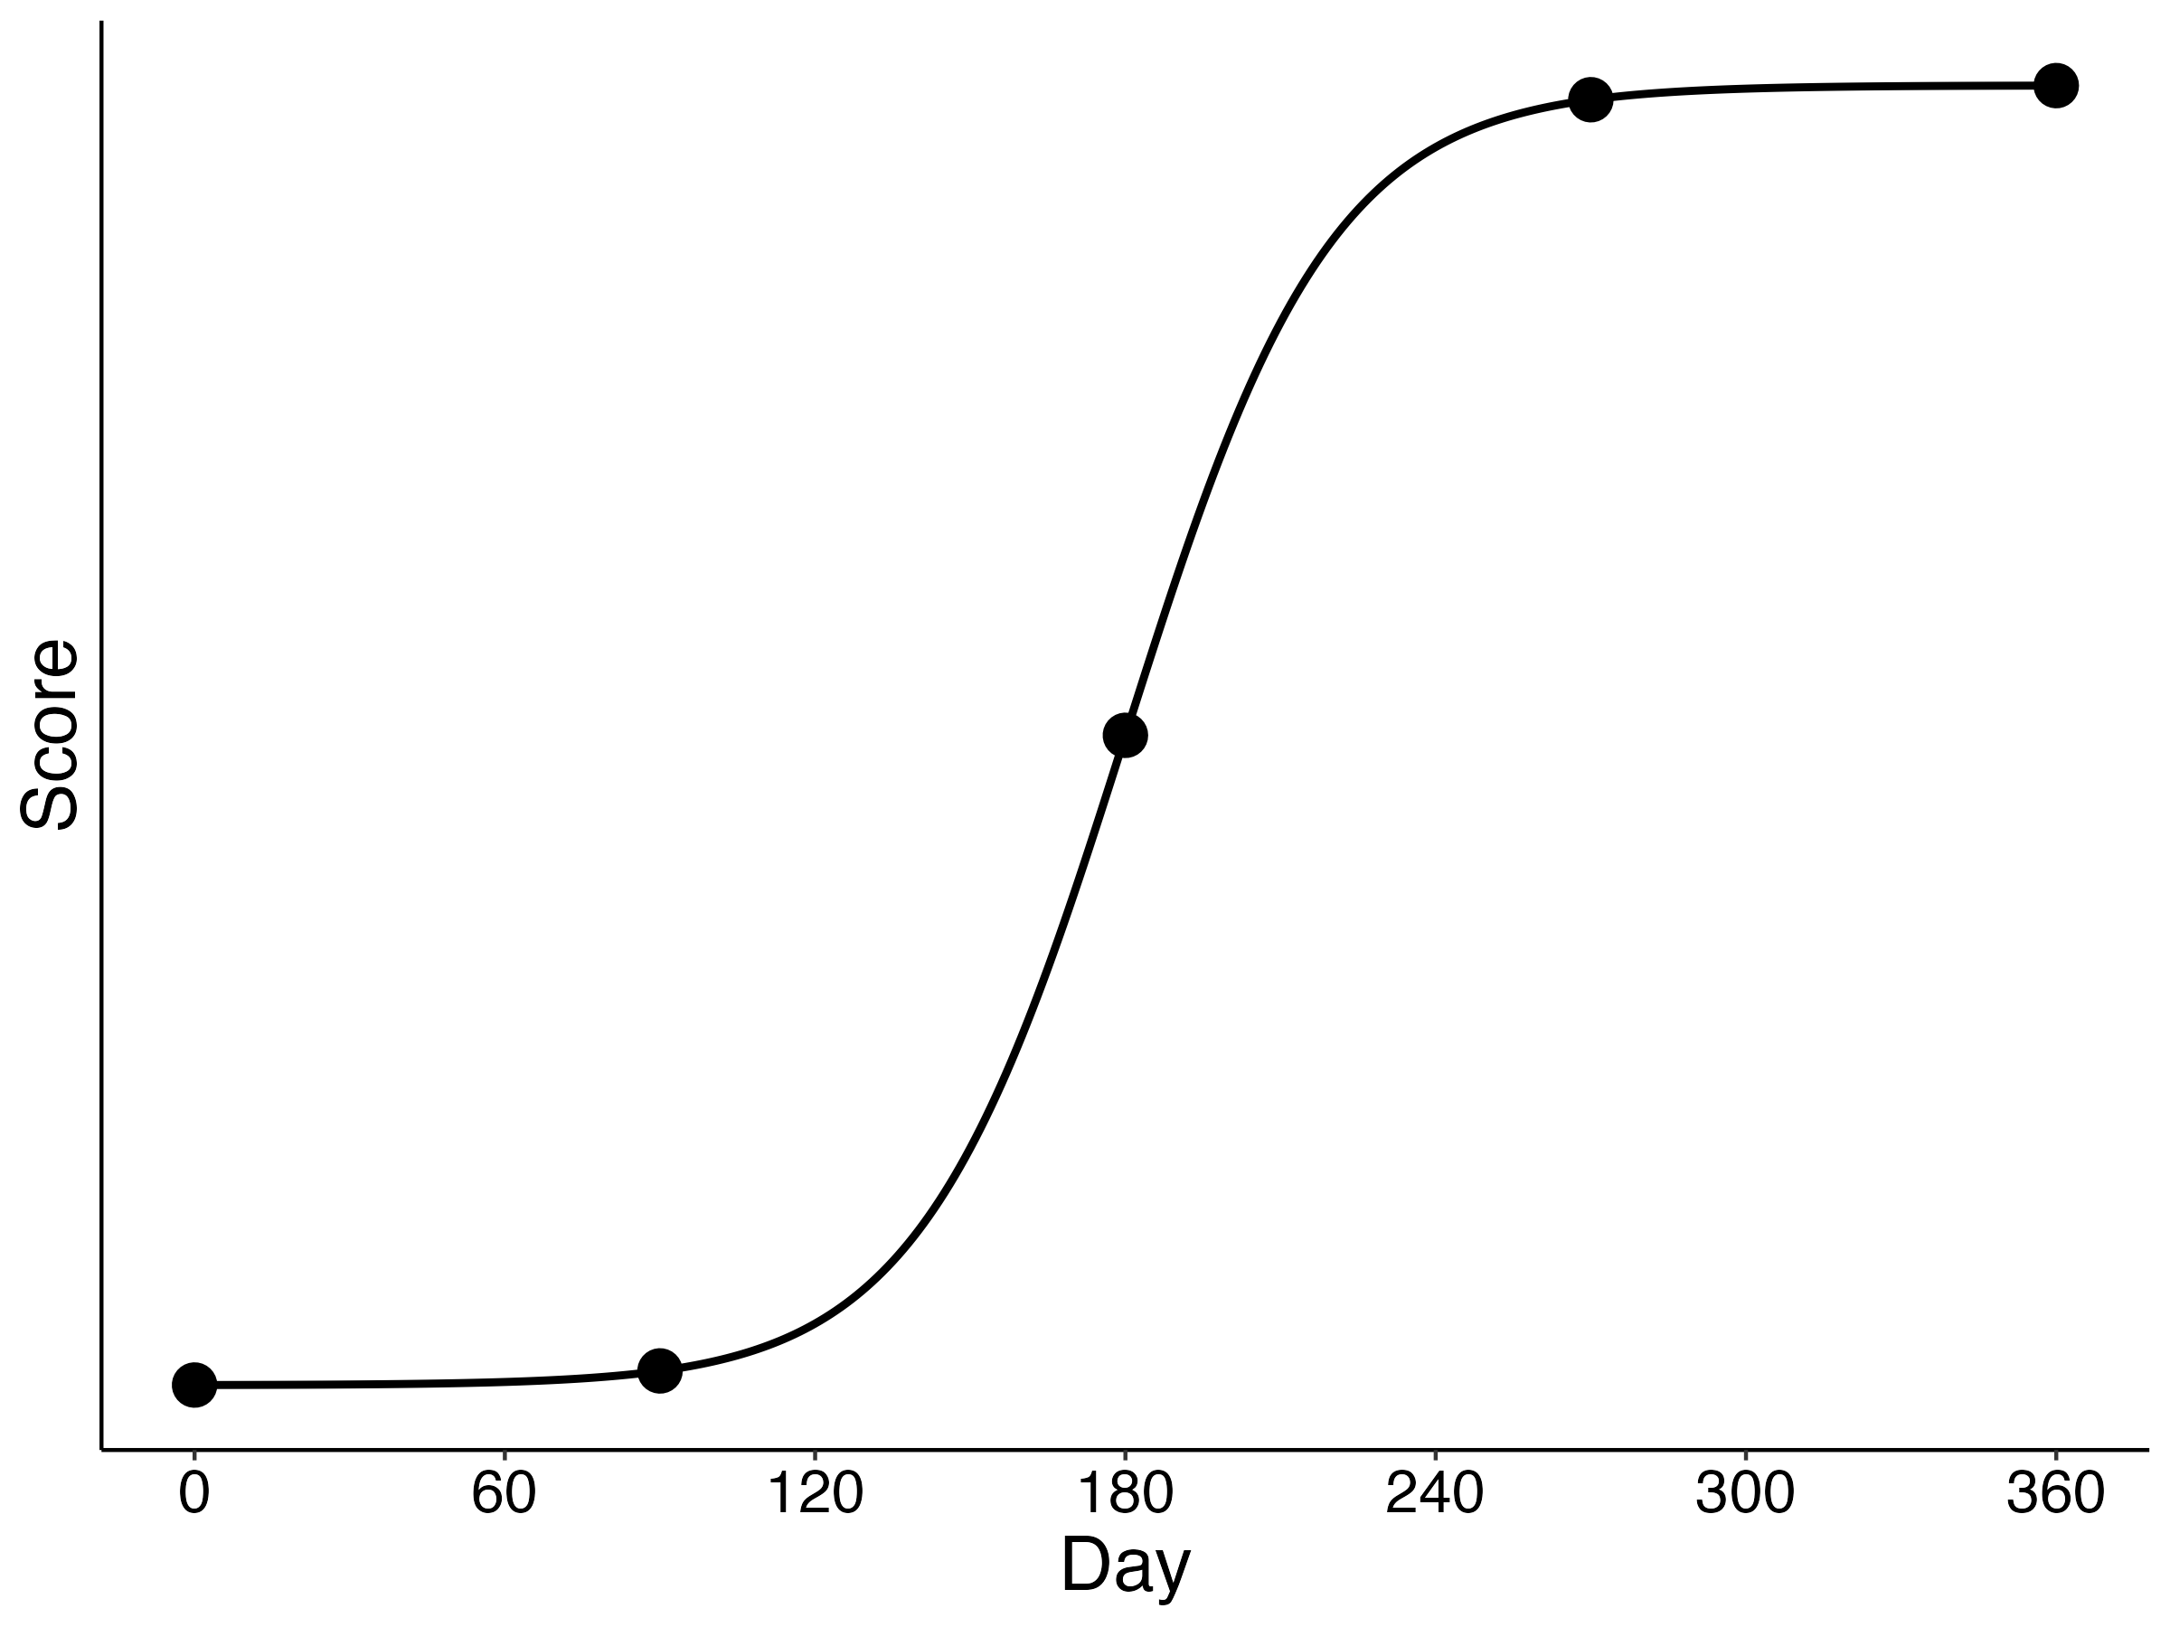
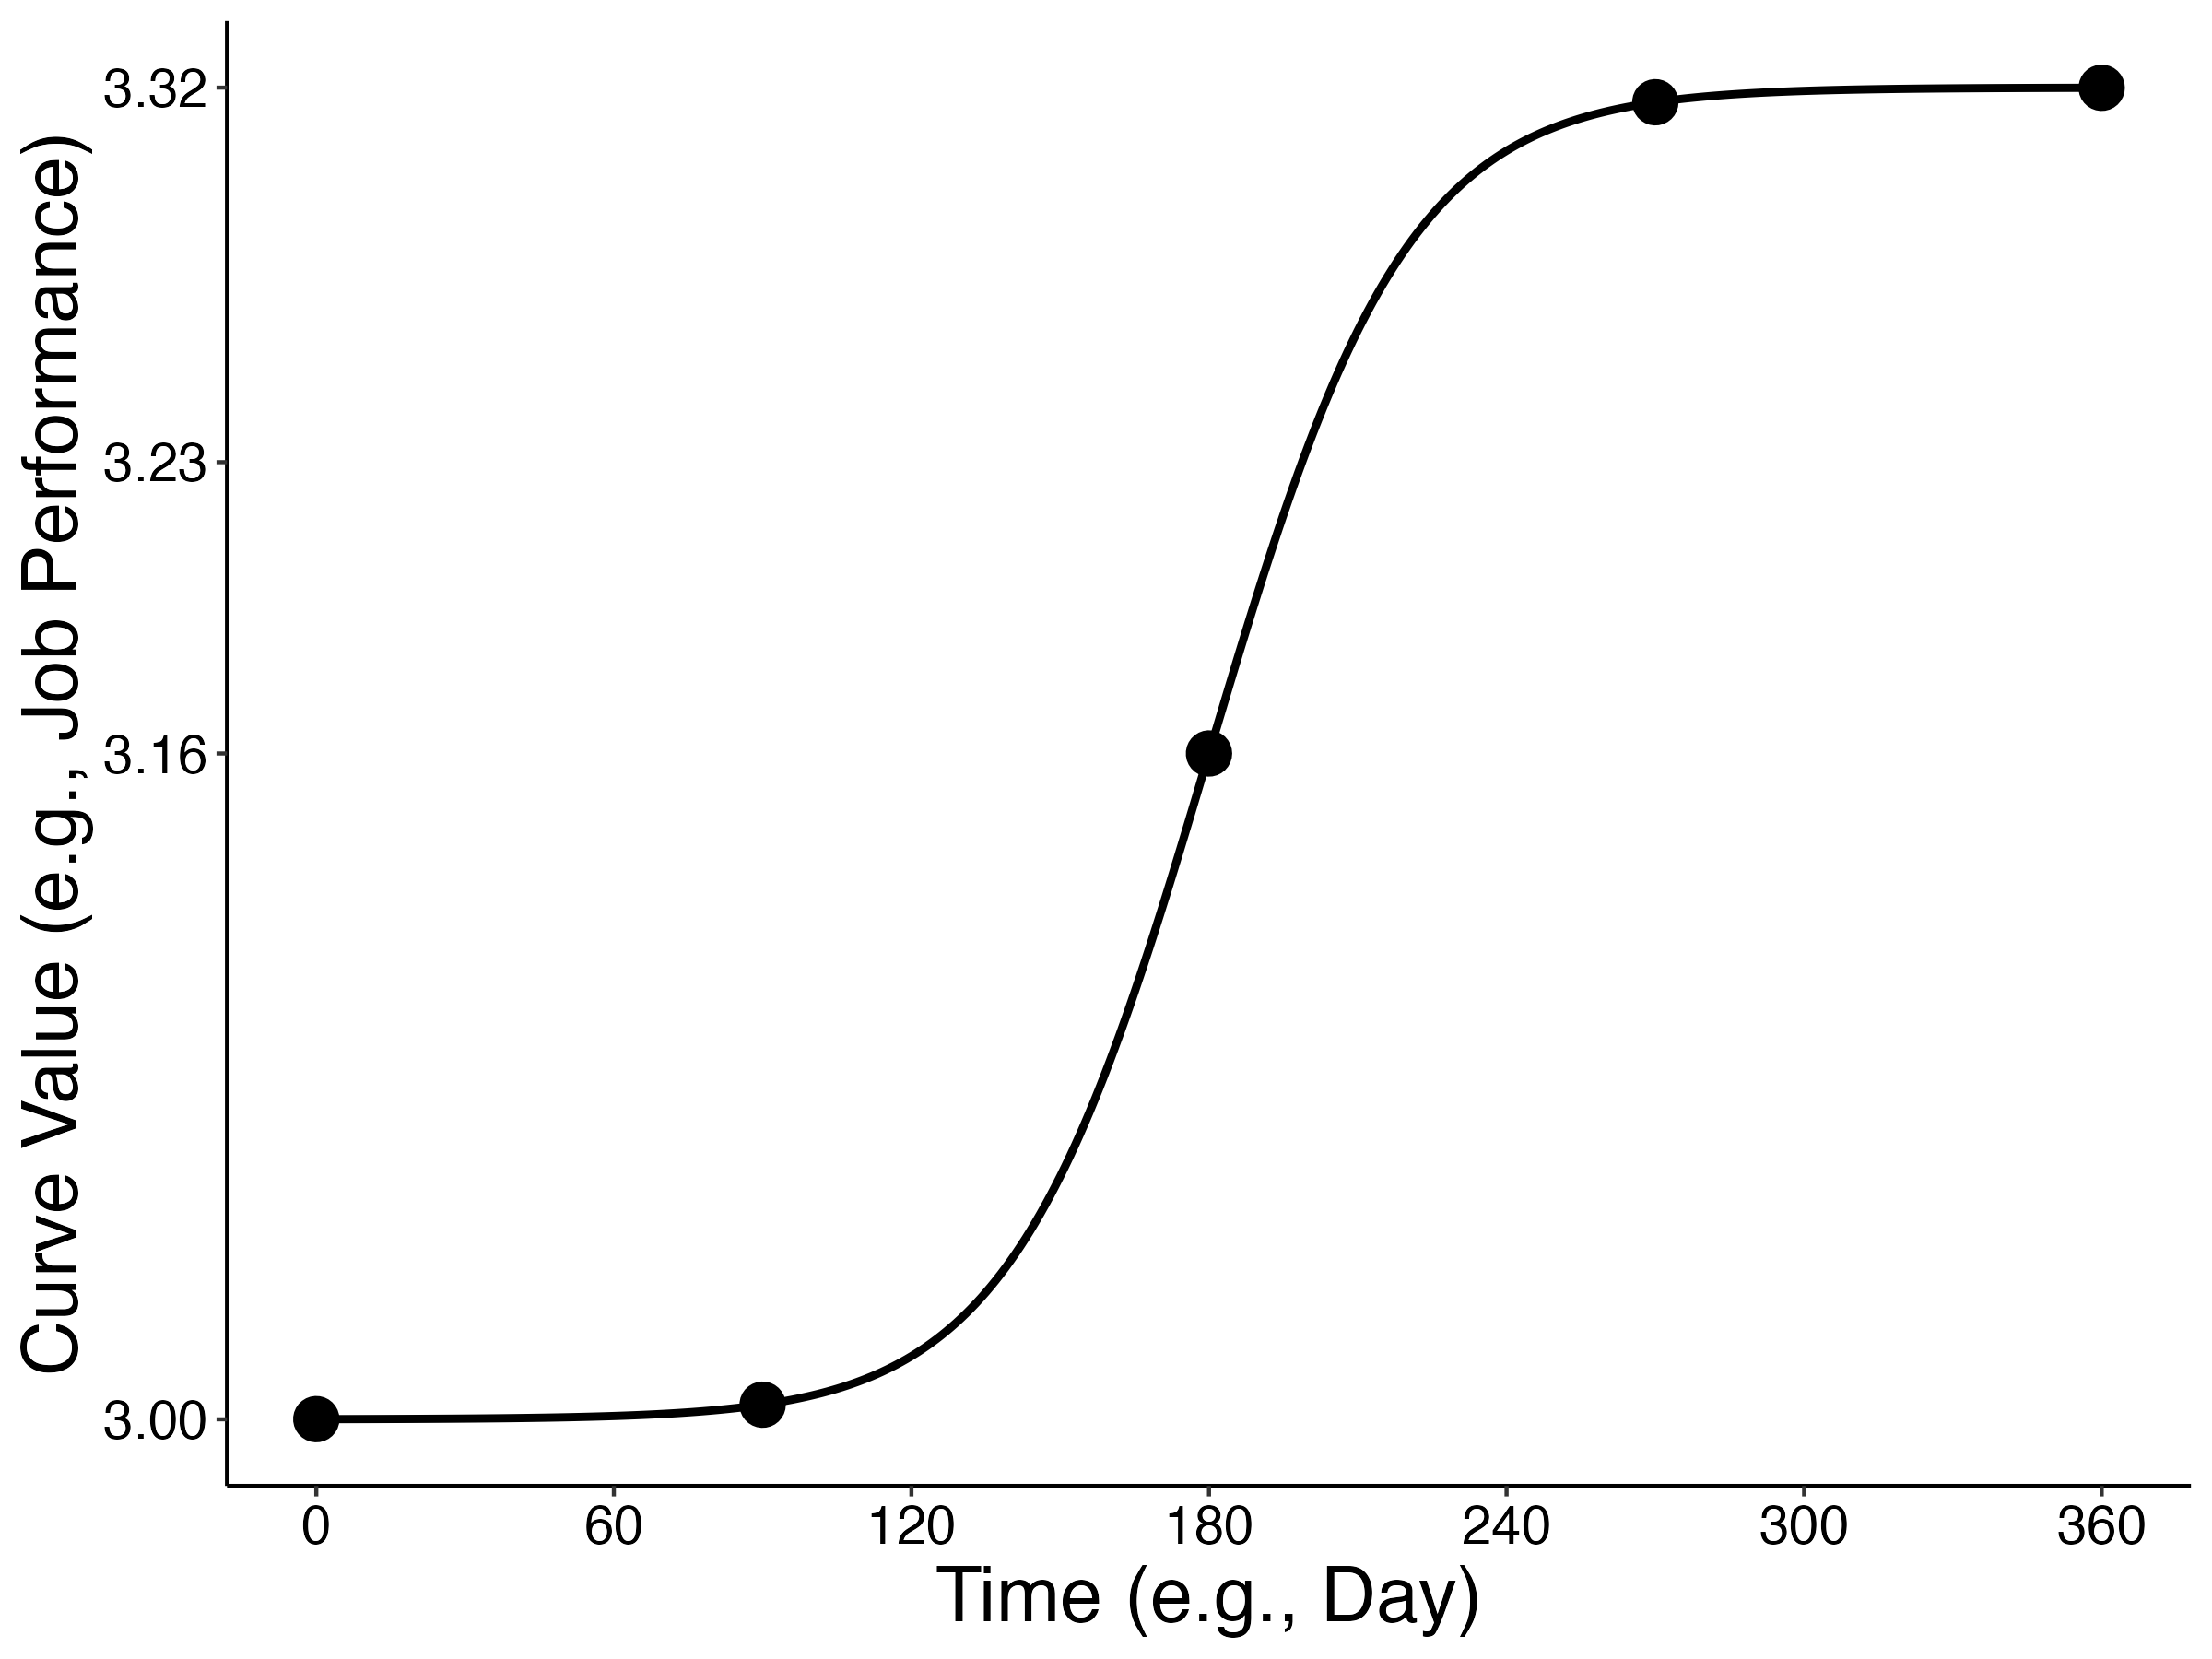
Independent variable II: Number of measurements
Five measurements

Slide 45
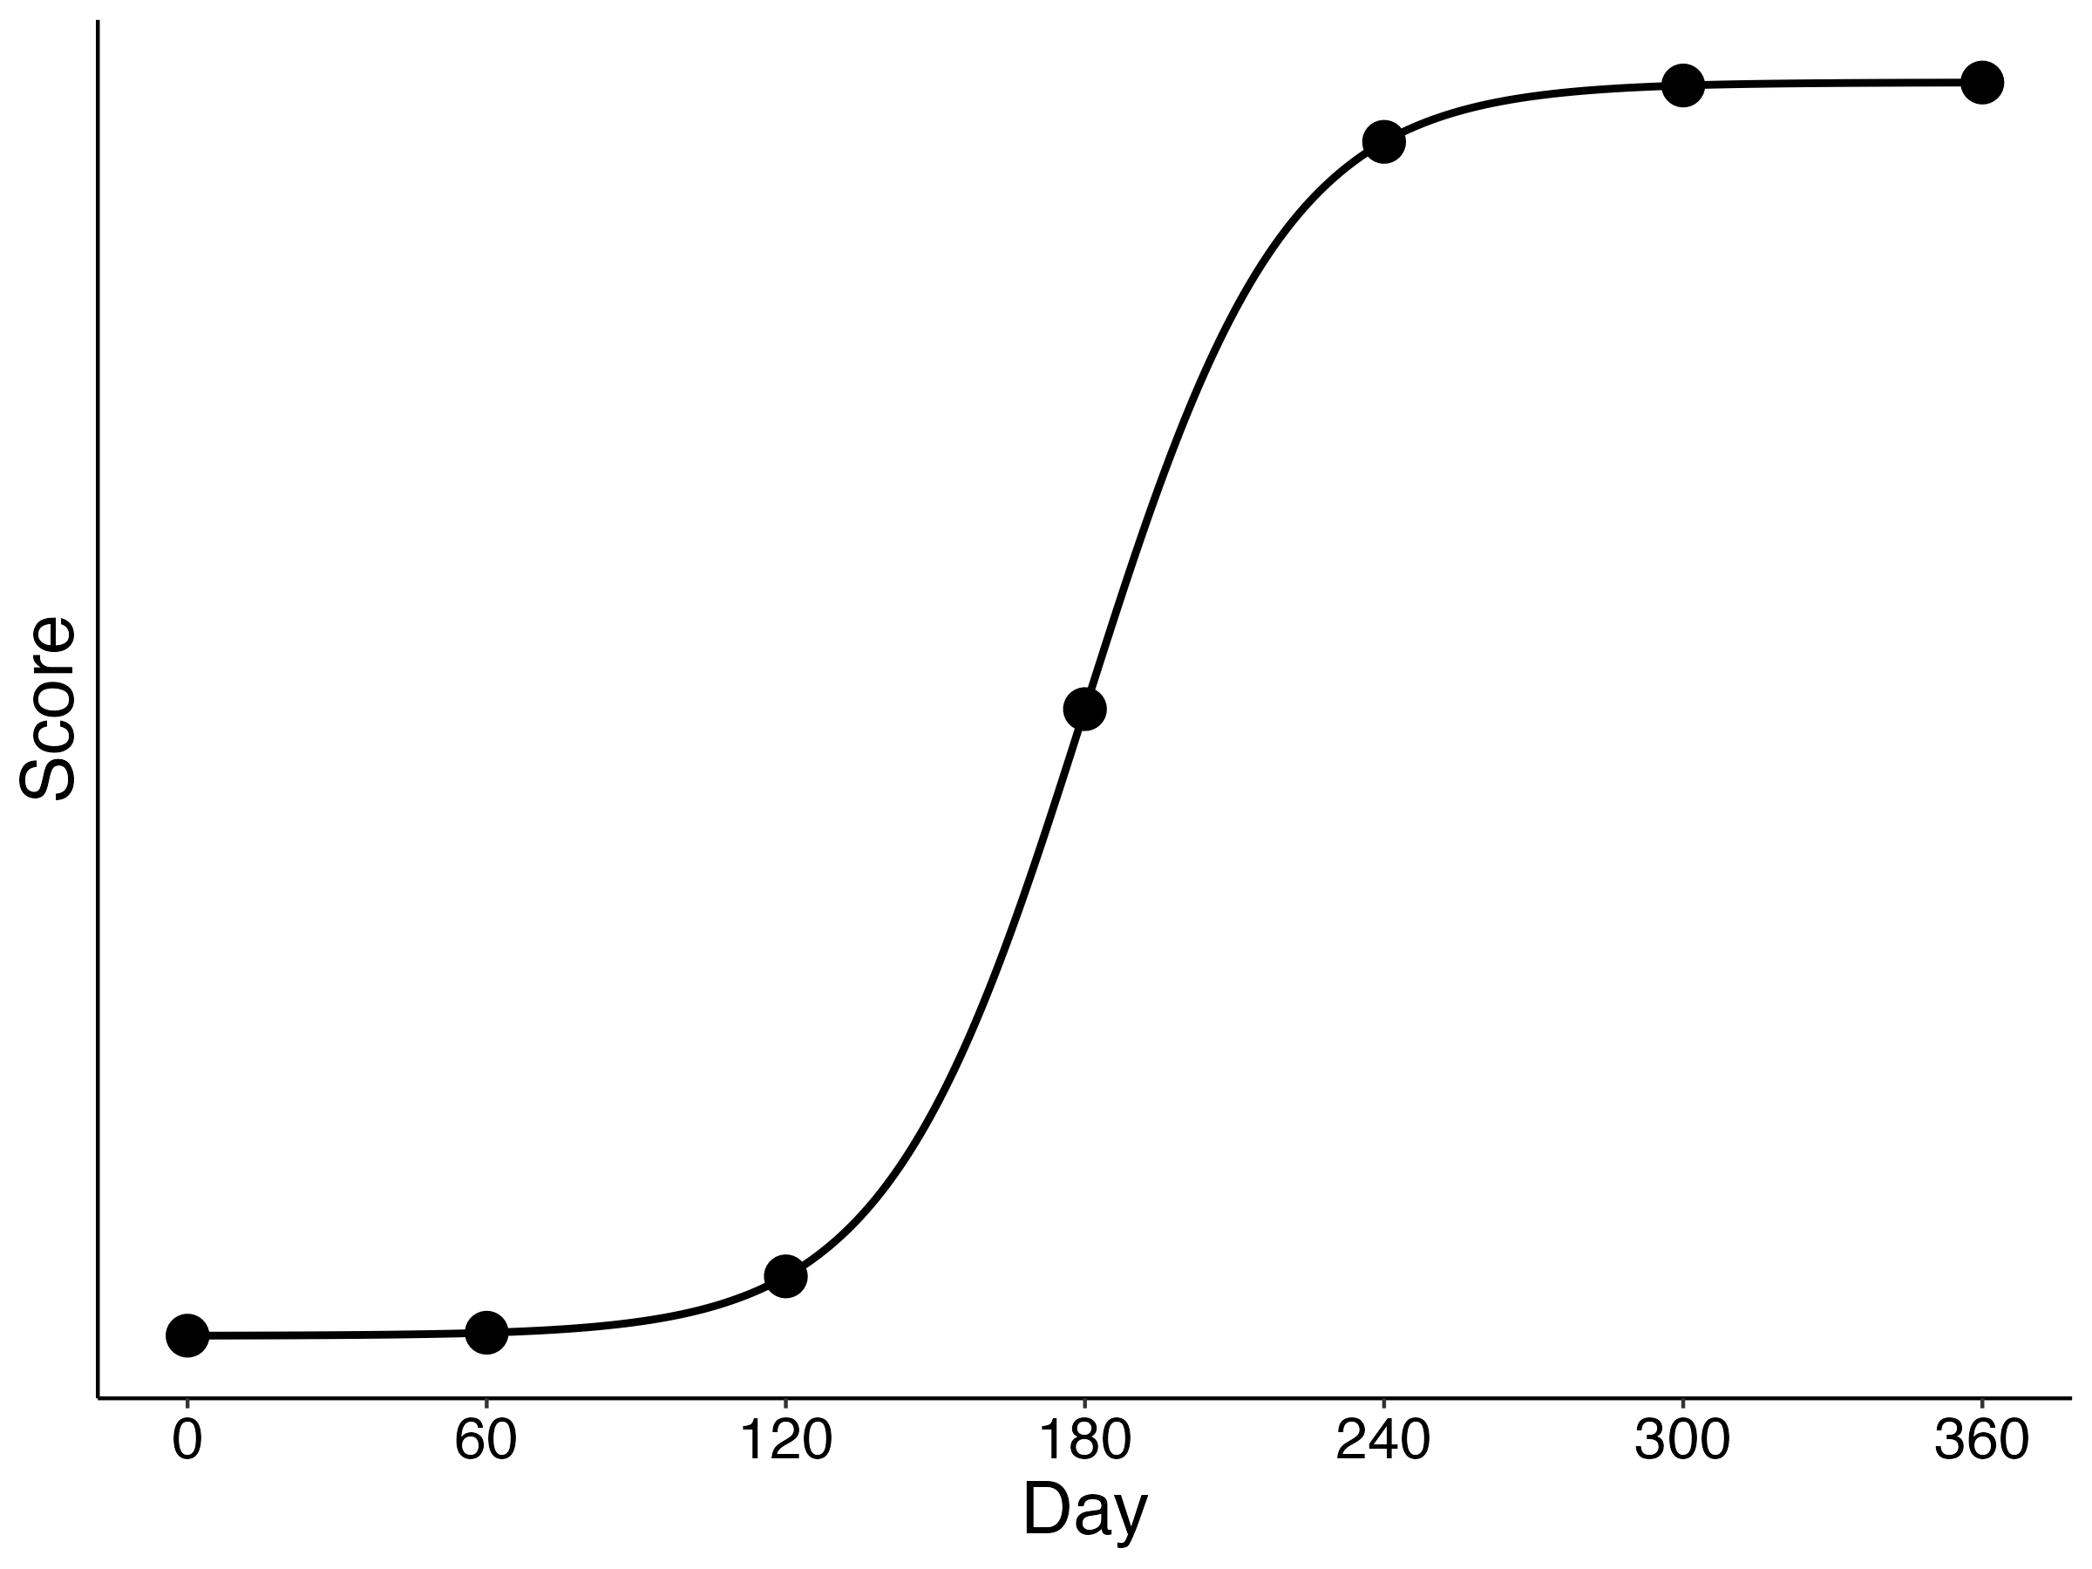
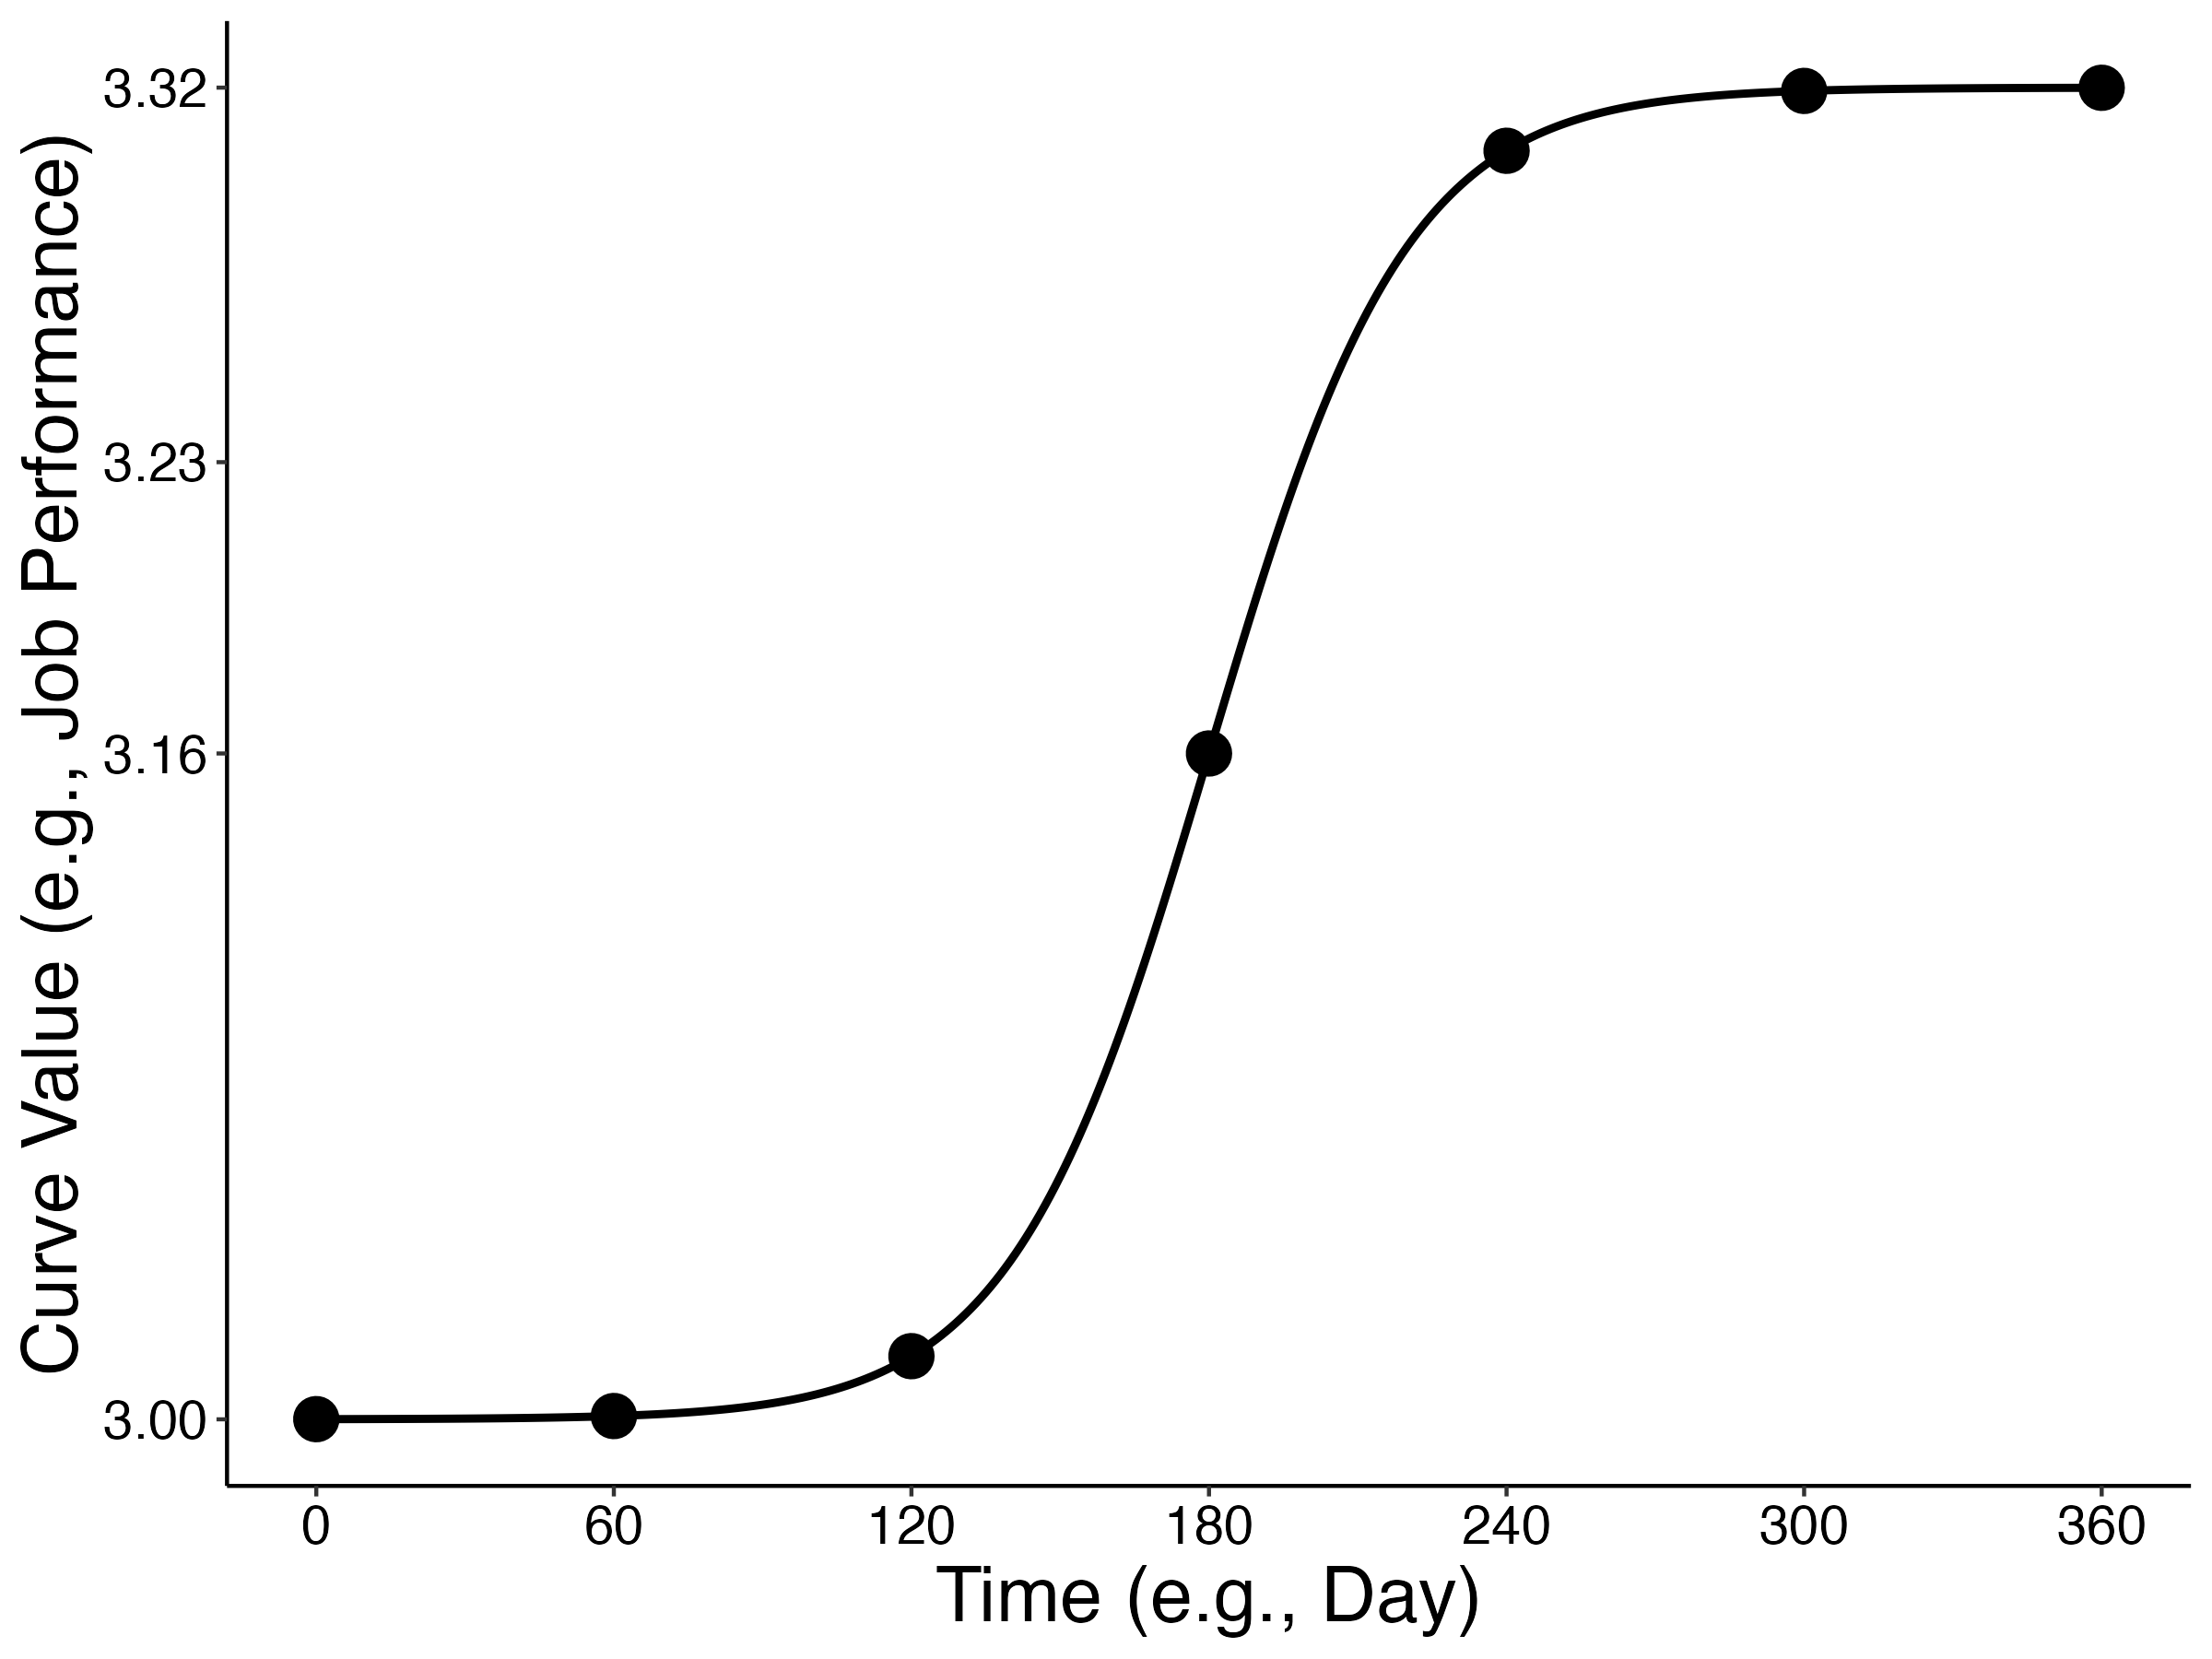
Independent variable II: Number of measurements
Seven measurements

Slide 46

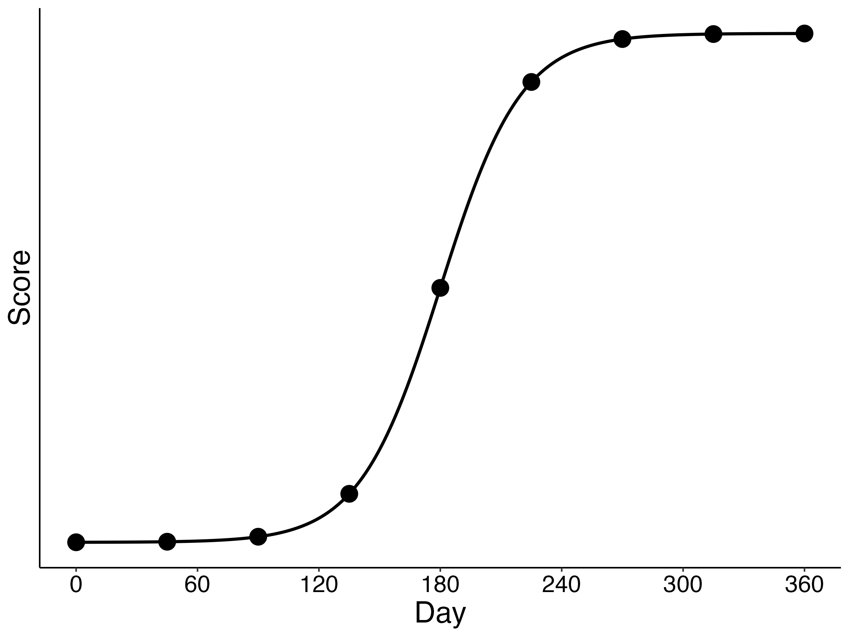
Independent variable II: Number of measurements
Nine measurements

Slide 47

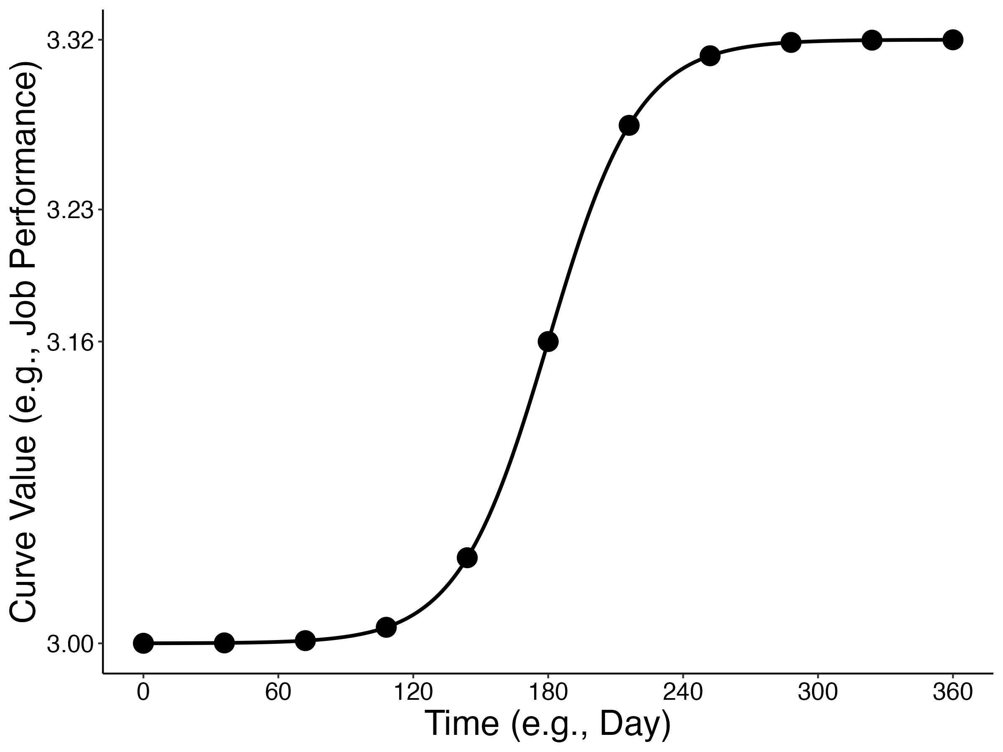
Independent variable II: Number of measurements
Eleven measurements

Slide 48
The Monte Carlo method
= model
= sample
$θ,α,β,γ$_{fixed + random,} $ε$ (known)
$θ,α,β,γ$_{fixed + random},$ε$ (estimated)
1. Population definition
IV 1: Nature of change ($β$_{fixed} = 80, 180, or 280)
2. Sample generation
IV 2: Number of measurements (5, 7, 9, or 11)
4. Model performance
m₁
m₂
m₃
m₄
m_{n}
3. Modelling
s₁
s₂
s₃
s₄
s_{n}
s₁
s₂
s₃
s₄
s_{n}
Notes:
In the Monte Carlo method, we define a population mean and then generate samples according to this population.

Slide 49
Independent variable III: Measurement spacing
Question 2: How to space measurements when the nature of change is unknown?

Slide 50
Independent variable III: Measurement spacing
Equal spacing
Question 2: How to space measurements when the nature of change is unknown?

Slide 51
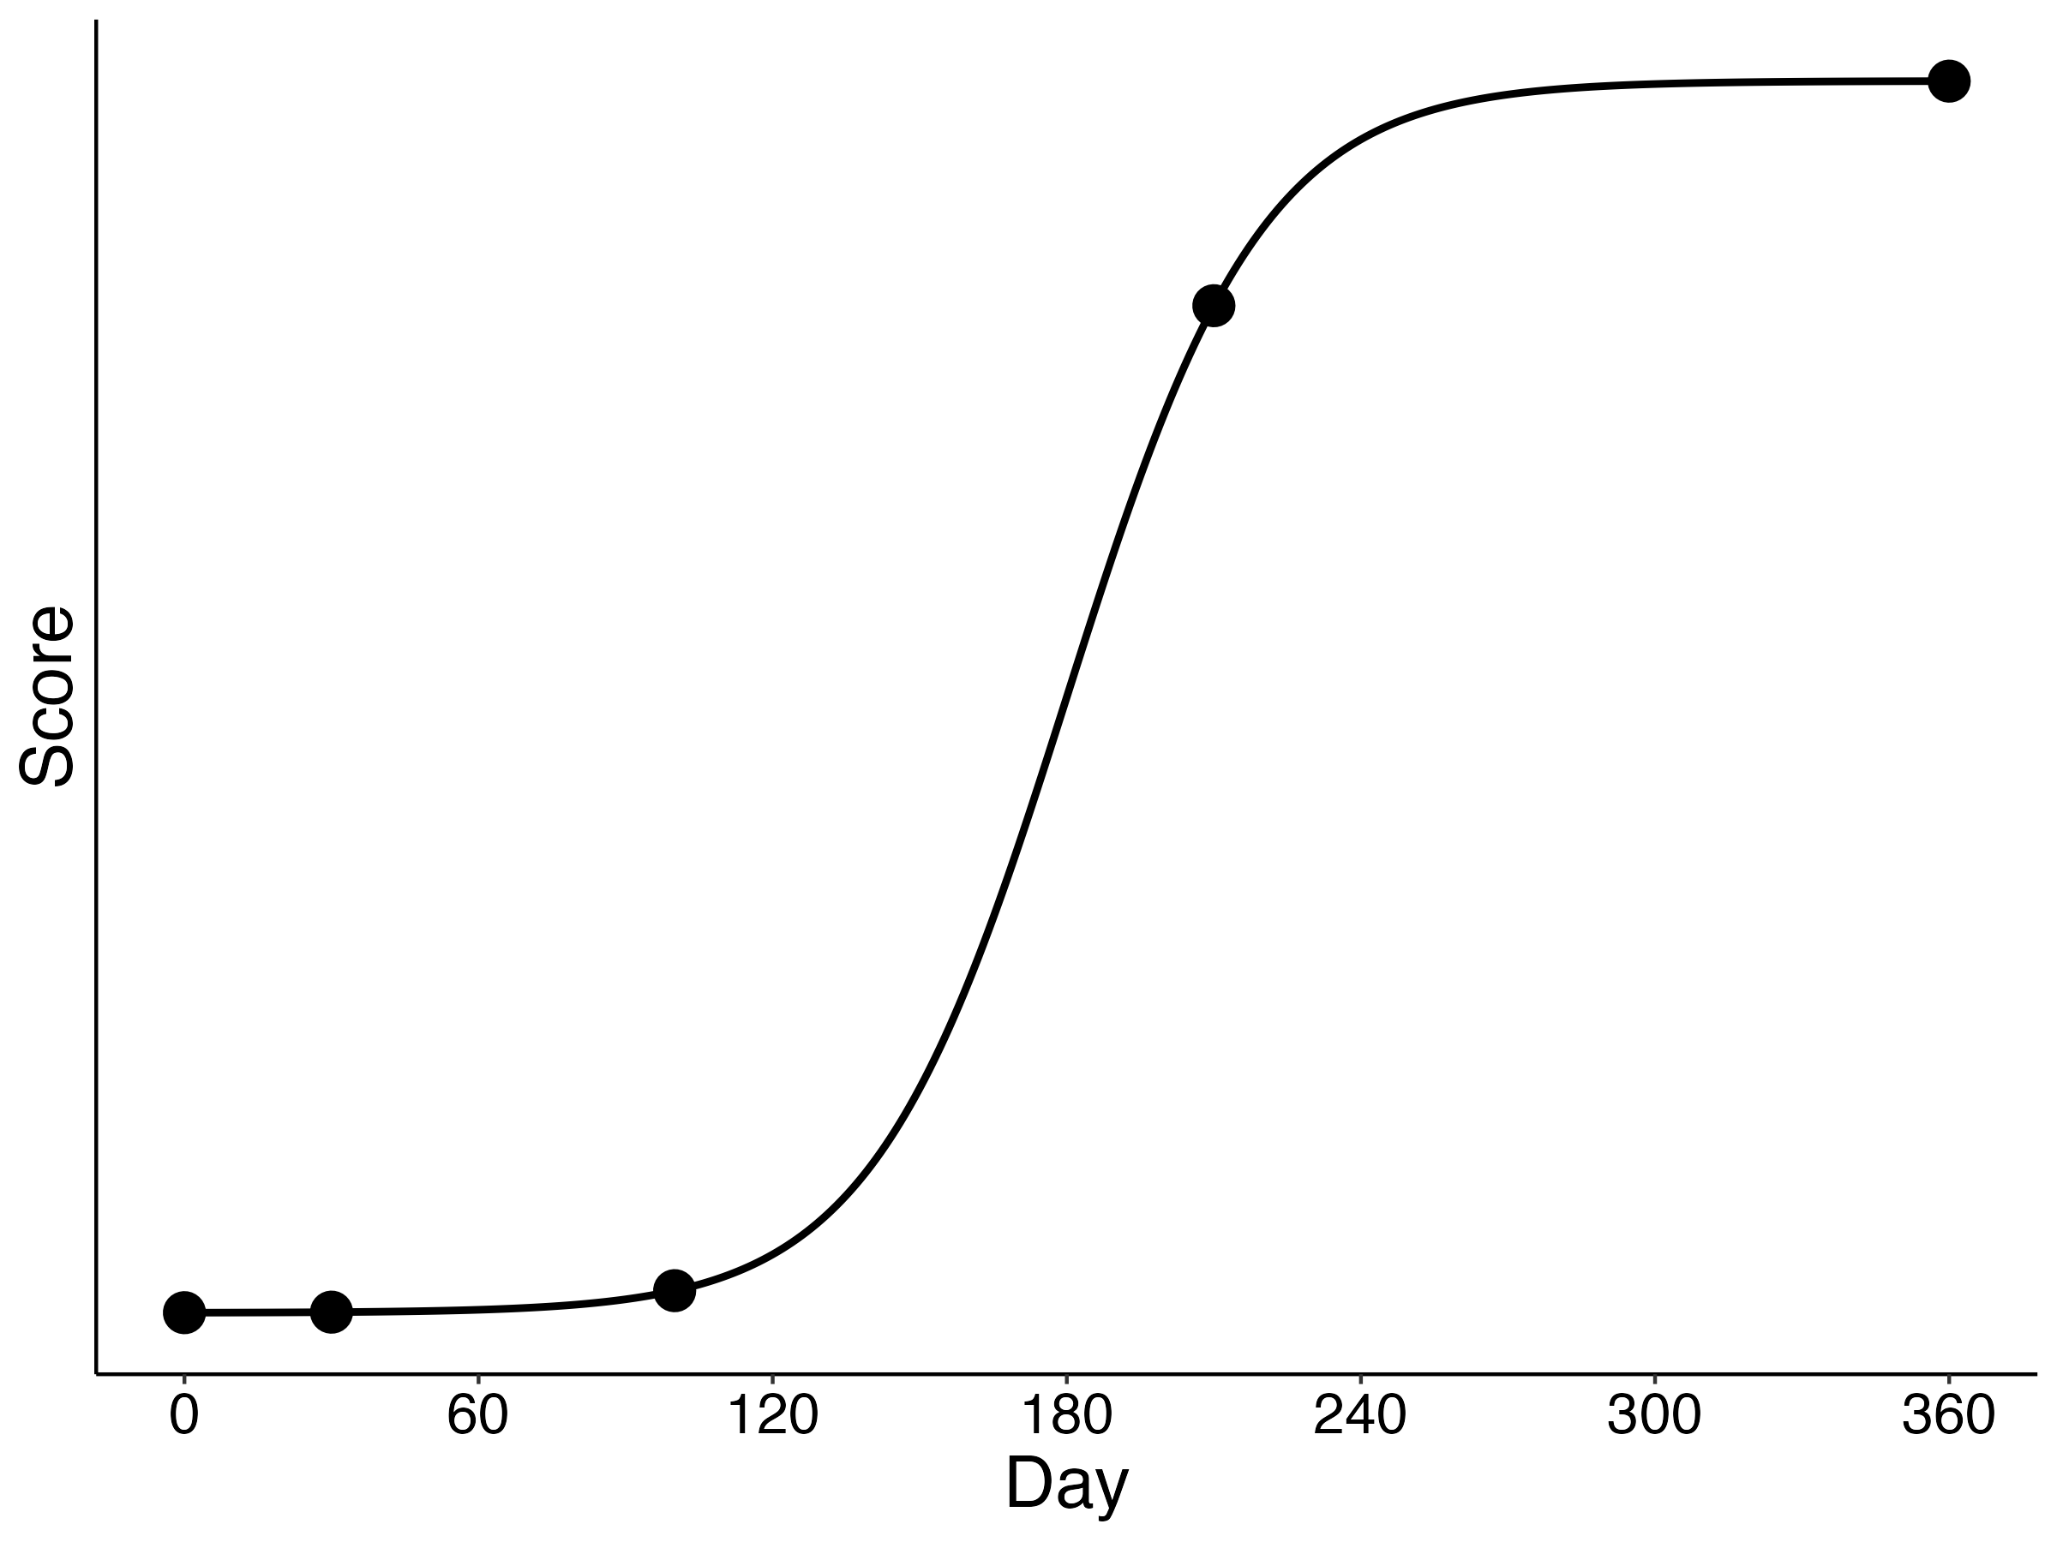
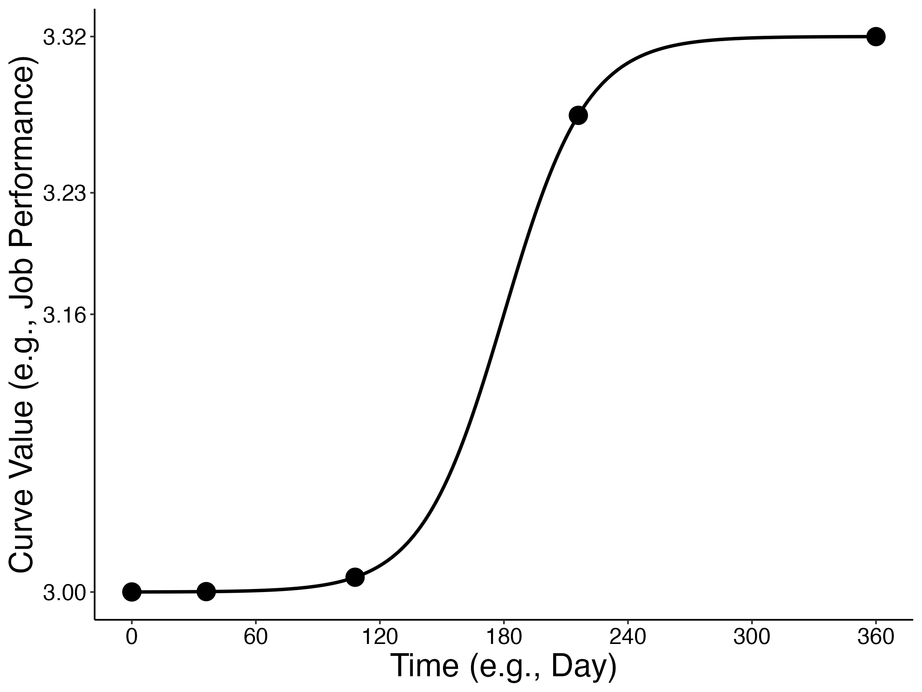
Independent variable III: Measurement spacing
Time-interval increasing spacing
Question 2: How to space measurements when the nature of change is unknown?

Slide 52

Independent variable III: Measurement spacing
Time-interval decreasing spacing
Question 2: How to space measurements when the nature of change is unknown?

Slide 53

Independent variable III: Measurement spacing
Middle-and-extreme spacing
Question 2: How to space measurements when the nature of change is unknown?

Slide 54
The Monte Carlo method
= model
= sample
$θ,α,β,γ$_{fixed + random,} $ε$ (known)
$θ,α,β,γ$_{fixed + random},$ε$ (estimated)
1. Population definition
IV 1: Nature of change ($β$_{fixed} = 80, 180, or 280)
2. Sample generation
IV 2: Number of measurements (5, 7, 9, or 11)
4. Model performance
IV 3: Spacing of measurements (equal, time-in., time-dec., middle-and-extreme)
m₁
m₂
m₃
m₄
m_{n}
3. Modelling
s₁
s₂
s₃
s₄
s_{n}
s₁
s₂
s₃
s₄
s_{n}
Notes:
In the Monte Carlo method, we define a population mean and then generate samples according to this population.

Slide 55
Monte Carlo method: Modelling
Notes:
Structured latent-growth curve model

Slide 56
Monte Carlo method: Modelling
Structured latent growth curve model
Notes:
Structured latent-growth curve model

Slide 57
Monte Carlo method: Modelling
Structured latent growth curve model
= latent growth curve model
+
Taylor series approximations
Notes:
Structured latent-growth curve model

Slide 58

The Monte Carlo method
= model
= sample
$θ,α,β,γ$_{fixed + random,} $ε$ (known)
$θ,α,β,γ$_{fixed + random},$ε$ (estimated)
1. Population definition
IV 1: Nature of change ($β$_{fixed} = 80, 180, 280)
2. Sample generation
IV 2: Number of measurements (5, 7, 9, 11)
4. Model performance
IV 3: Spacing of measurements (equal, time-inc., time dec., mid-extreme)
m₁
m₂
m₃
m₄
m_{n}
3. Modelling
Structured latent growth model
s₁
s₂
s₃
s₄
s_{n}
s₁
s₂
s₃
s₄
s_{n}
Notes:
In the Monte Carlo method, we define a population mean and then generate samples according to this population.

Slide 59
The Monte Carlo method
= model
= sample
$θ,α,β,γ$_{fixed + random,} $ε$ (known)
$θ,α,β,γ$_{fixed + random},$ε$ (estimated)
1. Population definition
IV 1: Nature of change ($β$_{fixed} = 80, 180, 280)
2. Sample generation
IV 2: Number of measurements (5, 7, 9, 11)
4. Model performance
IV 3: Spacing of measurements (equal, time-inc., time dec., mid-extreme)
m₁
m₂
m₃
m₄
m_{n}
3. Modelling
Structured latent growth model
s₁
s₂
s₃
s₄
s_{n}
s₁
s₂
s₃
s₄
s_{n}
n = k = 1000
Notes:
Focus on cell size. In each cell, I generated 100 samples. Because each sample is effectively a study, then the estimates of each cell were calculated from 1000 studies, and were therefore, meta-analytic estiomates. Given the large cell size, I did not use significance testing because the comparison of any two groups would almost certaintly return sigifnica

Slide 60
Experiment 1
Question 1: Does placing measurements near periods of change increase model performance?
Question 2: How to space measurements when the nature of change is unknown?
Notes:
Therefore, in each cell, 1000 samples are generated and 1000 models are applied. In other words, for each cell, 1000 studies are ‘conducted’ and 1000 models are applied. Thus, 1000 studies contribute to the parameter estimates of each cell in my simulation experiment, and so the estimates of each cell are effectively a meta-analysis. Therefore, significance testing was not conducted in this simulation experiment or anyof my other simulation experiments.

Slide 61
Experiment 1
Question 1: Does placing measurements near periods of change increase model performance?
Question 2: How to space measurements when the nature of change is unknown?
Notes:
Therefore, in each cell, 1000 samples are generated and 1000 models are applied. In other words, for each cell, 1000 studies are ‘conducted’ and 1000 models are applied. Thus, 1000 studies contribute to the parameter estimates of each cell in my simulation experiment, and so the estimates of each cell are effectively a meta-analysis. Therefore, significance testing was not conducted in this simulation experiment or anyof my other simulation experiments.

Slide 62

Experiment 1
Question 1: Does placing measurements near periods of change increase model performance?
Question 2: How to space measurements when the nature of change is unknown?
IV 3: Spacing of measurements (equal, time-inc., time dec., mid-extreme)
IV 1: Nature of change ($β$_{fixed} = 80, 180, 280)
IV 2: Number of measurements (5, 7, 9, 11)
Notes:
Therefore, in each cell, 1000 samples are generated and 1000 models are applied. In other words, for each cell, 1000 studies are ‘conducted’ and 1000 models are applied. Thus, 1000 studies contribute to the parameter estimates of each cell in my simulation experiment, and so the estimates of each cell are effectively a meta-analysis. Therefore, significance testing was not conducted in this simulation experiment or anyof my other simulation experiments.

Slide 63
Experiment 1
Question 1: Does placing measurements near periods of change increase model performance?
Question 2: How to space measurements when the nature of change is unknown?
IV 3: Spacing of measurements (equal, time-inc., time dec., mid-extreme)
IV 1: Nature of change ($β$_{fixed} = 80, 180, 280)
IV 2: Number of measurements (5, 7, 9, 11)
3
x
4
x
4
= 48 cells
Notes:
Therefore, in each cell, 1000 samples are generated and 1000 models are applied. In other words, for each cell, 1000 studies are ‘conducted’ and 1000 models are applied. Thus, 1000 studies contribute to the parameter estimates of each cell in my simulation experiment, and so the estimates of each cell are effectively a meta-analysis. Therefore, significance testing was not conducted in this simulation experiment or anyof my other simulation experiments.

Slide 64
Experiment 1
Question 1: Does placing measurements near periods of change increase model performance?
Question 2: How to space measurements when the nature of change is unknown?
IV 3: Spacing of measurements (equal, time-inc., time dec., mid-extreme)
IV 1: Nature of change ($β$_{fixed} = 80, 180, 280)
IV 2: Number of measurements (5, 7, 9, 11)
3
x
4
x
4
= 48 cells
1 cell
Notes:
Therefore, in each cell, 1000 samples are generated and 1000 models are applied. In other words, for each cell, 1000 studies are ‘conducted’ and 1000 models are applied. Thus, 1000 studies contribute to the parameter estimates of each cell in my simulation experiment, and so the estimates of each cell are effectively a meta-analysis. Therefore, significance testing was not conducted in this simulation experiment or anyof my other simulation experiments.

Slide 65

Experiment 1
Question 1: Does placing measurements near periods of change increase model performance?
Question 2: How to space measurements when the nature of change is unknown?
IV 3: Spacing of measurements (equal, time-inc., time dec., mid-extreme)
IV 1: Nature of change ($β$_{fixed} = 80, 180, 280)
IV 2: Number of measurements (5, 7, 9, 11)
3
x
4
x
4
= 48 cells
Nature of change ($β$_{fixed}) = 180
Number of measurements (NM) = 5
Spacing = time-interval increasing
1 cell
Notes:
Therefore, in each cell, 1000 samples are generated and 1000 models are applied. In other words, for each cell, 1000 studies are ‘conducted’ and 1000 models are applied. Thus, 1000 studies contribute to the parameter estimates of each cell in my simulation experiment, and so the estimates of each cell are effectively a meta-analysis. Therefore, significance testing was not conducted in this simulation experiment or anyof my other simulation experiments.

Slide 66

Experiment 1
Question 1: Does placing measurements near periods of change increase model performance?
Question 2: How to space measurements when the nature of change is unknown?
IV 3: Spacing of measurements (equal, time-inc., time dec., mid-extreme)
IV 1: Nature of change ($β$_{fixed} = 80, 180, 280)
IV 2: Number of measurements (5, 7, 9, 11)
3
x
4
x
4
= 48 cells
Nature of change ($β$_{fixed}) = 180
Number of measurements (NM) = 5
Spacing = time-interval increasing
Fixed-Effect Triquarter-Halfway Delta Parameter ($γ$_{fixed})
1 cell
Notes:
Therefore, in each cell, 1000 samples are generated and 1000 models are applied. In other words, for each cell, 1000 studies are ‘conducted’ and 1000 models are applied. Thus, 1000 studies contribute to the parameter estimates of each cell in my simulation experiment, and so the estimates of each cell are effectively a meta-analysis. Therefore, significance testing was not conducted in this simulation experiment or anyof my other simulation experiments.

Slide 67
Experiment 1
Question 1: Does placing measurements near periods of change increase model performance?
Question 2: How to space measurements when the nature of change is unknown?
IV 3: Spacing of measurements (equal, time-inc., time dec., mid-extreme)
IV 1: Nature of change ($β$_{fixed} = 80, 180, 280)
IV 2: Number of measurements (5, 7, 9, 11)
3
x
4
x
4
= 48 cells
Nature of change ($β$_{fixed}) = 180
Number of measurements (NM) = 5
Spacing = time-interval increasing
Fixed-Effect Triquarter-Halfway Delta Parameter ($γ$_{fixed})
1 cell
n = k = 1000
m₁
m₂
m₃
m₄
m_{n}
Notes:
Therefore, in each cell, 1000 samples are generated and 1000 models are applied. In other words, for each cell, 1000 studies are ‘conducted’ and 1000 models are applied. Thus, 1000 studies contribute to the parameter estimates of each cell in my simulation experiment, and so the estimates of each cell are effectively a meta-analysis. Therefore, significance testing was not conducted in this simulation experiment or anyof my other simulation experiments.

Slide 68

Monte Carlo method: Model performance
Values Estimated for Fixed-Effect Triquarter-Halfway Parameter ($γ\text{fixed} ;β$_{fixed} = 180.00, NM = 5, Spacing = Time-Interval Increasing)
m₁
m₂
m₃
m₄
m_{n}
n = 1000
Notes:
To assess model performance, two metrics were used. To understand why these metrics were used, it is important to remember that, in each cell, one thousand samples were generated and, thus, 1000 models were created to provide 1000 parameter estimates. Thus, in cell for each parameter, there is a distribution of values.

Slide 69



Monte Carlo method: Model performance
Values Estimated for Fixed-Effect Triquarter-Halfway Parameter ($γ\text{fixed} ;β$_{fixed} = 180.00, NM = 5, Spacing = Time-Interval Increasing)
m₁
m₂
m₃
m₄
m_{n}
n = 1000
Notes:
To assess model performance, two metrics were used. To understand why these metrics were used, it is important to remember that, in each cell, one thousand samples were generated and, thus, 1000 models were created to provide 1000 parameter estimates. Thus, in cell for each parameter, there is a distribution of values.

Slide 70

Monte Carlo method: Model performance
Values Estimated for Fixed-Effect Triquarter-Halfway Parameter ($γ\text{fixed} ;β$_{fixed} = 180.00, NM = 5, Spacing = Time-Interval Increasing)
m₁
m₂
m₃
m₄
m_{n}
n = 1000
Notes:
To assess model performance, two metrics were used. To understand why these metrics were used, it is important to remember that, in each cell, one thousand samples were generated and, thus, 1000 models were created to provide 1000 parameter estimates. Thus, in cell for each parameter, there is a distribution of values.

Slide 71

Monte Carlo method: Model performance
Values Estimated for Fixed-Effect Triquarter-Halfway Parameter ($γ\text{fixed} ;β$_{fixed} = 180.00, NM = 5, Spacing = Time-Interval Increasing)
m₁
m₂
m₃
m₄
m_{n}
n = 1000
Notes:
To assess model performance, two metrics were used. To understand why these metrics were used, it is important to remember that, in each cell, one thousand samples were generated and, thus, 1000 models were created to provide 1000 parameter estimates. Thus, in cell for each parameter, there is a distribution of values.

Slide 72

Monte Carlo method: Model performance
Values Estimated for Fixed-Effect Triquarter-Halfway Parameter ($γ\text{fixed} ;β$_{fixed} = 180.00, NM = 5, Spacing = Time-Interval Increasing)
Bias: difference between average estimated value and population value
m₁
m₂
m₃
m₄
m_{n}
n = 1000
Notes:
To assess model performance, two metrics were used. To understand why these metrics were used, it is important to remember that, in each cell, one thousand samples were generated and, thus, 1000 models were created to provide 1000 parameter estimates. Thus, in cell for each parameter, there is a distribution of values.

Slide 73

Monte Carlo method: Model performance
Values Estimated for Fixed-Effect Triquarter-Halfway Parameter ($γ\text{fixed} ;β$_{fixed} = 180.00, NM = 5, Spacing = Time-Interval Increasing)
Bias: difference between average estimated value and population value
Estimates were biased if bias > 10% of population value
m₁
m₂
m₃
m₄
m_{n}
n = 1000
Notes:
To assess model performance, two metrics were used. To understand why these metrics were used, it is important to remember that, in each cell, one thousand samples were generated and, thus, 1000 models were created to provide 1000 parameter estimates. Thus, in cell for each parameter, there is a distribution of values.

Slide 74

Monte Carlo method: Model performance
Values Estimated for Fixed-Effect Triquarter-Halfway Parameter ($γ\text{fixed} ;β$_{fixed} = 180.00, NM = 5, Spacing = Time-Interval Increasing)
Bias: difference between average estimated value and population value
Estimates were biased if bias > 10% of population value
m₁
m₂
m₃
m₄
m_{n}
n = 1000
Notes:
To assess model performance, two metrics were used. To understand why these metrics were used, it is important to remember that, in each cell, one thousand samples were generated and, thus, 1000 models were created to provide 1000 parameter estimates. Thus, in cell for each parameter, there is a distribution of values.

Slide 75
Monte Carlo method: Model performance
Values Estimated for Fixed-Effect Triquarter-Halfway Parameter ($γ\text{fixed} ;β$_{fixed} = 180.00, NM = 5, Spacing = Time-Interval Increasing)
Bias: difference between average estimated value and population value
Estimates were biased if bias > 10% of population value
m₁
m₂
m₃
m₄
m_{n}
n = 1000
Notes:
To assess model performance, two metrics were used. To understand why these metrics were used, it is important to remember that, in each cell, one thousand samples were generated and, thus, 1000 models were created to provide 1000 parameter estimates. Thus, in cell for each parameter, there is a distribution of values.

Slide 76
Monte Carlo method: Model performance
Values Estimated for Fixed-Effect Triquarter-Halfway Parameter ($γ\text{fixed} ;β$_{fixed} = 180.00, NM = 5, Spacing = Time-Interval Increasing)
Bias: difference between average estimated value and population value
Estimates were biased if bias > 10% of population value
Precision: range of values covered by the middle 95% of estimates
m₁
m₂
m₃
m₄
m_{n}
n = 1000
Notes:
To assess model performance, two metrics were used. To understand why these metrics were used, it is important to remember that, in each cell, one thousand samples were generated and, thus, 1000 models were created to provide 1000 parameter estimates. Thus, in cell for each parameter, there is a distribution of values.

Slide 77


Monte Carlo method: Model performance
Values Estimated for Fixed-Effect Triquarter-Halfway Parameter ($γ\text{fixed} ;β$_{fixed} = 180.00, NM = 5, Spacing = Time-Interval Increasing)
Bias: difference between average estimated value and population value
Estimates were biased if bias > 10% of population value
Precision: range of values covered by the middle 95% of estimates
m₁
m₂
m₃
m₄
m_{n}
n = 1000
Notes:
To assess model performance, two metrics were used. To understand why these metrics were used, it is important to remember that, in each cell, one thousand samples were generated and, thus, 1000 models were created to provide 1000 parameter estimates. Thus, in cell for each parameter, there is a distribution of values.

Slide 78

Monte Carlo method: Model performance
Values Estimated for Fixed-Effect Triquarter-Halfway Parameter ($γ\text{fixed} ;β$_{fixed} = 180.00, NM = 5, Spacing = Time-Interval Increasing)
Bias: difference between average estimated value and population value
Estimates were biased if bias > 10% of population value
Precision: range of values covered by the middle 95% of estimates
m₁
m₂
m₃
m₄
m_{n}
n = 1000
Notes:
To assess model performance, two metrics were used. To understand why these metrics were used, it is important to remember that, in each cell, one thousand samples were generated and, thus, 1000 models were created to provide 1000 parameter estimates. Thus, in cell for each parameter, there is a distribution of values.

Slide 79

Monte Carlo method: Model performance
Values Estimated for Fixed-Effect Triquarter-Halfway Parameter ($γ\text{fixed} ;β$_{fixed} = 180.00, NM = 5, Spacing = Time-Interval Increasing)
Bias: difference between average estimated value and population value
Estimates were biased if bias > 10% of population value
Precision: range of values covered by the middle 95% of estimates
Estimation was imprecise if a whisker length > 10% of population value
m₁
m₂
m₃
m₄
m_{n}
n = 1000
Notes:
To assess model performance, two metrics were used. To understand why these metrics were used, it is important to remember that, in each cell, one thousand samples were generated and, thus, 1000 models were created to provide 1000 parameter estimates. Thus, in cell for each parameter, there is a distribution of values.

Slide 80


Monte Carlo method: Model performance
Values Estimated for Fixed-Effect Triquarter-Halfway Delta Parameter ($γ\text{fixed} ;β$_{fixed} = 180.00, NM = 5, Spacing = Time-Interval Increasing)
Bias/Precision Plot for Fixed-Effect Triquarter-Halfway Delta Parameter
m₁
m₂
m₃
m₄
m_{n}
n = 1000
Notes:
To assess model performance, two metrics were used. To understand why these metrics were used, it is important to remember that, in each cell, one thousand samples were generated and, thus, 1000 models were created to provide 1000 parameter estimates. Thus, in cell for each parameter, there is a distribution of values.

Slide 81

Monte Carlo method: Model performance
Values Estimated for Fixed-Effect Triquarter-Halfway Delta Parameter ($γ\text{fixed} ;β$_{fixed} = 180.00, NM = 5, Spacing = Time-Interval Increasing)
Bias/Precision Plot for Fixed-Effect Triquarter-Halfway Delta Parameter
m₁
m₂
m₃
m₄
m_{n}
n = 1000
Notes:
To assess model performance, two metrics were used. To understand why these metrics were used, it is important to remember that, in each cell, one thousand samples were generated and, thus, 1000 models were created to provide 1000 parameter estimates. Thus, in cell for each parameter, there is a distribution of values.

Slide 82

Monte Carlo method: Model performance
Values Estimated for Fixed-Effect Triquarter-Halfway Delta Parameter ($γ\text{fixed} ;β$_{fixed} = 180.00, NM = 5, Spacing = Time-Interval Increasing)
Bias/Precision Plot for Fixed-Effect Triquarter-Halfway Delta Parameter
m₁
m₂
m₃
m₄
m_{n}
n = 1000
Notes:
To assess model performance, two metrics were used. To understand why these metrics were used, it is important to remember that, in each cell, one thousand samples were generated and, thus, 1000 models were created to provide 1000 parameter estimates. Thus, in cell for each parameter, there is a distribution of values.

Slide 83

Monte Carlo method: Model performance
Values Estimated for Fixed-Effect Triquarter-Halfway Delta Parameter ($γ\text{fixed} ;β$_{fixed} = 180.00, NM = 5, Spacing = Time-Interval Increasing)
Bias/Precision Plot for Fixed-Effect Triquarter-Halfway Delta Parameter
m₁
m₂
m₃
m₄
m_{n}
n = 1000
Notes:
To assess model performance, two metrics were used. To understand why these metrics were used, it is important to remember that, in each cell, one thousand samples were generated and, thus, 1000 models were created to provide 1000 parameter estimates. Thus, in cell for each parameter, there is a distribution of values.

Slide 84

Monte Carlo method: Model performance
Values Estimated for Fixed-Effect Triquarter-Halfway Delta Parameter ($γ\text{fixed} ;β$_{fixed} = 180.00, NM = 5, Spacing = Time-Interval Increasing)
Bias/Precision Plot for Fixed-Effect Triquarter-Halfway Delta Parameter
m₁
m₂
m₃
m₄
m_{n}
n = 1000
Notes:
To assess model performance, two metrics were used. To understand why these metrics were used, it is important to remember that, in each cell, one thousand samples were generated and, thus, 1000 models were created to provide 1000 parameter estimates. Thus, in cell for each parameter, there is a distribution of values.

Slide 85

Monte Carlo method: Model performance
Values Estimated for Fixed-Effect Triquarter-Halfway Delta Parameter ($γ\text{fixed} ;β$_{fixed} = 180.00, NM = 5, Spacing = Time-Interval Increasing)
Bias/Precision Plot for Fixed-Effect Triquarter-Halfway Delta Parameter
m₁
m₂
m₃
m₄
m_{n}
n = 1000
Notes:
To assess model performance, two metrics were used. To understand why these metrics were used, it is important to remember that, in each cell, one thousand samples were generated and, thus, 1000 models were created to provide 1000 parameter estimates. Thus, in cell for each parameter, there is a distribution of values.

Slide 86


Monte Carlo method: Model performance
Values Estimated for Fixed-Effect Triquarter-Halfway Delta Parameter ($γ\text{fixed} ;β$_{fixed} = 180.00, NM = 5, Spacing = Time-Interval Increasing)
Bias/Precision Plot for Fixed-Effect Triquarter-Halfway Delta Parameter
m₁
m₂
m₃
m₄
m_{n}
n = 1000
Notes:
To assess model performance, two metrics were used. To understand why these metrics were used, it is important to remember that, in each cell, one thousand samples were generated and, thus, 1000 models were created to provide 1000 parameter estimates. Thus, in cell for each parameter, there is a distribution of values.

Slide 87
Monte Carlo method: Model performance
Values Estimated for Fixed-Effect Triquarter-Halfway Delta Parameter ($γ\text{fixed} ;β$_{fixed} = 180.00, NM = 5, Spacing = Time-Interval Increasing)
Bias/Precision Plot for Fixed-Effect Triquarter-Halfway Delta Parameter for Time-Interval Increasing Spacing
m₁
m₂
m₃
m₄
m_{n}
n = 1000
Notes:
To assess model performance, two metrics were used. To understand why these metrics were used, it is important to remember that, in each cell, one thousand samples were generated and, thus, 1000 models were created to provide 1000 parameter estimates. Thus, in cell for each parameter, there is a distribution of values.

Slide 88


Slide 89
Experiment 1 design (Monte Carlo method)
= model
= sample
$θ,α,β,γ$_{fixed + random,} $ε$ (known)
$θ,α,β,γ$_{fixed + random},$ε$ (estimated)
1. Population definition
IV 1: Nature of change ($β$_{fixed} = 80, 180, 280)
2. Sample generation
IV 2: Number of measurements (5, 7, 9, 11)
4. Model performance
Bias + precision
IV 3: Spacing of measurements (equal, time-inc., time dec., mid-extreme)
m₁
m₂
m₃
m₄
m_{n}
3. Modelling
Structured latent growth model
s₁
s₂
s₃
s₄
s_{n}
s₁
s₂
s₃
s₄
s_{n}
n = k = 1000
Notes:
In the Monte Carlo method, we define a population mean and then generate samples according to this population.

Slide 90
Question 1: Does placing measurements near periods of change increase model performance?
Notes:
To answer question 1, I will look at the bias/precision plots within each spacing schedule and determine which nature of change results in the highest model performance. Importantly, because differences in bias across the experimental cells ere negligible, I only looked at precision to answer this question. As an example, let’s consider the bias/precision plot for the days-to-halfway elevation parameter for time-interval increasing spacing. In looking at this bias/precision plot, we can see that model performance is highest when the nature of change is 80.

Slide 91
Question 1: Does placing measurements near periods of change increase model performance?
Answer 1: Model performance increases when measurements are placed near periods of change
Notes:
To answer question 1, I will look at the bias/precision plots within each spacing schedule and determine which nature of change results in the highest model performance. Importantly, because differences in bias across the experimental cells ere negligible, I only looked at precision to answer this question. As an example, let’s consider the bias/precision plot for the days-to-halfway elevation parameter for time-interval increasing spacing. In looking at this bias/precision plot, we can see that model performance is highest when the nature of change is 80.

Slide 92





Answer 1: Model performance increases when measurements are placed near periods of change
Notes:
Moreover, we can see this is the case for all the other parameters. Again, note that I am only showing results for day-unit parameters because the results for the Likert-unit parameters were trivial.

Slide 93

Answer 1: Model performance increases when measurements are placed near periods of change
Time-interval increasing spacing
Notes:
To answer question 1, I will look at the bias/precision plots within each spacing schedule and determine which nature of change results in the highest model performance. Importantly, because differences in bias across the experimental cells ere negligible, I only looked at precision to answer this question. As an example, let’s consider the bias/precision plot for the days-to-halfway elevation parameter for time-interval increasing spacing. In looking at this bias/precision plot, we can see that model performance is highest when the nature of change is 80.

Slide 94
Answer 1: Model performance increases when measurements are placed near periods of change
Time-interval increasing spacing
Notes:
To answer question 1, I will look at the bias/precision plots within each spacing schedule and determine which nature of change results in the highest model performance. Importantly, because differences in bias across the experimental cells ere negligible, I only looked at precision to answer this question. As an example, let’s consider the bias/precision plot for the days-to-halfway elevation parameter for time-interval increasing spacing. In looking at this bias/precision plot, we can see that model performance is highest when the nature of change is 80.

Slide 95
Answer 1: Model performance increases when measurements are placed near periods of change
Time-interval increasing spacing
Notes:
Moreover, we can see this is the case for all the other parameters. Again, note that I am only showing results for day-unit parameters because the results for the Likert-unit parameters were trivial.

Slide 96
Answer 1: Model performance increases when measurements are placed near periods of change
Notes:
Moreover, we can see this is the case for all the other parameters. Again, note that I am only showing results for day-unit parameters because the results for the Likert-unit parameters were trivial.

Slide 97
Question 1: Does placing measurements near periods of change increase model performance?
Answer 1: Model performance increases when measurements are placed near periods of change
Question 2: How to space measurements when the nature of change is unknown?
Notes:
To answer question 1, I will look at the bias/precision plots within each spacing schedule and determine which nature of change results in the highest model performance. Importantly, because differences in bias across the experimental cells ere negligible, I only looked at precision to answer this question. As an example, let’s consider the bias/precision plot for the days-to-halfway elevation parameter for time-interval increasing spacing. In looking at this bias/precision plot, we can see that model performance is highest when the nature of change is 80.

Slide 98
Question 1: Does placing measurements near periods of change increase model performance?
Answer 1: Model performance increases when measurements are placed near periods of change
Question 2: How to space measurements when the nature of change is unknown?
Answer 2: When the nature of change is unknown, model performance is highest with equal spacing
Notes:
To answer question 1, I will look at the bias/precision plots within each spacing schedule and determine which nature of change results in the highest model performance. Importantly, because differences in bias across the experimental cells ere negligible, I only looked at precision to answer this question. As an example, let’s consider the bias/precision plot for the days-to-halfway elevation parameter for time-interval increasing spacing. In looking at this bias/precision plot, we can see that model performance is highest when the nature of change is 80.

Slide 99

Answer 2: When the nature of change is unknown, model performance is highest with equal spacing
Notes:
To answer my second question, I examined model performance under each spacing schedule across all nature-of-change values. Specifically, I used the bias/precision plots to determine the number of measurements needed to obtain the greatest improvements in model performance. when the greatest improvements in model performance

Slide 100
Answer 2: When the nature of change is unknown, model performance is highest with equal spacing
Notes:
To answer my second question, I examined model performance under each spacing schedule across all nature-of-change values. Specifically, I used the bias/precision plots to determine the number of measurements needed to obtain the greatest improvements in model performance. when the greatest improvements in model performance

Slide 101
Answer 2: When the nature of change is unknown, model performance is highest with equal spacing
Notes:
To answer my second question, I examined model performance under each spacing schedule across all nature-of-change values. Specifically, I used the bias/precision plots to determine the number of measurements needed to obtain the greatest improvements in model performance. when the greatest improvements in model performance

Slide 102
Answer 2: When the nature of change is unknown, model performance is highest with equal spacing
Notes:
To answer my second question, I examined model performance under each spacing schedule across all nature-of-change values. Specifically, I used the bias/precision plots to determine the number of measurements needed to obtain the greatest improvements in model performance. when the greatest improvements in model performance

Slide 103
Answer 2: When the nature of change is unknown, model performance is highest with equal spacing
Notes:
To answer my second question, I examined model performance under each spacing schedule across all nature-of-change values. Specifically, I used the bias/precision plots to determine the number of measurements needed to obtain the greatest improvements in model performance. when the greatest improvements in model performance

Slide 104
Answer 2: When the nature of change is unknown, model performance is highest with equal spacing
Notes:
To answer my second question, I examined model performance under each spacing schedule across all nature-of-change values. Specifically, I used the bias/precision plots to determine the number of measurements needed to obtain the greatest improvements in model performance. when the greatest improvements in model performance

Slide 105
Answer 2: When the nature of change is unknown, model performance is highest with equal spacing
Notes:
To answer my second question, I examined model performance under each spacing schedule across all nature-of-change values. Specifically, I used the bias/precision plots to determine the number of measurements needed to obtain the greatest improvements in model performance. when the greatest improvements in model performance

Slide 106
Answer 2: When the nature of change is unknown, model performance is highest with equal spacing
Notes:
To answer my second question, I examined model performance under each spacing schedule across all nature-of-change values. Specifically, I used the bias/precision plots to determine the number of measurements needed to obtain the greatest improvements in model performance. when the greatest improvements in model performance

Slide 107
Question 1: Does placing measurements near periods of change increase model performance?
Answer 1: Model performance increases when measurements are placed near periods of change
Question 2: How to space measurements when the nature of change is unknown?
Answer 2: When the nature of change is unknown, model performance is highest with equal spacing
Notes:
To answer question 1, I will look at the bias/precision plots within each spacing schedule and determine which nature of change results in the highest model performance. Importantly, because differences in bias across the experimental cells ere negligible, I only looked at precision to answer this question. As an example, let’s consider the bias/precision plot for the days-to-halfway elevation parameter for time-interval increasing spacing. In looking at this bias/precision plot, we can see that model performance is highest when the nature of change is 80.

Slide 108
Experiment 2
Question: For each spacing schedule, what combination of measurement number and sample size is needed to obtain high model performance (i.e., low bias, high precision)?

Slide 109
Experiment 2 – Systematic Review
Number of measurements
Spacing of measurements
Notes:
To understand the purpose of Experiment 2, it is important to consider the challenges involved in modelling nonlinear patterns of change. As previously discussed, researchers have to decide how many measurements to take and how to space measurements.

Slide 110
Experiment 2 – Systematic Review
Number of measurements
Spacing of measurements
Sample size
Notes:
Another challenge involved in modelling nonlinear patterns of change is to determine what sample size to use.

Slide 111
Experiment 2 – Systematic Review
Number of measurements
Spacing of measurements
Few guidelines
Sample size
Notes:
One concerning result is the lack of guidelines that exist to help researchers answer these questions.

Slide 112

Notes:
In a systematic review I conducted of the simulation literature, I investigated, among other variables, whether any study investigated how the number of measurements, spacing of measurements, and sample size affected model performance.

Slide 113
Notes:
In a systematic review I conducted of the simulation literature, I investigated, among other variables, whether any study investigated how the number of measurements, spacing of measurements, and sample size affected model performance.

Slide 114
Notes:
In a systematic review I conducted of the simulation literature, I investigated, among other variables, whether any study investigated how the number of measurements, spacing of measurements, and sample size affected model performance.

Slide 115
Notes:
In a systematic review I conducted of the simulation literature, I investigated, among other variables, whether any study investigated how the number of measurements, spacing of measurements, and sample size affected model performance.

Slide 116
Experiment 2 design (Monte Carlo method)
= model
= sample
$θ,α,β,γ$_{fixed + random,} $ε$ (known)
$θ,α,β,γ$_{fixed + random},$ε$ (estimated)
1. Population definition
2. Sample generation
IV 1: Number of measurements (5, 7, 9, 11)
4. Model performance
IV 2: Spacing of measurements (equal, time-inc., time dec., middle-extreme)
Bias + precision
m₁
m₂
m₃
m₄
m_{n}
IV 3: Sample size (N = 30, 50, 100, 200, 500, 1000)
3. Modelling
Structured latent growth model
s₁
s₂
s₃
s₄
s_{n}
s₁
s₂
s₃
s₄
s_{n}
n = k = 1000
Notes:
In the Monte Carlo method, we define a population mean and then generate samples according to this population.

Slide 117
Experiment 2
Question: For each spacing schedule, what combination of measurement number and sample size is needed to obtain high model performance (i.e., low bias, high precision)?

Slide 118

Experiment 2
Question: For each spacing schedule, what combination of measurement number and sample size is needed to obtain high model performance (i.e., low bias, high precision)?
Answer: The greatest improvements in model performance for each spacing schedule result from either seven measurements with N $≥$ 200 or nine measurements with N $≤$100.

Slide 119


Answer: The greatest improvements in model performance for each spacing schedule result from either seven measurements with N $≥$ 200 or nine measurements with N $≤$100.

Slide 120
Answer: The greatest improvements in model performance for each spacing schedule result from either seven measurements with N $≥$ 200 or nine measurements with N $≤$100.

Slide 121
Answer: The greatest improvements in model performance for each spacing schedule result from either seven measurements with N $≥$ 200 or nine measurements with N $≤$100.

Slide 122
Answer: The greatest improvements in model performance for each spacing schedule result from either seven measurements with N $≥$ 200 or nine measurements with N $≤$100.

Slide 123
Answer: The greatest improvements in model performance for each spacing schedule result from either seven measurements with N $≥$ 200 or nine measurements with N $≤$100.

Slide 124
Answer: The greatest improvements in model performance for each spacing schedule result from either seven measurements with N $≥$ 200 or nine measurements with N $≤$100.

Slide 125
Answer: The greatest improvements in model performance for each spacing schedule result from either seven measurements with N $≥$ 200 or nine measurements with N $≤$100.

Slide 126
Answer: The greatest improvements in model performance for each spacing schedule result from either seven measurements with N $≥$ 200 or nine measurements with N $≤$100.

Slide 127
Experiment 3

Slide 128
Experiment 3
Question: Do the number of measurements and sample sizes needed to obtain high model performance (i.e., low bias, high precision) increase as time structuredness decreases?

Slide 129
Experiment 3
Question: Do the number of measurements and sample sizes needed to obtain high model performance (i.e., low bias, high precision) increase as time structuredness decreases?
1) What is time structuredness?
2) Why is time structuredness important?

Slide 130
Experiment 3
Question: Do the number of measurements and sample sizes needed to obtain high model performance (i.e., low bias, high precision) increase as time structuredness decreases?
1) What is time structuredness?
2) Why is time structuredness important?

Slide 131
Time structuredness: the extent to which the same response schedule characterizes how participants provide data over time

Slide 132


Time structuredness: the extent to which the same response schedule characterizes how participants provide data over time
Time-structured data (same response schedule)

Slide 133

Time structuredness: the extent to which the same response schedule characterizes how participants provide data over time
Time-structured data (same response schedule)

Slide 134

Time structuredness: the extent to which the same response schedule characterizes how participants provide data over time
Time-structured data (same response schedule)

Slide 135

Time structuredness: the extent to which the same response schedule characterizes how participants provide data over time
Time-structured data (same response schedule)

Slide 136

Time structuredness: the extent to which the same response schedule characterizes how participants provide data over time
Time-structured data (same response schedule)

Slide 137

Time structuredness: the extent to which the same response schedule characterizes how participants provide data over time
Time-structured data (same response schedule)

Slide 138
Time structuredness: the extent to which the same response schedule characterizes how participants provide data over time
Time-structured data (same response schedule)
Time-unstructured data

Slide 139

Time structuredness: the extent to which the same response schedule characterizes how participants provide data over time
Time-structured data (same response schedule)
Time-unstructured data (different response schedules)

Slide 140

Time structuredness: the extent to which the same response schedule characterizes how participants provide data over time
Time-structured data (same response schedule)
Time-unstructured data (different response schedules)

Slide 141

Time structuredness: the extent to which the same response schedule characterizes how participants provide data over time
Time-structured data (same response schedule)
Time-unstructured data (different response schedules)

Slide 142

Time structuredness: the extent to which the same response schedule characterizes how participants provide data over time
Time-structured data (same response schedule)
Time-unstructured data (different response schedules)

Slide 143

Time structuredness: the extent to which the same response schedule characterizes how participants provide data over time
Time-structured data (same response schedule)
Time-unstructured data (different response schedules)

Slide 144
Experiment 3
Question: Do the number of measurements and sample sizes needed to obtain high model performance (i.e., low bias, high precision) increase as time structuredness decreases?
1) What is time structuredness?
The extent to which the same response schedule characterizes how participants provide data over time
2) Why is time structuredness important?

Slide 145

Notes:
When data are time-unstructured, however, the model will force the curve to shift leftwards. Given that this is a systematic shift on each individual curve, the systematic increase in bias that occurs in the estimation of the parameters is to be expected.

Slide 146


Notes:
When data are time-unstructured, however, the model will force the curve to shift leftwards. Given that this is a systematic shift on each individual curve, the systematic increase in bias that occurs in the estimation of the parameters is to be expected.

Slide 147

By assuming one response pattern (i.e., time-structured data), individual curves are shifted to fit this response pattern and result in considerable error
Notes:
When data are time-unstructured, however, the model will force the curve to shift leftwards. Given that this is a systematic shift on each individual curve, the systematic increase in bias that occurs in the estimation of the parameters is to be expected.

Slide 148
Experiment 3
Question: Do the number of measurements and sample sizes needed to obtain high model performance (i.e., low bias, high precision) increase as time structuredness decreases?
1) What is time structuredness?
The extent to which the same response schedule characterizes how participants provide data over time
2) Why is time structuredness important?
Considerable error can be incurred if a model assuming time-structured data is used to analyse time-unstructured data

Slide 149
Experiment 3 – Systematic Review
Number of measurements
Spacing of measurements
Few guidelines
Sample size
Time structuredness
Notes:
One concerning result is the lack of guidelines that exist to help researchers answer these questions.

Slide 150
Notes:
In a systematic review I conducted of the simulation literature, I investigated, among other variables, whether any study investigated how the number of measurements, spacing of measurements, and sample size affected model performance.

Slide 151
Notes:
In a systematic review I conducted of the simulation literature, I investigated, among other variables, whether any study investigated how the number of measurements, spacing of measurements, and sample size affected model performance.

Slide 152
Notes:
Additionally, no study examined the three-way interaction. Therefore, I also examined this effect.

Slide 153
Notes:
Additionally, no study examined the three-way interaction. Therefore, I also examined this effect.

Slide 154
Experiment 3 design (Monte Carlo method)
= model
= sample
$θ,α,β,γ$_{fixed + random,} $ε$ (known)
$θ,α,β,γ$_{fixed + random},$ε$ (estimated)
1. Population definition
2. Sample generation
IV 1: Number of measurements (5, 7, 9, 11)
IV 2: Spacing of measurements (equal, time-inc., time dec., mid-extreme)
4. Model performance
Bias + precision
IV 3: Time structuredness
m₁
m₂
m₃
m₄
m_{n}
3. Modelling
n = 1000
Structured latent growth model
s₁
s₂
s₃
s₄
s_{n}
s₁
s₂
s₃
s₄
s_{n}
Notes:
In the Monte Carlo method, we define a population mean and then generate samples according to this population.

Slide 155

Time-structured data
(High time structuredness)
Momentary response window (immediate response rate)
High
Time structuredness
Low
Short
Response window length
Long
Fast
Response rate
Slow

Slide 156

Time-structured data
(High time structuredness)
Medium time structuredness
Momentary response window (immediate response rate)
Short response window (fast response rate)
High
Time structuredness
Low
Short
Response window length
Long
Fast
Response rate
Slow

Slide 157

Time-structured data
(High time structuredness)
Medium time structuredness
Low time structuredness
Momentary response window (immediate response rate)
Short response window (fast response rate)
Long response window (slow response rate)
High
Time structuredness
Low
Short
Response window length
Long
Fast
Response rate
Slow

Slide 158
Experiment 3 design (Monte Carlo method)
= model
= sample
$θ,α,β,γ$_{fixed + random,} $ε$ (known)
$θ,α,β,γ$_{fixed + random},$ε$ (estimated)
1. Population definition
2. Sample generation
IV 1: Number of measurements (5, 7, 9, 11)
IV 2: Spacing of measurements (equal, time-inc., time dec., mid-extreme)
4. Model performance
Bias + precision
IV 3: Time structuredness (time structured, fast response rate, slow response rate
m₁
m₂
m₃
m₄
m_{n}
3. Modelling
n = 1000
Structured latent growth model
s₁
s₂
s₃
s₄
s_{n}
s₁
s₂
s₃
s₄
s_{n}
Notes:
In the Monte Carlo method, we define a population mean and then generate samples according to this population.

Slide 159
Experiment 3
Question: Do the number of measurements and sample sizes needed to obtain high model performance (i.e., low bias, high precision) increase as time structuredness decreases?

Slide 160
Experiment 3
Question: Do the number of measurements and sample sizes needed to obtain high model performance (i.e., low bias, high precision) increase as time structuredness decreases?
Answer: Bias systematically increases as time structuredness decreases

Slide 161


Answer: Bias systematically increases as time structuredness decreases
High
Time structuredness
Low
Fast
Response rate
Slow
Time structured data
(immediate response rate)
Sample Size (N)

Slide 162

Answer: Bias systematically increases as time structuredness decreases
High
Time structuredness
Low
Fast
Response rate
Slow
Time structured data
(immediate response rate)
Fast response rate
Sample Size (N)

Slide 163

Answer: Bias systematically increases as time structuredness decreases
High
Time structuredness
Low
Fast
Response rate
Slow
Time structured data
(immediate response rate)
Fast response rate
Slow response rate
Sample Size (N)

Slide 164



Answer: Bias systematically increases as time structuredness decreases
High
Time structuredness
Low
Fast
Response rate
Slow
Time structured data
(immediate response rate)
Fast response rate
Slow response rate
Sample Size (N)

Slide 165



Answer: Bias systematically increases as time structuredness decreases
High
Time structuredness
Low
Fast
Response rate
Slow
Time structured data
(immediate response rate)
Fast response rate
Slow response rate
Sample Size (N)

Slide 166
By assuming one response pattern, all individual curves are shifted to fit this response pattern
Notes:
When data are time-unstructured, however, the model will force the curve to shift leftwards. Given that this is a systematic shift on each individual curve, the systematic increase in bias that occurs in the estimation of the parameters is to be expected.

Slide 167
By assuming one response pattern, all individual curves are shifted to fit this response pattern
Notes:
When data are time-unstructured, however, the model will force the curve to shift leftwards. Given that this is a systematic shift on each individual curve, the systematic increase in bias that occurs in the estimation of the parameters is to be expected.

Slide 168
By assuming one response pattern, all individual curves are shifted to fit this response pattern
Notes:
When data are time-unstructured, however, the model will force the curve to shift leftwards. Given that this is a systematic shift on each individual curve, the systematic increase in bias that occurs in the estimation of the parameters is to be expected.

Slide 169
Experiment 3 design (Monte Carlo method)
= model
= sample
$θ,α,β,γ$_{fixed + random,} $ε$ (known)
$θ,α,β,γ$_{fixed + random},$ε$ (estimated)
1. Population definition
2. Sample generation
IV 1: Number of measurements (5, 7, 9, 11)
IV 2: Spacing of measurements (equal, time-inc., time dec., mid-extreme)
4. Model performance
Bias + precision
IV 3: Time structuredness (time structured, fast response rate, slow response rate
m₁
m₂
m₃
m₄
m_{n}
3. Modelling
n = 1000
Structured latent growth model
s₁
s₂
s₃
s₄
s_{n}
s₁
s₂
s₃
s₄
s_{n}
Notes:
In the Monte Carlo method, we define a population mean and then generate samples according to this population.

Slide 170
Experiment 3 design (Monte Carlo method)
= model
= sample
$θ,α,β,γ$_{fixed + random,} $ε$ (known)
$θ,α,β,γ$_{fixed + random},$ε$ (estimated)
1. Population definition
2. Sample generation
IV 1: Number of measurements (5, 7, 9, 11)
IV 2: Spacing of measurements (equal, time-inc., time dec., mid-extreme)
4. Model performance
Bias + precision
m₁
m₂
m₃
m₄
m_{n}
Constant: slow response rate
3. Modelling
n = 1000
Structured latent growth model + definition variables
s₁
s₂
s₃
s₄
s_{n}
s₁
s₂
s₃
s₄
s_{n}
Notes:
In the Monte Carlo method, we define a population mean and then generate samples according to this population.

Slide 171
Definition variables can be used to prevent low time structurednesss from inflating bias
High
Time structuredness
Low
Fast
Response rate
Slow
Time structured data
(immediate response rate)
Fast response rate
Slow response rate
Sample Size (N)

Slide 172

Definition variables can be used to prevent low time structurednesss from inflating bias
High
Time structuredness
Low
Fast
Response rate
Slow
Time structured data
(immediate response rate)
Slow response rate + definition variables
Fast response rate
Sample Size (N)

Slide 173
Definition variables can be used to prevent low time structurednesss from inflating bias
High
Time structuredness
Low
Fast
Response rate
Slow
Time structured data
(immediate response rate)
Fast response rate
Slow response rate
Sample Size (N)

Slide 174

Definition variables can be used to prevent low time structurednesss from inflating bias
High
Time structuredness
Low
Fast
Response rate
Slow
Time structured data
(immediate response rate)
Slow response rate + definition variables
Fast response rate
Sample Size (N)

Slide 175
Definition variables can be used to prevent low time structurednesss from inflating bias
High
Time structuredness
Low
Fast
Response rate
Slow
Time structured data
(immediate response rate)
Fast response rate
Slow response rate
Sample Size (N)

Slide 176

Definition variables can be used to prevent low time structurednesss from inflating bias
High
Time structuredness
Low
Fast
Response rate
Slow
Time structured data
(immediate response rate)
Slow response rate + definition variables
Fast response rate
Sample Size (N)

Slide 177
Experiment 3
Question: Do the number of measurements and sample sizes needed to obtain high model performance (i.e., low bias, high precision) increase as time structuredness decreases?

Slide 178
Experiment 3
Question: Do the number of measurements and sample sizes needed to obtain high model performance (i.e., low bias, high precision) increase as time structuredness decreases?
Answer: Bias systematically increases as time structuredness decreases

Slide 179
Experiment 3
Question: Do the number of measurements and sample sizes needed to obtain high model performance (i.e., low bias, high precision) increase as time structuredness decreases?
Answer: Bias systematically increases as time structuredness decreases
Definition variables can be used to prevent low time structuredness from increasing in bias.

Slide 180

Experiment 3
Question: Do the number of measurements and sample sizes needed to obtain high model performance (i.e., low bias, high precision) increase as time structuredness decreases?
Answer: Bias systematically increases as time structuredness decreases
Definition variables can be used to prevent low time structuredness from increasing in bias.
If using definition variable, the largest improvements in model performance result from using either seven measurements with N $≥$ 200 or nine measurements with N $≤$100.

Slide 181
Experiment 1
Model performance increases when measurements are placed near periods of change
When the nature of change is unknown, model performance is highest with equal spacing

Slide 182
Experiment 1
Model performance increases when measurements are placed near periods of change
When the nature of change is unknown, model performance is highest with equal spacing
Experiment 2
The greatest improvements in model performance result from either seven measurements with N $≥$ 200 or nine measurements with N $≤$100.

Slide 183

Experiment 1
Model performance increases when measurements are placed near periods of change
When the nature of change is unknown, model performance is highest with equal spacing
Experiment 2
The greatest improvements in model performance result from either seven measurements with N $≥$ 200 or nine measurements with N $≤$100.
Experiment 3
If using definition variables, the largest improvements in model performance result from using either seven measurements with N $≥$ 200 or nine measurements with N $≤$100.

Slide 184
The results of my experiments are the first (to my knowledge) to provide recommendations for modelling nonlinear change

Slide 185
The results of my experiments are the first (to my knowledge) to provide recommendations for modelling nonlinear change
Number of measurements
Spacing of measurements
Few guidelines
Sample size
Time structuredness

Slide 186
Limitations & future directions
1) Cutoff values
2) External validity

Slide 187
Limitations & future directions
1) Cutoff values
2) External validity

Slide 188
I used a percentage-based cutoff rule in my experiments
Bias: difference between average estimated value and population value
Estimates were biased if bias > 10% of population value
Precision: range of values covered by the middle 95% of estimates
Estimation was imprecise if a whisker length > 10% of population value
m₁
m₂
m₃
m₄
m_{n}
n = 1000

Slide 189
Percentage-based cutoff values are context dependent
A 10% increase in heart rate does not lead to the same health outcomes as a 10% increase in body temperature

Slide 190



Percentage-based cutoff values are context dependent
A 10% increase in heart rate does not lead to the same health outcomes as a 10% increase in body temperature
10% increase in heart rate = 7–8 beats/minute
10% increase body temperature = 3.7$℃$

Slide 191
Future research could use smallest cutoff values of interest to account for the context
Notes:
Inspired from

Slide 192
Future research could use smallest cutoff values of interest to account for the context
Smallest effect sizes of interest
Test for meaningful effect sizes
Notes:
Inspired from

Slide 193
Future research could use smallest cutoff values of interest to account for the context
Smallest effect sizes of interest
Test for meaningful effect sizes
Test for meaningful changes in model performance
Smallest cutoff values of interest
Notes:
Inspired from

Slide 194
Limitations & future directions
1) Cutoff values
2) External validity

Slide 195
The current simulation experiments generated data under ideal conditions
1) Data generation assumed 100% response rate

Slide 196
The current simulation experiments generated data under ideal conditions
1) Data generation assumed 100% response rate
Data are estimated to be missing 30% of the time, and increase over time

Slide 197
The current simulation experiments generated data under ideal conditions
1) Data generation assumed 100% response rate
Data are estimated to be missing 30% of the time, and increase over time
2) Model assumed a constant measurement model over time (i.e., measurement invariance)

Slide 198
The current simulation experiments generated data under ideal conditions
1) Data generation assumed 100% response rate
Data are estimated to be missing 30% of the time, and increase over time
2) Model assumed a constant measurement model over time (i.e., measurement invariance)
Measurement invariance is seldom observed

Slide 199
The current simulation experiments generated data under ideal conditions
1) Data generation assumed 100% response rate
Data are estimated to be missing 30% of the time, and increase over time
2) Model assumed a constant measurement model over time (i.e., measurement invariance)
Measurement invariance is seldom observed
3) Error variances assumed to be constant and uncorrelated over time

Slide 200
The current simulation experiments generated data under ideal conditions
1) Data generation assumed 100% response rate
Data are estimated to be missing 30% of the time, and increase over time
2) Model assumed a constant measurement model over time (i.e., measurement invariance)
Measurement invariance is seldom observed
3) Error variances assumed to be constant and uncorrelated over time
Error variances are likely to be heterogeneous and correlated.

Slide 201
A gap exists between researchers and practitioners whereby research findings seldom make their way into practice
Notes:
Modelling nonlinear change allows researchers to develop a more nuanced understanding of change, thus allowing researchers to provide more specific recommendations to practitioners.

Slide 202
A gap exists between researchers and practitioners whereby research findings seldom make their way into practice
Poor understanding of organizational psychology among managers
Notes:
Modelling nonlinear change allows researchers to develop a more nuanced understanding of change, thus allowing researchers to provide more specific recommendations to practitioners.

Slide 203
A gap exists between researchers and practitioners whereby research findings seldom make their way into practice
Poor understanding of organizational psychology among managers
~55% of practitioners skeptical that organizational psychology can effect positive change
Notes:
Modelling nonlinear change allows researchers to develop a more nuanced understanding of change, thus allowing researchers to provide more specific recommendations to practitioners.

Slide 204
One factor that may contribute to the academic-practitioner gap is the lack of specific recommendations
Notes:
Modelling nonlinear change allows researchers to develop a more nuanced understanding of change, thus allowing researchers to provide more specific recommendations to practitioners.

Slide 205
One factor that may contribute to the academic-practitioner gap is the lack of specific recommendations
Organizational theory typically specifies non-zero relations
Notes:
Modelling nonlinear change allows researchers to develop a more nuanced understanding of change, thus allowing researchers to provide more specific recommendations to practitioners.

Slide 206
One factor that may contribute to the academic-practitioner gap is the lack of specific recommendations
Organizational theory typically specifies non-zero relations
~3% of human resource articles address problems faced by practitioners
Notes:
Modelling nonlinear change allows researchers to develop a more nuanced understanding of change, thus allowing researchers to provide more specific recommendations to practitioners.

Slide 207
Modelling nonlinear change could provide one avenue for to developing specific recommendations
Notes:
Modelling nonlinear change allows researchers to develop a more nuanced understanding of change, thus allowing researchers to provide more specific recommendations to practitioners.

Slide 208

Modelling nonlinear change could provide one avenue for to developing specific recommendations
Notes:
Modelling nonlinear change allows researchers to develop a more nuanced understanding of change, thus allowing researchers to provide more specific recommendations to practitioners.

Slide 209
References
Bliese, P. D., Kautz, J., & Lang, J. W. B. (2020). Discontinuous growth models: Illustrations, recommendations, and an R function for generating the design matrix. In Y. Griep & S. D. Hansen (Eds.), Handbook on the temporal dynamics of organizational behavior (pp. 319–350). Edward Elgar Publishing. https://doi.org/10.4337/9781788974387.00030
Bliese, P. D., & Ployhart, R. E. (2002). Growth modeling using random coefficient models: Model building, testing, and illustrations. Organizational Research Methods, 5(4), 362– 387. https://doi.org/10.1177/109442802237116
Browne, M. W. (1993). Structured latent curve models. In C. M. Cuadras & C. R. Rao (Eds.), Multivariate analysis: Future directions 2 (1st ed., pp. 171–197). Elsevier. https://doi.org/10.1016/B978-0-444-81531-6.50016-7
Browne, M. W., & du Toit, S. H. C. (1991). Models for learning data. In L. M. Collins & J. L. Horn (Eds.), Best methods for the analysis of change: Recent advances, unanswered questions, future directions (pp. 47–68). American Psychological Association. https://doi.org/10.1037/10099-004
Burchinal, M., & Appelbaum, M. I. (1991). Estimating individual developmental functions: Methods and their assumptions. Child Development, 62(1), 23–42. https://doi.org/10.2307/1130702

Slide 210
References
Chen, G., Ployhart, R. E., Thomas, H. C., Anderson, N., & Bliese, P. D. (2011). The power
of momentum: A new model of dynamic relationships between job satisfaction change and turnover intentions. Academy of Management Journal, 54(1), 159–181. https://doi.org/10.5465/amj.2011.59215089
Christian, M. S., & Ellis, A. P. J. (2011). Examining the effects of sleep deprivation
on workplace deviance: A self-regulatory perspective. Academy of Management Journal, 54(5), 913–934. https://doi.org/10.5465/amj.2010.0179
Coulombe, P., Selig, J. P., & Delaney, H. D. (2016). Ignoring individual differences in
times of assessment in growth curve modeling. International Journal of Behavioral Development, 40(1), 76–86. https://doi.org/10.1177/0165025415577684
Edwards, J. R., & Berry, J. W. (2010). The presence of something or the absence of nothing: Increasing theoretical precision in management research. Organizational Research Methods, 13(4), 668–689. https://doi.org/10.1177/1094428110380467
Fournier, M., d’Arripe-Longueville, F., Rovere, C., Easthope, C. S., Schwabe, L., El
Methni, J., & Radel, R. (2017). Effects of circadian cortisol on the development of
a health habit. Health Psychology, 36(11), 1059–1064. https://doi.org/10.1037/hea0000510

Slide 211
References
Lakens, D. (2017). Equivalence tests: A practical primer for t tests, correlations, and
meta-analyses. Social Psychological and Personality Science, 8(4), 355–362. https://doi.org/10.1177/1948550617697177
Lakens, D., Scheel, A. M., & Isager, P. M. (2018). Equivalence testing for psychological research: A tutorial. Advances in Methods and Practices in Psychological Science, 1(2), 259–269. https://doi.org/10.1177/2515245918770963
Lawrence, T. B., Winn, M. I., & Jennings, P. D. (2001). The temporal dynamics of institutionalization. Academy of Management Review, 26(4), 624–644.
https://doi.org/10.5465/amr.2001.5393901
Li, L. (2017). Sentiment-enhanced learning model for online language learning system. Electronic Commerce Research, 18(1), 23–64.
https://doi.org/10.1007/s10660-017- 9284-5
Mayer, R. C., Davis, J. H., & Schoorman, F. D. (1995). An integrative model of organizational trust. The Academy of Management Review, (3), 709. https://doi.org/10.2307/258792
McKnight, P., McKnight, P. K., Sidani, S., & Figueredo, A. J. (2007). Missing data: A gentle introduction. Guilford Press. https://bit.ly/3i5of1W
Mehta, P. D., & Neale, M. C. (2005). People are variables too: Multilevel structural equations modeling. Psychological Methods,10(3), 259–284.
https://doi.org/10.1037/1082-989x.10.3.259

Slide 212
References
Mehta, P. D., & West, S. G. (2000). Putting the individual back into individual growth
curves. Psychological Methods, 5(1), 23–43. https://doi.org/10.1037/1082-989x.5.1.23
Mellenbergh, G. J. (1989). Item bias and item response theory. International Journal of Educational Research, 13(2), 127–143. https://doi.org/10.1016/0883-0355(89)90002-5
Moran, D. S., & Mendal, L. (2002). Core temperature measurement. Sports Medicine, 32(14), 879–885. https://doi.org/10.2165/00007256-200232140-00001
Muthén, B. O., du Toit, S. H. C., & Spisic, D. (1997). Robust inference using weighted
least squares and quadratic estimating equations in latent variable modeling with categorical and continuous outcomes [Unpublished technical report]. https://bit.ly/3Q3Yyew
Nanchen, D. (2018). Resting heart rate: What is normal? Heart, 104(13), 1048–1049. https://doi.org/10.1136/heartjnl-2017-312731
Navarro, J., Roe, R. A., & Artiles, M. (2015). Taking time seriously: Changing practices
and perspectives in work/organizational psychology. Journal of Work and Organizational Psychology, 31(3), 135–145. https://doi.org/10.1016/j.rpto.2015.07.002
Newman, D. A. (2003). Longitudinal modeling with randomly and systematically missing data: A simulation of ad hoc, maximum likelihood, and multiple imputation techniques. Organizational Research Methods, 6(3), 328–362. https://doi.org/10.1177/1094428103254673

Slide 213
References
Pickup, M. (2014). Introduction to time series analysis. Sage Publications. https://bit.ly/3WDtdll
Rynes, S. L., Colbert, A. E., & Brown, K. G. (2002). HR professionals’ beliefs about effective human resource practices: Correspondence between research and practice. Human Resource Management, 41(2), 149–174. https://doi.org/10.1002/hrm.10029
Sackett, P. R., & Larson, J., J. R. (1990). Research strategies and tactics in industrial and
organizational psychology. In M. D. Dunnette & L. M. Hough (Eds.), Handbook of industrial and organizational psychology (pp. 419–489). Consulting Psychologists Press. https://bit.ly/3GymBiR
Sanders, K., van Riemsdijk, M., & Groen, B. (2008). The gap between research and practice: A replication study on the hr professionals’ beliefs about effective human resource practices. The International Journal of Human Resource Management, 19(10), 1976– 1988. https://doi.org/10.1080/09585190802324304
Spears, M., & Bolton, R. (2015). Evidence-based hr: The bridge between your people and
delivering business strategy. KPMG International.
Van De Schoot, R., Schmidt, P., De Beuckelaer, A., Lek, K., & Zondervan-Zwijnenburg,
M. (2015). Editorial: Measurement invariance. Frontiers in Psychology, 6, 1064.
https://doi.org/10.3389/fpsyg.2015.01064

Slide 214
References
van der Nest, G., Lima Passos, V., Candel, M. J., & van Breukelen, G. J. (2020). An
overview of mixture modelling for latent evolutions in longitudinal data: Modelling approaches, fit statistics and software. Advances in Life Course Research, 43, 100323. https://doi.org/10.1016/j.alcr.2019.100323
Vancouver, J. B., Wang, M., & Li, X. (2020). Translating informal theories into formal theories: The case of the dynamic computational model of the integrated model of work motivation. Organizational Research Methods, 23(2), 238–274. https://doi.org/10.1177/1094428118780308
Whitley, J. D., & Schoene, L. L. (1987). Comparison of heart rate responses. Physical Therapy,
67(10), 1501–1504. https://doi.org/10.1093/ptj/67.10.1501
Yang, Y., & Li, X. (2021). The impact of challenge and hindrance stressors on thriving at work double mediation based on affect and motivation. Frontiers in Psychology, 12. https://doi.org/10.3389/fpsyg.2021.613871

Slide 215
Break
Slide.

Slide 216


IV 1: Nature of change ($β$_{fixed} = 80, 180, 280)

Slide 217


IV 1: Nature of change ($β$_{fixed} = 80, 130 180, 230, 280)

Slide 218
Definition variables can be used to prevent low time structurednesss from inflating bias

Slide 219

Definition variables can be used to prevent low time structurednesss from inflating bias

Slide 220

Definition variables can be used to prevent low time structurednesss from inflating bias

Slide 221
Limitations & future directions
1) Cutoff values
2) External validity

Slide 222
Limitations & future directions
1) Cutoff values
2) External validity
3) Simulations with other longitudinal analyses
Discontinuous growth models for punctuated change

Slide 223
Limitations & future directions
1) Cutoff values
2) External validity
3) Simulations with other longitudinal analyses
Discontinuous growth models for punctuated change
Time series model for cyclical patterns

Slide 224
Limitations & future directions
1) Cutoff values
2) External validity
3) Simulations with other longitudinal analyses
Discontinuous growth models for punctuated change
Time series model for cyclical patterns
Growth mixture models for heterogeneous response patterns

Slide 225

Small = .01
Medium = .09
Large = .25

Slide 226

Small = .01
Medium = .09
Large = .25

Slide 227

Small = .01
Medium = .09
Large = .25

Slide 228



Answer: The greatest improvements in model performance for each spacing schedule result from either seven measurements with N $≥$ 200 or nine measurements with N $≤$100.
Time-interval increasing spacing
Unbiased and precise estimation in all cells

Slide 229

Answer: The greatest improvements in model performance for each spacing schedule result from either seven measurements with N $≥$ 200 or nine measurements with N $≤$100.
Time-interval increasing spacing
Unbiased and precise estimation in all cells
Largest improvements in precision using NM = 7 with N $≥$ 200 or NM = 9 with N $≤$ 100

Slide 230

Answer: The greatest improvements in model performance for each spacing schedule result from either seven measurements with N $≥$ 200 or nine measurements with N $≤$100.
Time-interval increasing spacing
Unbiased and precise estimation in all cells
Largest improvements in precision using NM = 7 with N $≥$ 200 or NM = 9 with N $≤$ 100
Largest improvements in precision using NM = 7

Slide 231

Answer: The greatest improvements in model performance for each spacing schedule result from either seven measurements with N $≥$ 200 or nine measurements with N $≤$100.
Time-interval increasing spacing
Unbiased and precise estimation in all cells
Largest improvements in precision using NM = 7 with N $≥$ 200 or NM = 9 with N $≤$ 100
Largest improvements in precision using NM = 7 with N $≥$ 100 or NM = 9 with N $≤$ 50
Largest improvements in precision using NM = 7

Slide 232

Answer: The greatest improvements in model performance for each spacing schedule result from either seven measurements with N $≥$ 200 or nine measurements with N $≤$100.
Time-interval increasing spacing
Unbiased and precise estimation in all cells
Largest improvements in precision using NM = 7 with N $≥$ 200 or NM = 9 with N $≤$ 100
Largest improvements in precision using NM = 7 with N $≥$ 100 or NM = 9 with N $≤$ 50
Largest improvements in precision using NM = 7

Slide 233
Answer: The greatest improvements in model performance for each spacing schedule result from either seven measurements with N $≥$ 200 or nine measurements with N $≤$100.

Slide 234
Answer: The greatest improvements in model performance for each spacing schedule result from either seven measurements with N $≥$ 200 or nine measurements with N $≤$100.

Slide 235
Answer: The greatest improvements in model performance for each spacing schedule result from either seven measurements with N $≥$ 200 or nine measurements with N $≤$100.

Slide 236
Answer: The greatest improvements in model performance for each spacing schedule result from either seven measurements with N $≥$ 200 or nine measurements with N $≤$100.

Slide 237
Answer: The greatest improvements in model performance for each spacing schedule result from either seven measurements with N $≥$ 200 or nine measurements with N $≤$100.

Slide 238
Cross-sectional designs often provide results that differ from those of longitudinal designs
238
Notes:
Given the importance of time, research must address it to understand psychological processes. Unfortunately, this cannot be done using cross-sectional designs. As an example, consider the relation between the risk of heart attacks and exercise intensity.

Slide 239


Cross-sectional designs often provide results that differ from those of longitudinal designs
239
Notes:
Given the importance of time, research must address it to understand psychological processes. Unfortunately, this cannot be done using cross-sectional designs. As an example, consider the relation between the risk of heart attacks and exercise intensity.

Slide 240
Cross-sectional designs often provide results that differ from those of longitudinal designs
240
Notes:
Given the importance of time, research must address it to understand psychological processes. Unfortunately, this cannot be done using cross-sectional designs. As an example, consider the relation between the risk of heart attacks and exercise intensity.

Slide 241
Cross-sectional designs often provide results that differ from those of longitudinal designs
time
241
Notes:
Given the importance of time, research must address it to understand psychological processes. Unfortunately, this cannot be done using cross-sectional designs. As an example, consider the relation between the risk of heart attacks and exercise intensity.

Slide 242
Cross-sectional designs often provide results that differ from those of longitudinal designs
242
Notes:
Given the importance of time, research must address it to understand psychological processes. Unfortunately, this cannot be done using cross-sectional designs. As an example, consider the relation between the risk of heart attacks and exercise intensity.

Slide 243
Cross-sectional designs often provide results that differ from those of longitudinal designs
243
Notes:
Given the importance of time, research must address it to understand psychological processes. Unfortunately, this cannot be done using cross-sectional designs. As an example, consider the relation between the risk of heart attacks and exercise intensity.

Slide 244
Cross-sectional designs often provide results that differ from those of longitudinal designs
time
244
Notes:
Given the importance of time, research must address it to understand psychological processes. Unfortunately, this cannot be done using cross-sectional designs. As an example, consider the relation between the risk of heart attacks and exercise intensity.

Slide 245
Cross-sectional designs often provide results that differ from those of longitudinal designs
=
time
245
Notes:
Given the importance of time, research must address it to understand psychological processes. Unfortunately, this cannot be done using cross-sectional designs. As an example, consider the relation between the risk of heart attacks and exercise intensity.

Slide 246


Cross-sectional designs often provide results that differ from those of longitudinal designs
Cross-sectional result
Notes:
Given the importance of time, research must address it to understand psychological processes. Unfortunately, this cannot be done using cross-sectional designs. As an example, consider the relation between the risk of heart attacks and exercise intensity.

Slide 247



Cross-sectional designs often provide results that differ from those of longitudinal designs
Longitudinal result
Cross-sectional result
Notes:
Given the importance of time, research must address it to understand psychological processes. Unfortunately, this cannot be done using cross-sectional designs. As an example, consider the relation between the risk of heart attacks and exercise intensity.

Slide 248
Cross-sectional designs often provide results that differ from those of longitudinal designs
Longitudinal result
Cross-sectional result
Notes:
Given the importance of time, research must address it to understand psychological processes. Unfortunately, this cannot be done using cross-sectional designs. As an example, consider the relation between the risk of heart attacks and exercise intensity.

Slide 249
Cross-sectional designs often provide results that differ from those of longitudinal designs
Longitudinal result
Cross-sectional result
Correlation magnitudes
Mediation analysis
Big-five personality model
Notes:
Given the importance of time, research must address it to understand psychological processes. Unfortunately, this cannot be done using cross-sectional designs. As an example, consider the relation between the risk of heart attacks and exercise intensity.

Slide 250
Cross-sectional designs often provide results that differ from those of longitudinal designs
Longitudinal result
Cross-sectional result
Correlation magnitudes
Mediation analysis
Big-five personality model
Notes:
Given the importance of time, research must address it to understand psychological processes. Unfortunately, this cannot be done using cross-sectional designs. As an example, consider the relation between the risk of heart attacks and exercise intensity.

Slide 251
Answer 2: When the nature of change is unknown, model performance is highest with equal spacing
Time-interval increasing spacing
Largest improvement in bias with N = 9
Notes:
For the fixed-effect days-to-halfway elevation parameter, the largest improvements result from using 9 measurements.

Slide 252
Question 2: How to space measurements when the nature of change is unknown?
Largest improvement in bias with N = 9
Largest improvement in bias with N = 9
Largest improvement in bias with N = 9
Largest improvement in bias with N = 9 s
Notes:
Same result for random-effect parameter. Therefore, for time-interval increasing spacing, the largest improvements result from using 9 parameters.

Slide 253


Slide 254
Notes:
The numbers on the slope parameter b1j assume that each person provides data over five equally spaced time points

Slide 255
Latent growth curve models assume one response pattern

Slide 256
Latent growth curve models assume one response pattern

Slide 257
Latent growth curve models assume one response pattern
Notes:
When data are time-unstructured, however, the model will force the curve to shift leftwards. Given that this is a systematic shift on each individual curve, the systematic increase in bias that occurs in the estimation of the parameters is to be expected.

Slide 258
Latent growth curve models assume one response pattern
Notes:
When data are time-unstructured, however, the model will force the curve to shift leftwards. Given that this is a systematic shift on each individual curve, the systematic increase in bias that occurs in the estimation of the parameters is to be expected.

Slide 259
By assuming one response pattern, model performance systematically decreases as time structuredness decreases
Notes:
When data are time-unstructured, however, the model will force the curve to shift leftwards. Given that this is a systematic shift on each individual curve, the systematic increase in bias that occurs in the estimation of the parameters is to be expected.

Slide 260
Definition variables can be used to prevent low time structurednesss from inflating bias

Slide 261
Definition variables can be used to prevent low time structurednesss from inflating bias

Slide 262
Answer: The greatest improvements in model performance for each spacing schedule result from either seven measurements with N $≥$ 200 or nine measurements with N $≤$100.

Slide 263

Content
01 Page title
02 Page title
03 Page title
04 Page title
05 Page title
06 Page title

